Slide 1
Learn to create your own Vox Pop
Workshop Series 2
Practise, film and edit your own vox pop (using a mobile phone or tablet)

Slide 2


Download the VN Editor APP

Slide 3
Workshop goals – Create!
Part One:
Understand what a vox pop is
Plan a clear, open-ended question
Interview people [from office], and film on your phone
Part Two:
Learn basic editing using the Free VN Editor App
Leave with a Vox Pop draft underway

Slide 4
This is hands on!
Awkward is expected
Authenticity, not polish
Today is about starting, not finishing
Have fun with it!

Slide 5
Vox Pop Essentials
One clear question
Real people, real answers, real reactions
Short, punchy

Slide 6
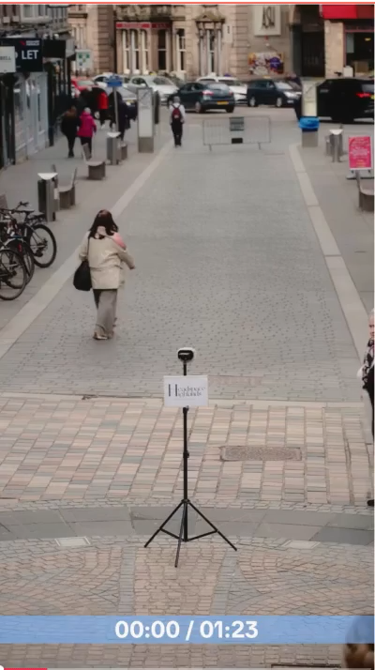

Slide 7
Planning your Vox Pop
Topics can be light, serious, surprising
Pick a question that genuinely interests you
Ask open-ended questions.
Keep your questions simple
Let them talk. Stay quiet while they answer.

Slide 8
Question examples
What’s your go-to comfort habit?
What’s something you are grateful for?
If you could give your 11-year-old-self one piece of advice, what would it be?
What’s something that you’ve changed your mind about?

Slide 9
Question examples
What’s something you have changed your mind about when it comes to disability?
What’s something people get wrong about disability?
What comes to mind when you hear the word ‘inspiring’?
What’s the most creative work-around you have used

Slide 10


Use Open Ended Questions
Do you feel confident?
What makes you feel confident?

Slide 11
Vox Pop Brainstorm and Practice
Who
How
When
Why
Tell me about

Slide 12
Mobile phone filming tips
One meter away
Pay attention to sound
Face lighter than background
Frame - Rule of Thirds**
Get consent recorded on camera

Slide 13
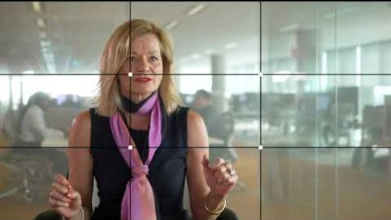
Rule of thirds

Slide 14
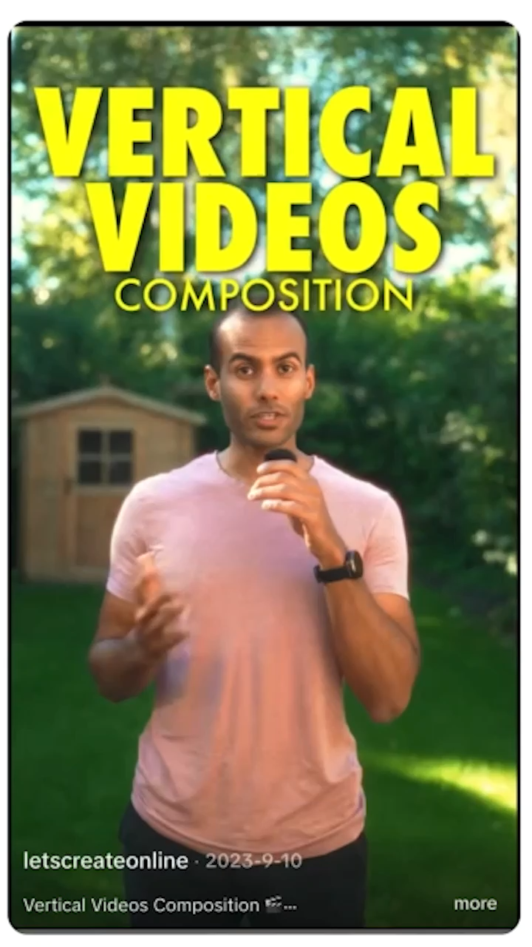
Rule of thirds - vertical

Slide 15
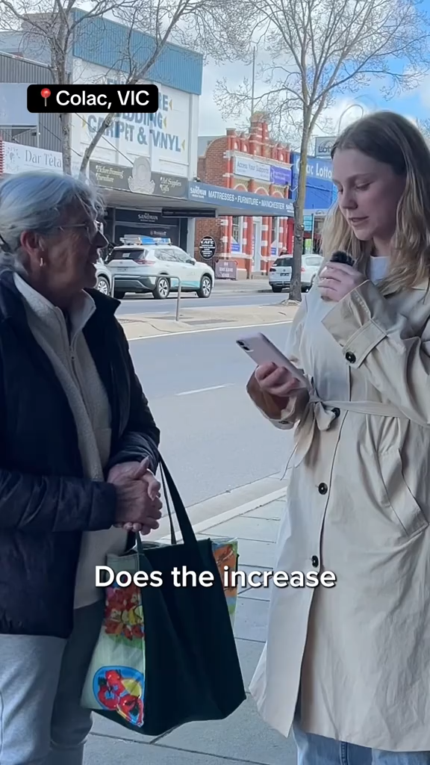
Do you want to be in the video? Your choice!

Slide 16
Directing and people skills
Introduce yourself and ask permission
Be respectful and calm, not pushy
If they’re nervous, warm them up with an easy question
Keep them still in frame while you talk

Slide 17
Vox Pop intro and outros
Set the tone
Frame the story
Leave a lasting impression

Slide 18
Why the intro matters
If you are in the story – intro example:
“Since the pandemic, more people work from home. I wanted to know what people think about this change.”
If you are using text on screen – example:
What is your view on allowing people to work from home?

Slide 19
The outro: Making it feel complete
If you are in the video – example:
“The pandemic may have changed where we work, but for most people, it appears to be a change they don’t want to reverse.” If you are using text on screen – example:
Flexibility isn’t just a perk- It creates access.

Slide 20
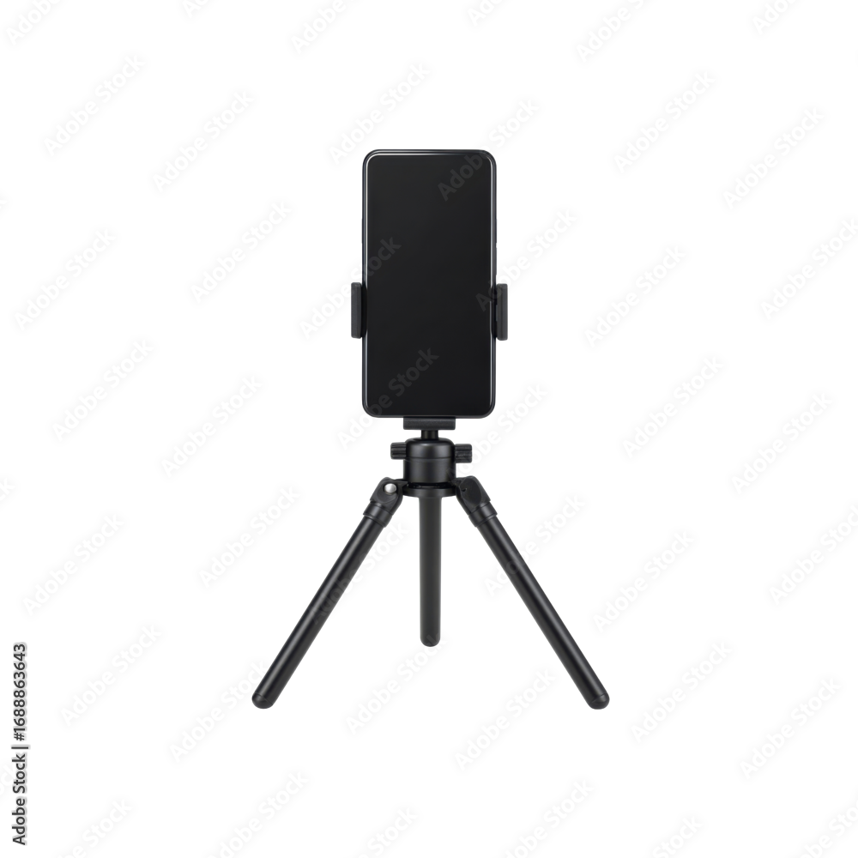
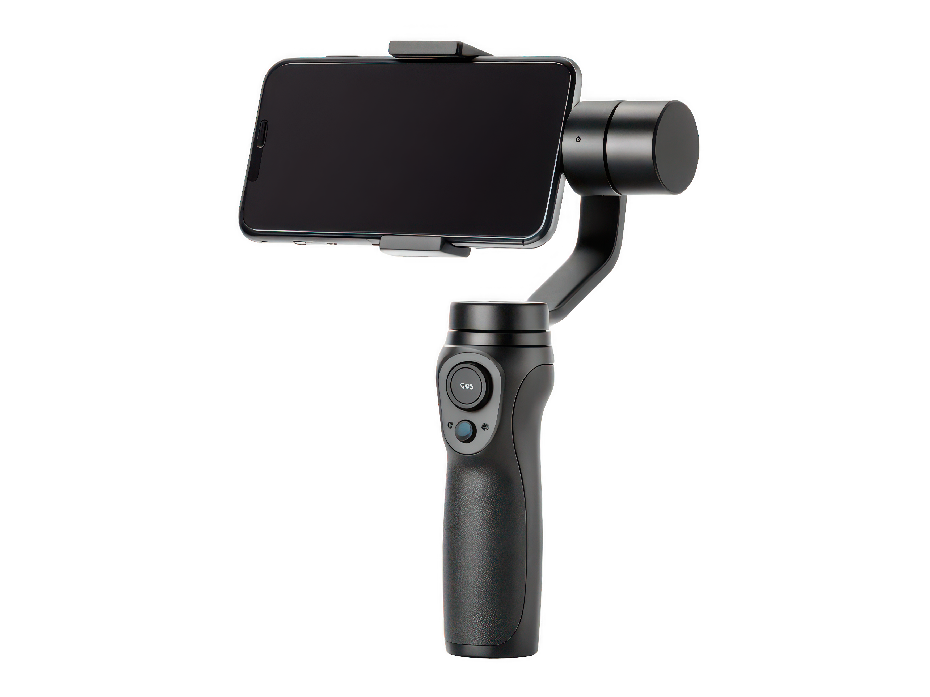
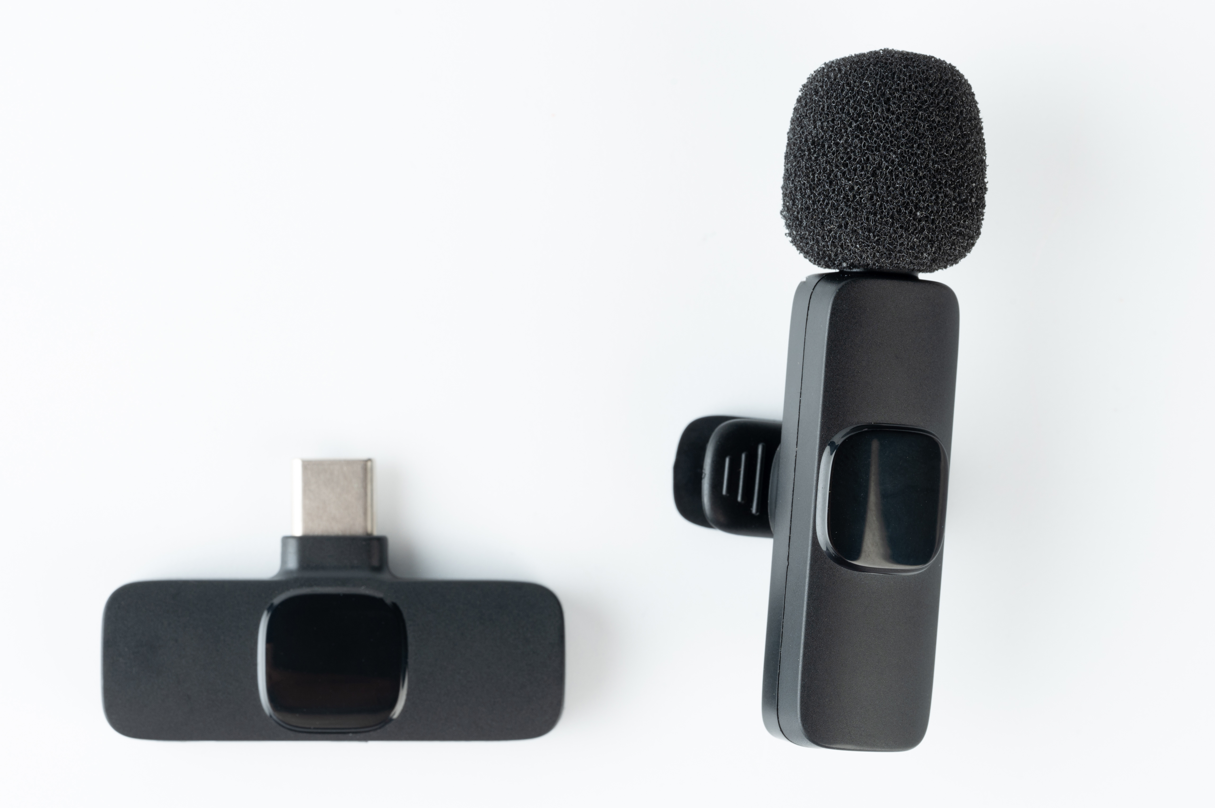
Equipment extras
Notes:
Microphones, Gimbals, Tripods

Slide 21
Time to create!
Notes:
Aim for 3 to 5 responses!

