Slide 1

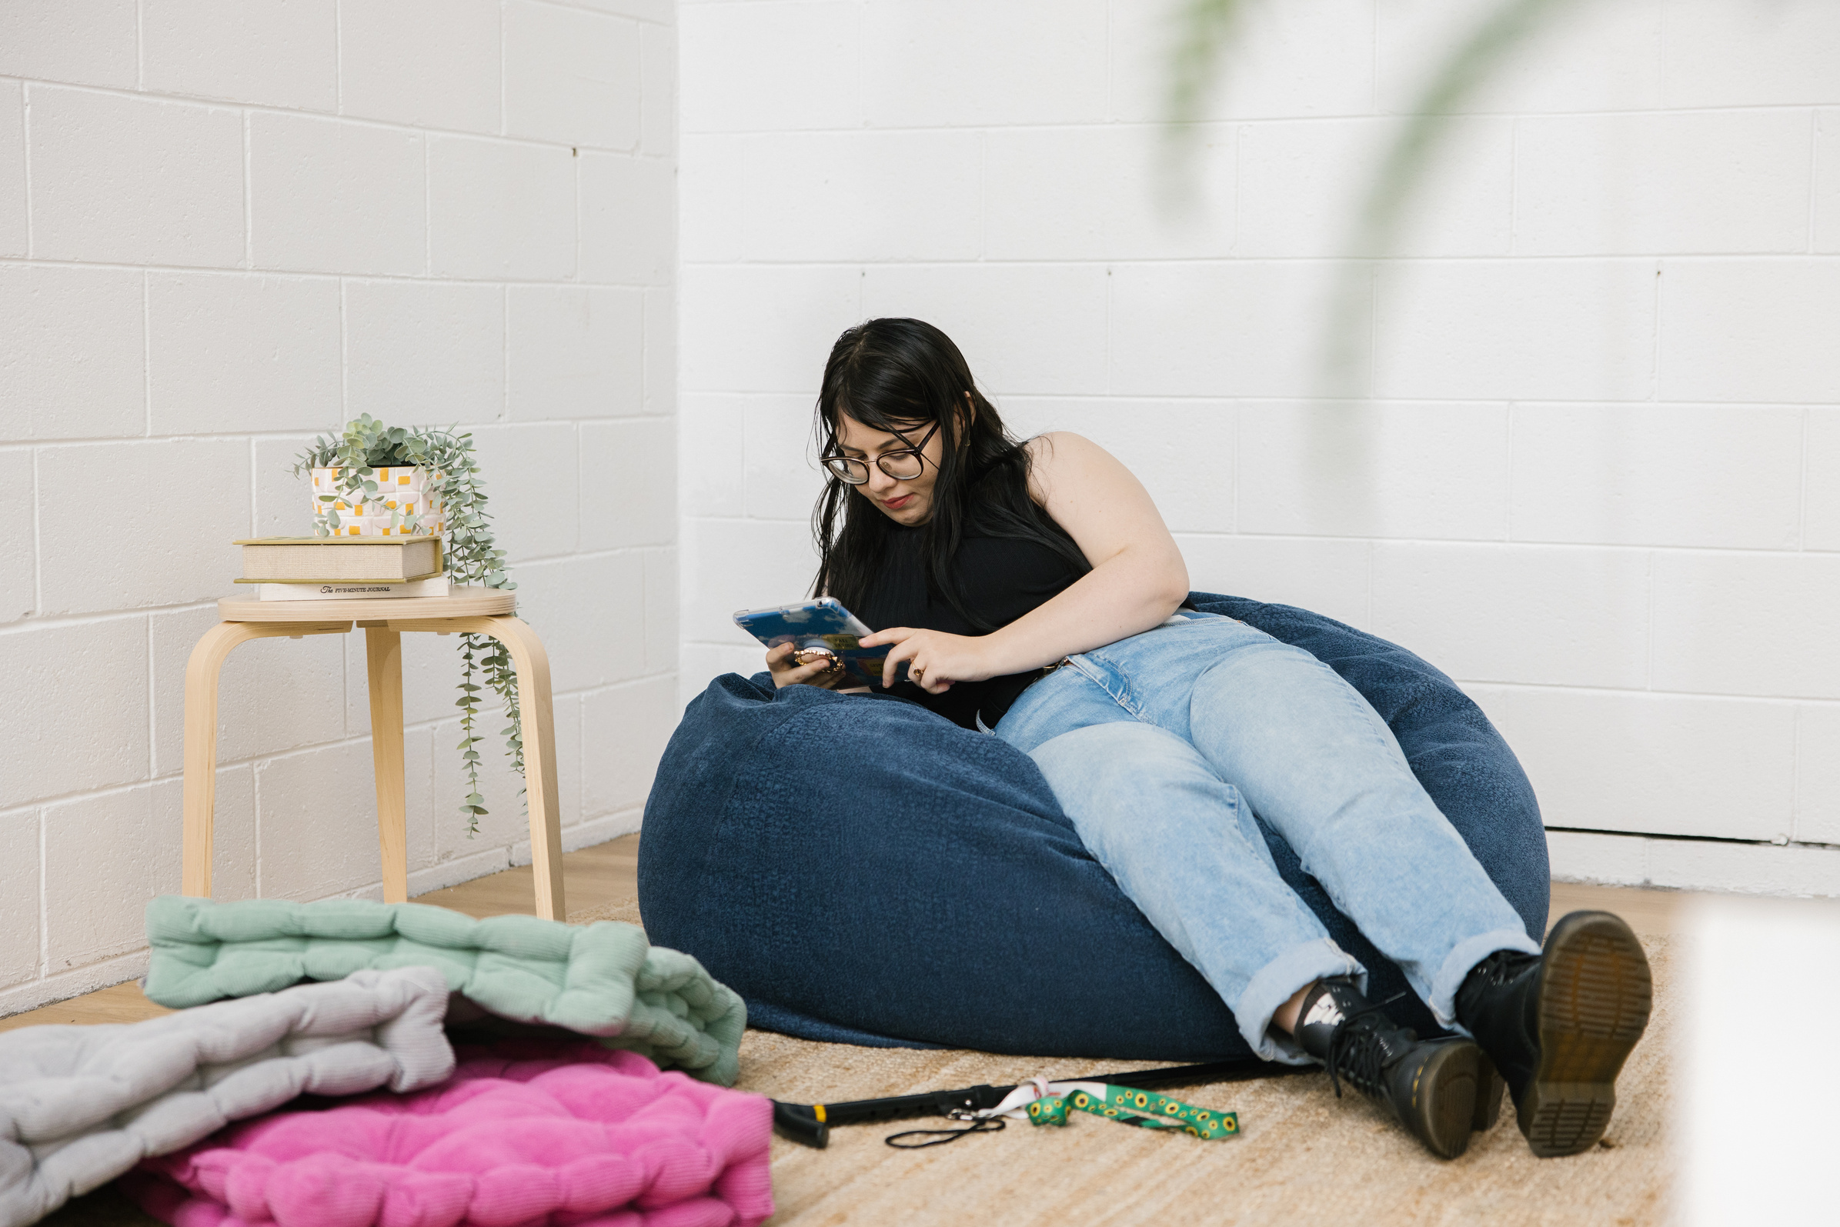
Social Media for
Advocacy and Storytelling ​
Workshop series 1
Workshop 2: Advocates, storytelling
and content creation

Slide 2


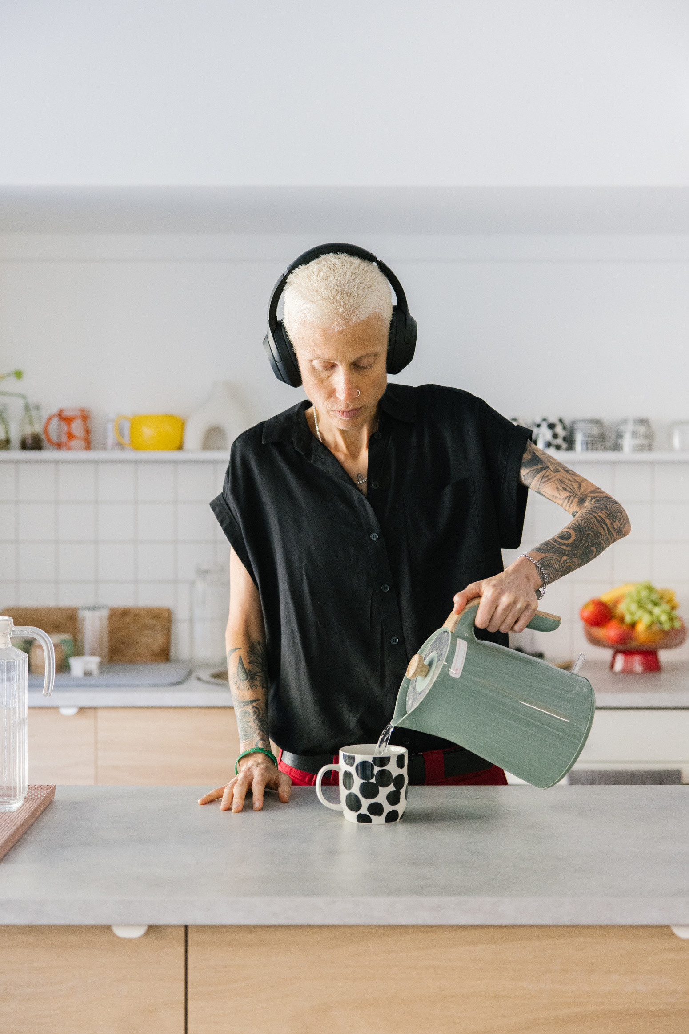
Welcome
PRESS RECORD
  Acknowledgement of Country
  Recognition of the disability community.
  Housekeeping: mute/unmute, chat, Zoom tools
  Today’s session will be recorded
  Introduction to today’s hosts:
    Nick Roach
    Mel Merlino

Slide 3
Welcome
  Recap on workshop 1
    What is social media and common platforms
    Accessibility, safety and security
    Understanding the algorithm
  What we’ll explore in this session
    Advocates
    Storytelling tips
    Finding your style
Have you ever followed or shared a disability advocate’s content?

Slide 4

Inspiration: Disability
Advocates Using Social Media
What are influencers?
  Influencers are people who build a following on social media by sharing content that others trust or enjoy.
  They can shape opinions or trends by sharing their views, experiences, or recommendations.
  Many use their platform to promote ideas, causes, or products, including advocacy and social change.

Slide 5
Inspiration: Disability
Advocates Using Social Media
Why look at examples?
  To see how different advocates use their voices online.
  To understand the power of lived experience in shaping change.
  To explore different advocacy styles, from humour to storytelling to systemic activism.
Today’s advocates
ChronicallyJenni
Authentic storytelling
and everyday advocacy
Khadija Gbla
Bold, intersectional
human rights activism
Matthew and Paul
Representation through
relationships and humour
Who do you follow online and why do you like their content?

Slide 6
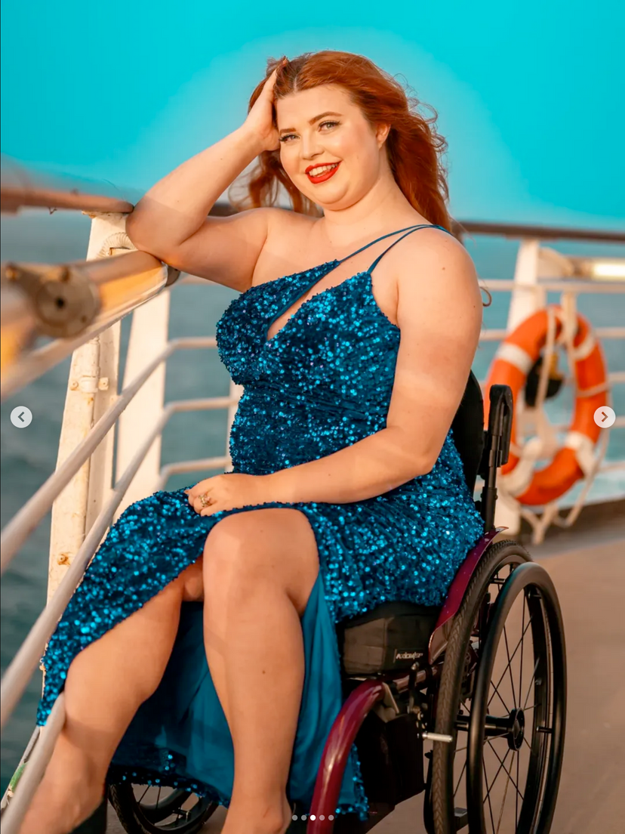
Inspiration: Chronicallyjenni
@chronicallyjenni
Who are they?
  Disabled, chronically ill and neurodivergent content creator.
  Shares lived experience of chronic illness and disability through reels, Instagram, and TikTok.
  Also a model, challenging stereotypes about disability in fashion and media.

Slide 7
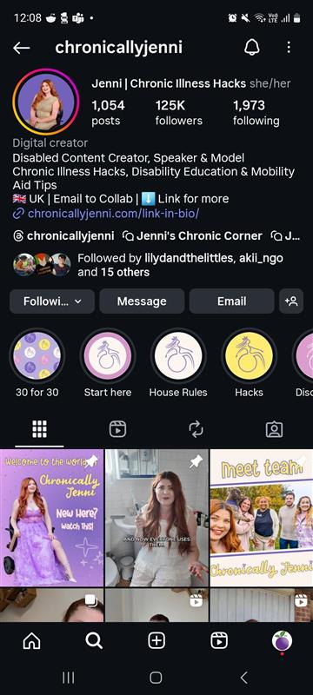
Inspiration: Chronicallyjenni
@chronicallyjenni
(Instagram)
Advocacy style
  Honest storytelling about daily life with chronic illness.
  Mix of advocacy with lifestyle content.
  Practical tips and reviews of mobility aids and accessible products.
  Uses visibility in modelling and collaborations to shift representation.

Slide 8
Inspiration: Chronicallyjenni
Strengths
  Authentic, vulnerable and relatable.
  Provides practical advice and resources.
  Normalises disabled presence in lifestyle and fashion spaces.
  Builds trust and strong audience engagement.
Areas to think about
  Could a blend of lifestyle and advocacy dilute the overall message?
  Does a reliance on brand partnerships risk tokenism?
  Would a focus on daily life underplay systemic advocacy?

Slide 9
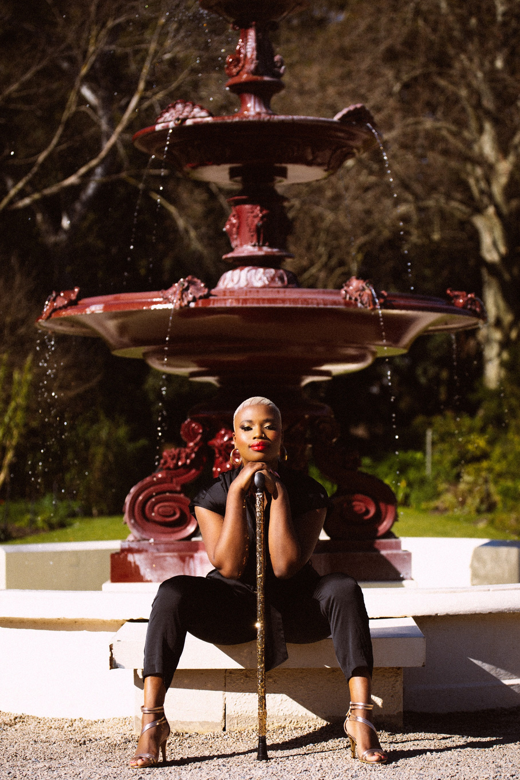
Inspiration: Khadija Gbla
@King_Khadija_Gbla
Who are they?
  Born in Sierra Leone.
  South Australia–based human rights activist, cultural consultant and disability advocate.
  Refugee, Black, neurodivergent, queer, and disabled person with chronic illness.
  Known for work against female genital mutilation and for strong disability pride advocacy.

Slide 10
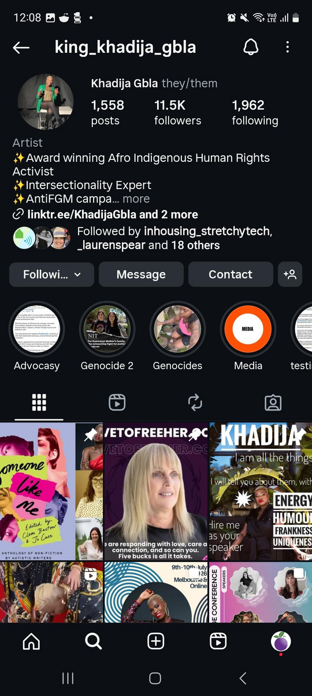
Inspiration: Khadija Gbla
@King_Khadija_Gbla
(Instagram)
Advocacy style
  Intersectional storytelling: race, gender, migration, disability, neurodiversity.
  Embraces “coming out of the disability closet” and claiming disability identity with pride.
  Uses strong visual and symbolic activism (e.g. reclaiming assistive devices).
  Blends personal narrative with structural advocacy and systemic calls to action.

Slide 11
Inspiration: Khadija Gbla
Strengths
  Bold intersectional voice across disability, race, gender and culture.
  Uses personal story powerfully to humanise advocacy.
  Combines vulnerability with systemic critique.
  Strong visual presence and symbolic activism.
Areas to think about
  Can a wide advocacy focus risk message dilution?
  Are complex systemic issues harder to translate into short social posts?
  Could challenging cultural stigma around disability attract backlash?

Slide 12

Inspiration: Matthew and Paul
@matthewandpaul
Who are they?
  Couple on TikTok known for disability advocacy through relationship storytelling.
  Paul is legally blind; Matthew is his partner.
  Share insights into interabled love, daily life and disability barriers.

Slide 13
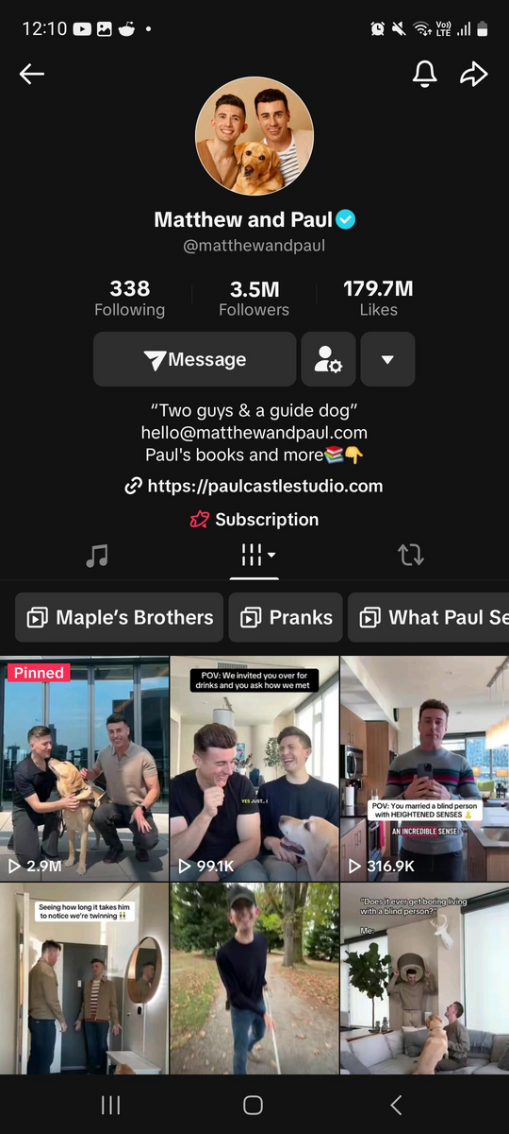
Inspiration: Matthew and Paul
@matthewandpaul
(TikTok)
Advocacy style
  Use humour and “edutainment” to make disability relatable.
  Showcase lived experiences of blindness and access barriers.
  Their relationship is itself an advocacy tool, challenging stereotypes.
  Balance fun, light-hearted content with serious education (e.g. service dog rights).

Slide 14
Inspiration: Matthew and Paul
Strengths
  Relatable and approachable style.
  Show disability and relationships in a positive, human light.
  Mix humour with education, lowering barriers for new audiences.
  Strong visibility on a youth-oriented platform (TikTok).
Areas to think about
  Can humour overshadow deeper advocacy messages?
  Are they constantly countering misconceptions about “invisible” blindness?
  Would the algorithm put more pressure on them to entertain and reduce space for serious issues?

Slide 15


Inspiration: Disability
Advocates Using Social Media
Question
From the examples of social media advocates we mentioned today, which style of advocacy do you prefer and why?

Slide 16
Telling Your Story Your Way
Pick one message
What’s the key point you want people to
understand or feel?
Be yourself
You don’t have to be polished or professional. Your
story matters as it is.
Short and relatable
Shorter content holds attention for a longer amount of time, and algorithms will boost content that gets played more than once

Slide 17
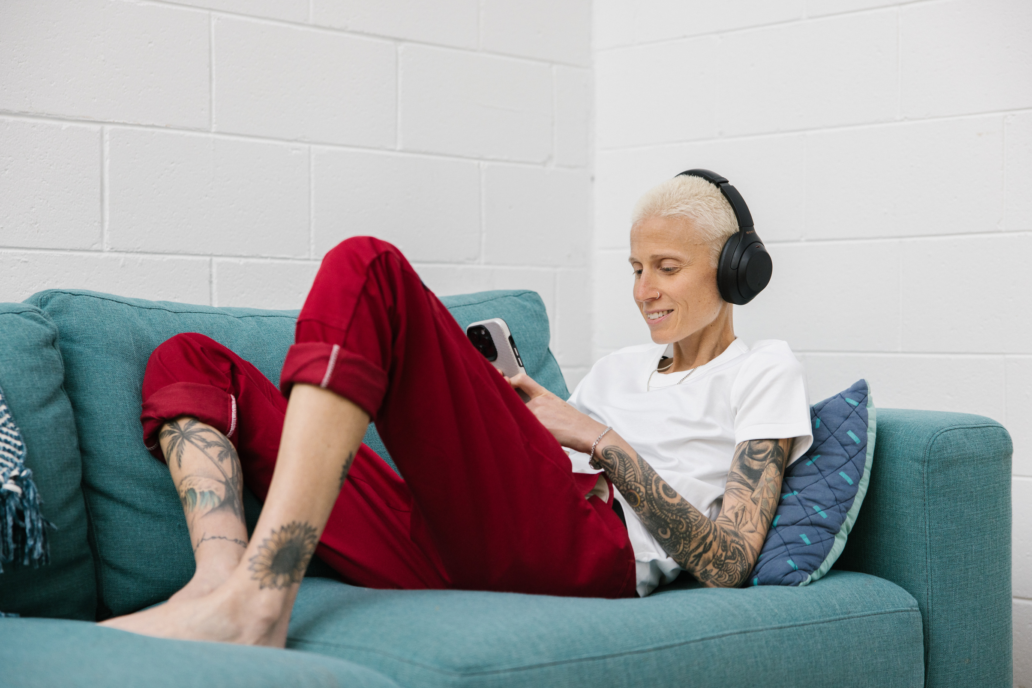
Telling Your Story Your Way
Show the real, not the perfect
People connect more with honesty than with highly edited videos.
Be clear about your purpose
Do you want people to understand something new, feel inspired, or take action?
Tip: Think about your audience. Who do you
want to reach (e.g. friends, community,
decision-makers, or the general public)?

Slide 18
Telling Your Story Your Way
Choose your format
You can post in
many ways:
- Short posts with photos or text
- A series of posts across a week or month
- Fun skits or re-enactments to make a point
Try a theme
Create content
around ideas like:
- “A day in my life”
- “Things I wish people knew”
- “One myth I want to bust”

Slide 19
Telling your story your way: Wrap up
Have
a clear goal
One
message
Short and relatable
Be
yourself
Show
the real

Slide 20


Telling Your Story Your Way
Question
What’s one key takeaway that
you‘ll use to tell your story your way?

Slide 21


Accessibility and safety
Add captions
or text
Many people watch without sound, and captions make content accessible.
Use plain,
simple language
Keep your message clear and easy to understand.

Slide 22
Accessibility and safety
Colours
and contrast
Avoid pale text on
a light background.
Check your privacy settings
Decide who can see, share, or comment on your posts.

Slide 23
Accessibility and safety
Ask for consent
Ask for permission before sharing photos or videos of other people.
Take breaks
when needed
You don’t need to post all the time to make
an impact.

Slide 24


Break time!
It’s time for a 5 minutes break.

Slide 25

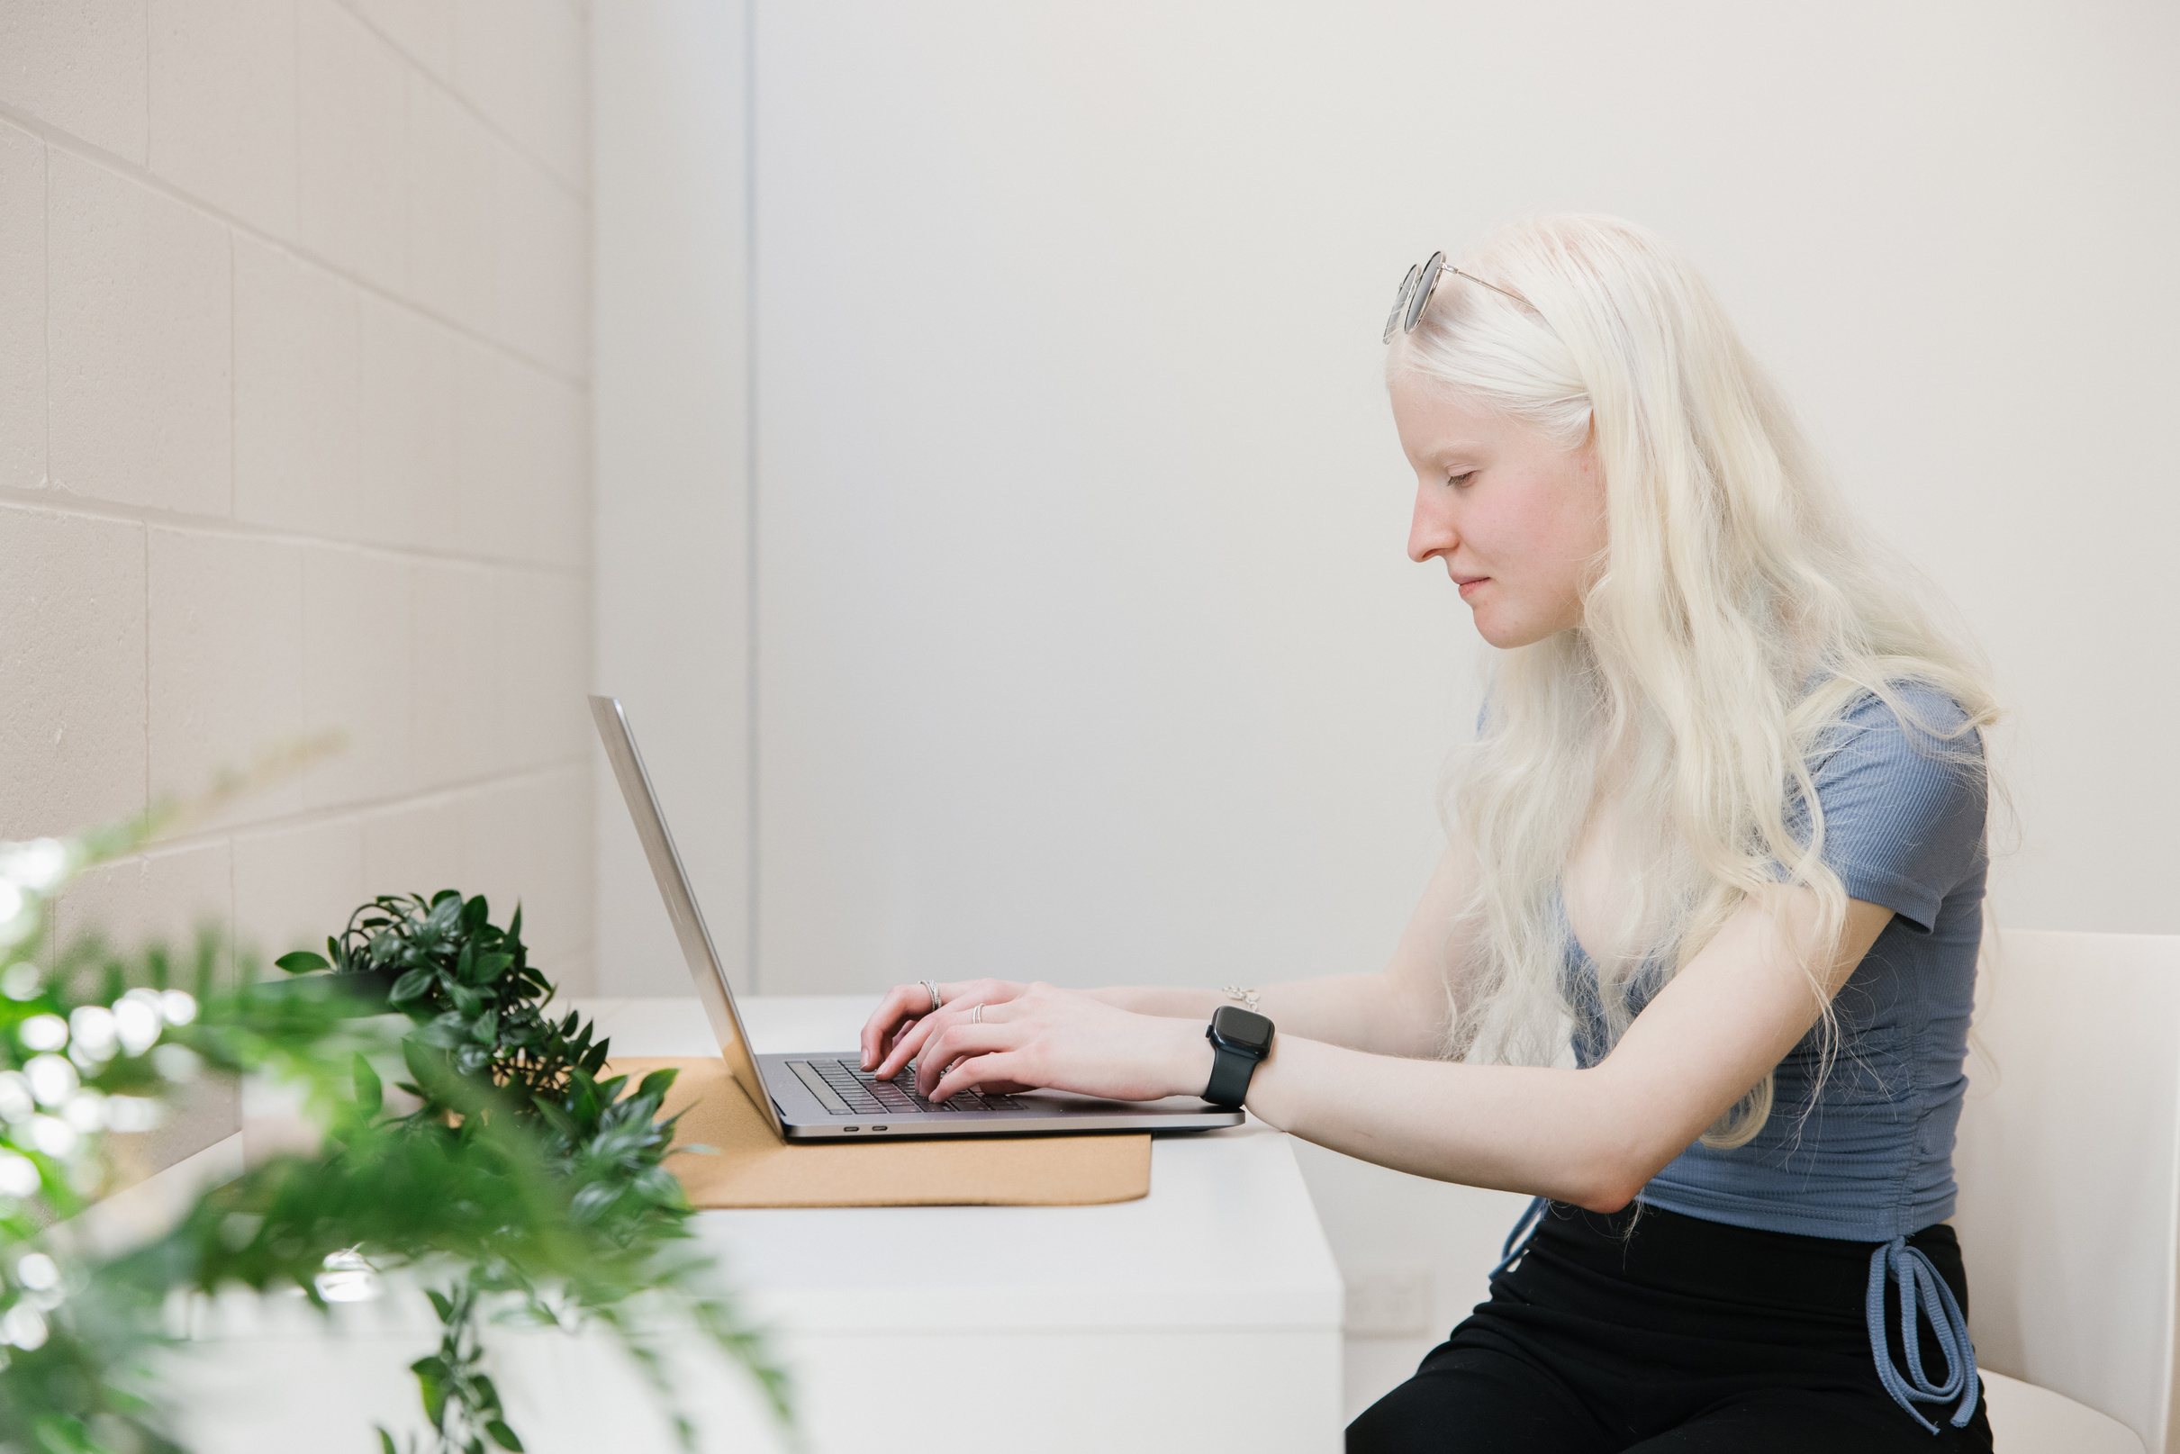
Tips for writing an
engaging personal post
Catch attention
Start your post with a short sentence or question (a hook) relevant to the post.
Invite conversation
Adding a question at the end can get people to engage and comment on your post

Slide 26
Tips for writing an
engaging personal post
Reply to comments
Replying keeps people engaged and will help spread your message further
Short and sharp
Focus on clarity, tone,
and purpose.
Be clear in your message.

Slide 27
Tips for writing an
engaging personal post
Hashtags
Use relevant hashtags to get more reach. Use camel case so people can understand your hashtags (e.g. #AccessibilityMatters vs #accessibilitymatters)
Plain English
Using plain English and clear structure makes your post accessible to as many people as possible

Slide 28
Practicing advocacy
“Advocacy is not just a task for charismatic
individuals or high-profile community organizers. Advocacy is for all of us; advocacy is a
way of life. It is a natural response to the
injustices and inequality in the world.”
Alice Wong, Disability Visibility:
First-Person Stories from the Twenty-first Century

Slide 29
Practicing advocacy
Exercise: Write a short post about
something that matters to you.
  Reflect on a message you would like to share.
  Keep it clear and simple.
  Use your own voice, don’t worry about grammar or being perfect.
Optional: Share with the group for feedback, or keep it private if you prefer.

Slide 30
Practicing advocacy
Exercise: Write a short post about
something that matters to you.
Example prompts to get started:
  “One thing I wish people knew about disability is…”
  “A barrier I face every day that others might not notice is…”
  “Something that helps me feel included is…”

Slide 31

Basic Tips for Creating Content
Think about your audience.
Who are you speaking to?
You can mix content types or find a content type that suits you, there’s no one-size-fits-all.
Try videos, text and photos and find a style that suits you and your message.
Tip: If you’re not ready to post yet, just
practice, share privately or with a friend first.

Slide 32

Basic Tips for Creating Content
Clear visuals
Avoid cluttered graphics, flashing lights or fast edits that might be overwhelming or unsafe.
Pace yourself
Consistency matters more than frequency.
Don’t feel pressure to post every day.

Slide 33

Basic Tips for Creating Content
Engagement tip
End with a simple question to start conversation and connection.
Respect boundaries
Only share what feels comfortable.
You don’t need to reveal everything about yourself to be a strong advocate.

Slide 34
Basic Tips for Creating Content
Engaging and interesting videos
  Keep videos short and direct (under 60 seconds)
  Use captions
  Keep visuals simple
  Background music is good for engagement, but keep it quiet
  You don’t need fancy equipment!
    Film in a well lit area
    Record audio somewhere quiet
Exercise: Think of a short advocacy idea for social media and what content type you would use.

Slide 35


Basic Tips for Creating Content
Question
What kind of audience are you hoping to reach and what ways do you think you can reach them?

Slide 36
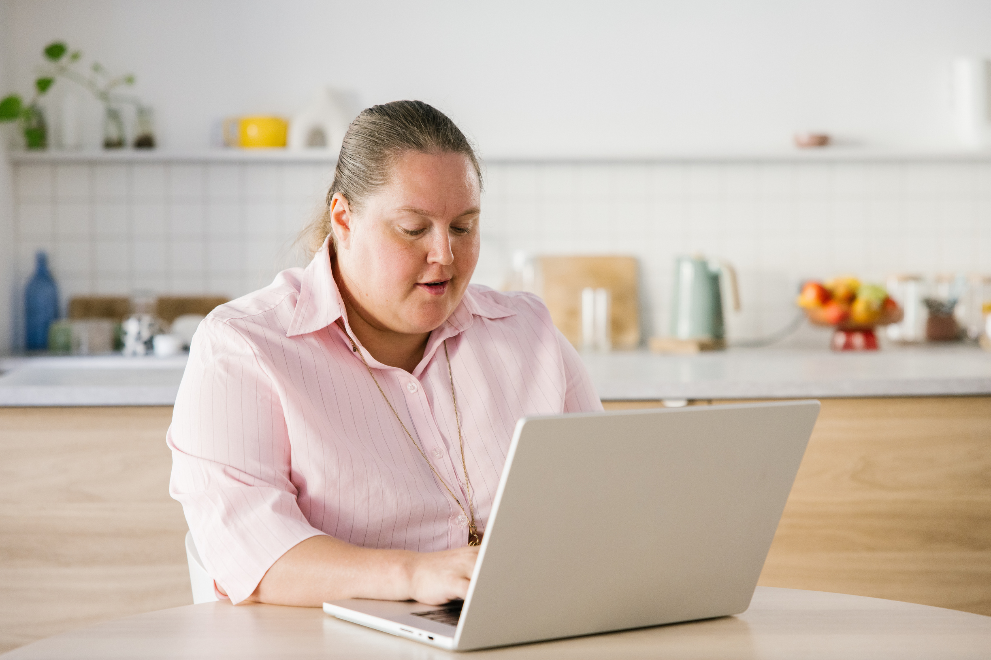
Boundaries and bravery
There is no “right” way to advocate
Your style, whether it’s serious, silly or both,
is your own.
You decide what’s shared and when
It’s okay to say “no”.
Community matters
Leaning on peers, friends or networks can make advocacy safer and less lonely.

Slide 37
Boundaries and bravery
You can take breaks
Taking breaks from posting doesn’t make you any less of an advocate.
Protect your mental health
Be mindful of rejection sensitivity and burnout.
Celebrate small wins
Every post is practice.

Slide 38
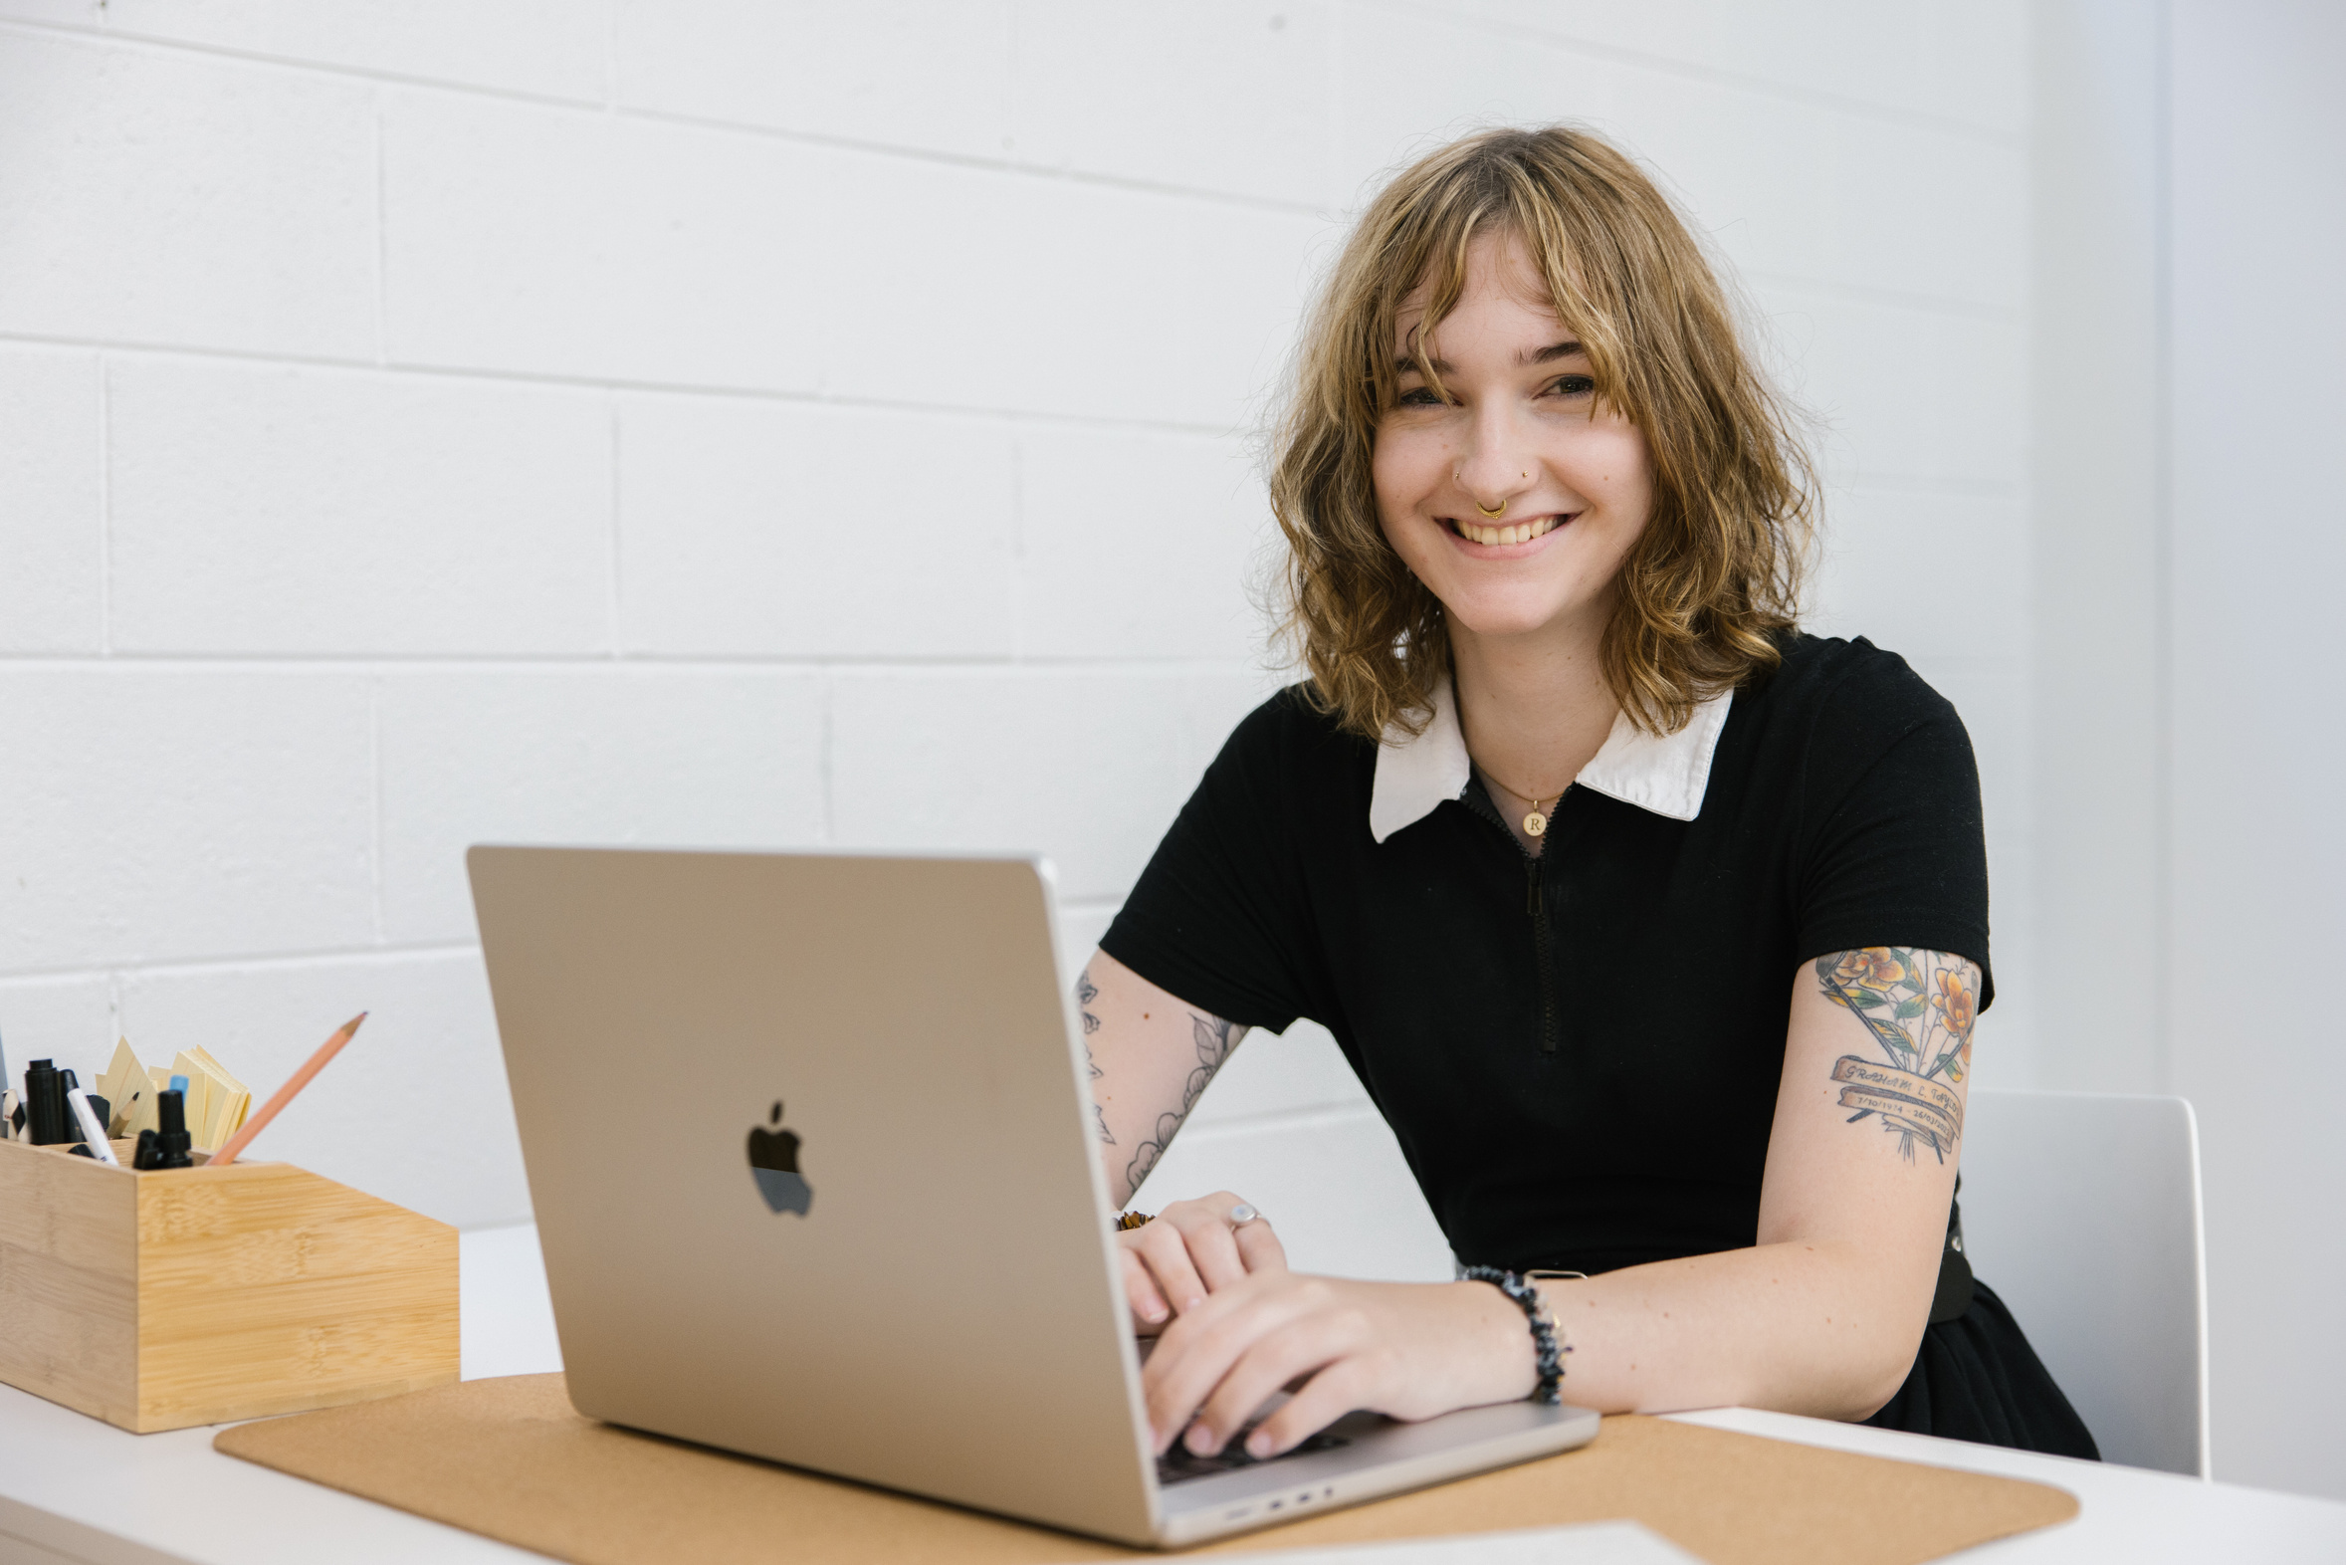
Workshop 2: Wrap up
Remember: Sharing your story is an offer, not an obligation. You don’t have to explain or justify your experience to anyone.
“Our stories are our power. Share
when you can, rest when you need,
and know that silence is also resistance.”
Alice Wong (founder of the Disability Visibility Project)

Slide 39
Workshop 2: Wrap up
We’d like to know
How confident do you feel about using social media now?
Optional: Share your favourite tip or takeaway from today’s workshop.

Slide 40
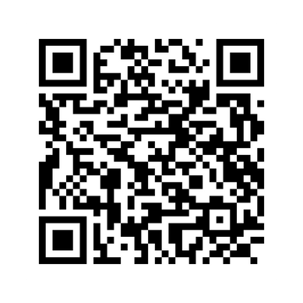
Thank you for coming!
What’s next in the workshop series:
    Creating vox pops
    Using LinkedIn
You’re invited to complete a short survey about today’s workshop.
Links to advocacy examples, and other resources will be shared via email.

