Slide 1
Getting started on LinkedIn
Workshop Series 3
Workshop 1: Understanding LinkedIn and how to create a professional profile

Slide 2

Welcome
PRESS RECORD
Today’s session will be recorded.
Acknowledgement of Country.
Recognition of disability community.
Housekeeping: mute/unmute, raise your hand to speak, use the chat, turning on captions.
Notes:
Acknowledgement of Country
JFA Purple Orange acknowledges the Traditional Owners of Country throughout Australia. We work on many Aboriginal lands, including Kaurna Country, where our head office is located. We extend our respect to all Aboriginal peoples on the lands where we work, live, and learn. We are committed to walking together and building relationships grounded in the self-determination of First Nations peoples.
Recognition of the disability community
We recognise that JFA Purple Orange exists to advance the rights of people with disability.
All our work aims to create a more inclusive world where people with disability have access to the same opportunities as everyone else

Slide 3

Introductions
Meet the team:
  Marissa Brown (presenting)
  Nick Roach and Mel Merlino (supporting / in chat)
  Lee (live captioner)
Introduce yourself in the chat

Slide 4


What we’ll cover
What is LinkedIn (and what it isn’t)?
Building your LinkedIn profile.
Staying safe and in control on LinkedIn.
Using LinkedIn.
Finding opportunities.
Next session (30 Jan): Get your
professional headshot taken
Notes:
Let’s have a look at what we will cover in today’s session
This workshop is an introduction to LinkedIn. It’s designed for people who are curious about the platform, want to build a professional presence online, or are looking for opportunities in work or learning.
We understand that LinkedIn might not be useful for everyone; this session is about helping people make an informed decision for themselves.
We’ll be covering quite a bit of ground, but don’t worry too much about remembering everything as we will share the recording afterwards so that you can go back over anything that you might have missed.
A reminder to book in for the headshot session on 30 January if you can make it to our Unley office – Nick / Mel will pop booking details in the chat now

Slide 5

Learning goals
By the end you will know:
What LinkedIn is useful for.
How to draft or improve your profile.
How to control key privacy and safety settings.
Simple next steps to connect and post.
Notes:
confidence is the goal, not perfection.
We’ll give you the opportunity to complete a short feedback survey at the end.

Slide 6
Question
Have you used LinkedIn before?
Notes:
If yes, what have been your experiences?
If no, why?

Slide 7
What is LinkedIn (and what it isn’t)?

Slide 8
What is LinkedIn?
A professional social network.
Share skills, interests and goals.
Connect with people and organisations.
Learn about opportunities.

Slide 9

What LinkedIn isn’t
Not your “whole life”.
Not daily posting.
Not only for paid work.

Slide 10




How LinkedIn is different
Facebook | Instagram | TikTok | X (Twitter) | LinkedIn
Groups Events Peer support | Photos Reels Stories | Short videos Trends | Fast news Political commentary | Work Individual and company profiles
Post and share photos, videos, links | Post and share photos and videos | Post short form videos and photo collections | Post and interact with short messages called ”tweets” | Share work content, connect with colleagues and find job opportunities
Notes:
Reference past social media workshops

Slide 11
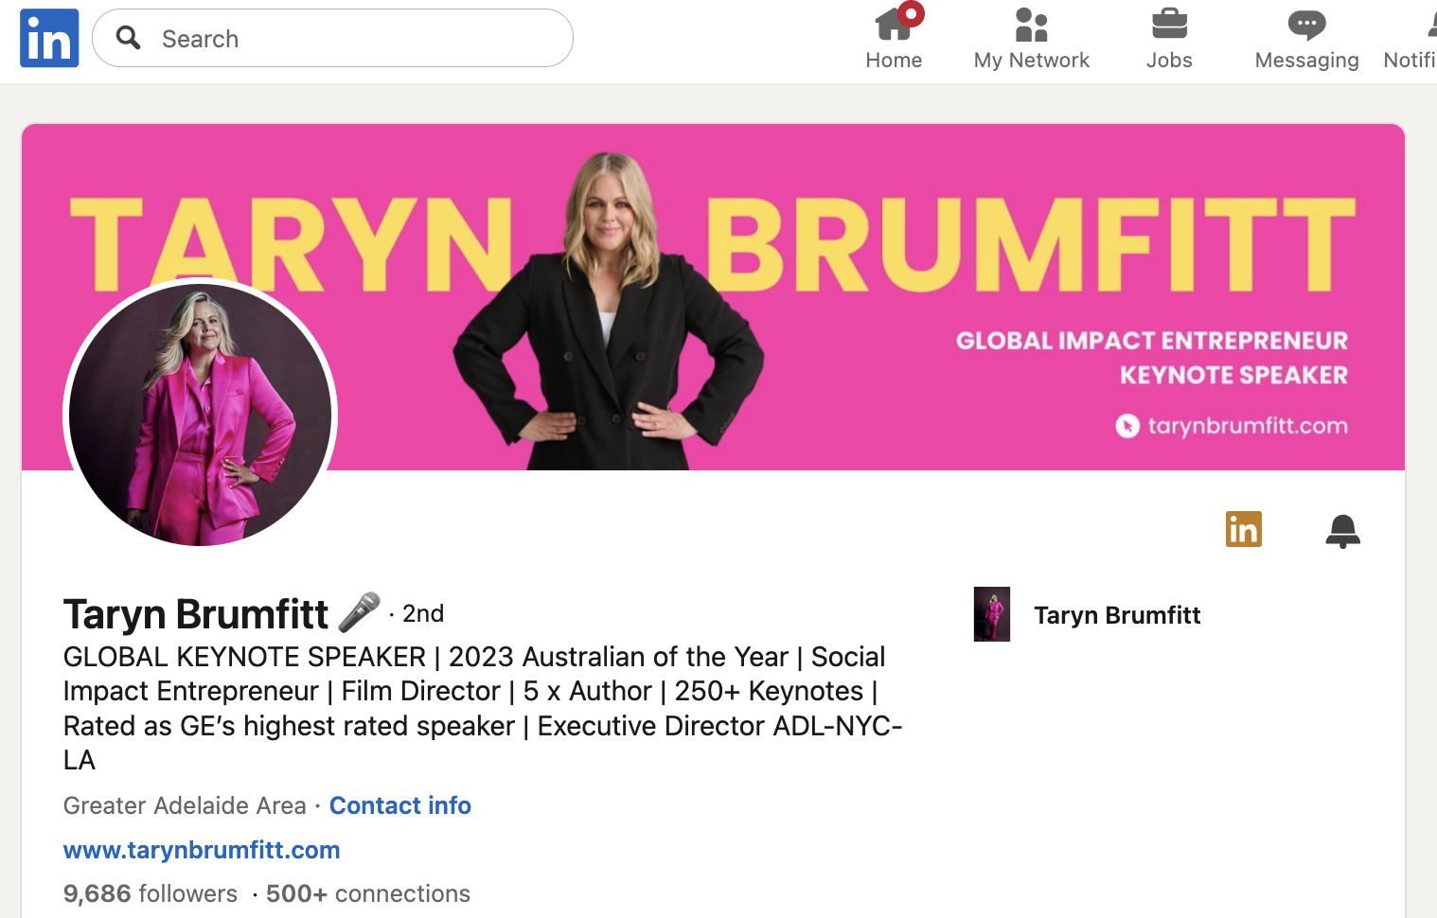
What a LinkedIn profile looks like
Notes:
Desktop and app versions

Slide 12
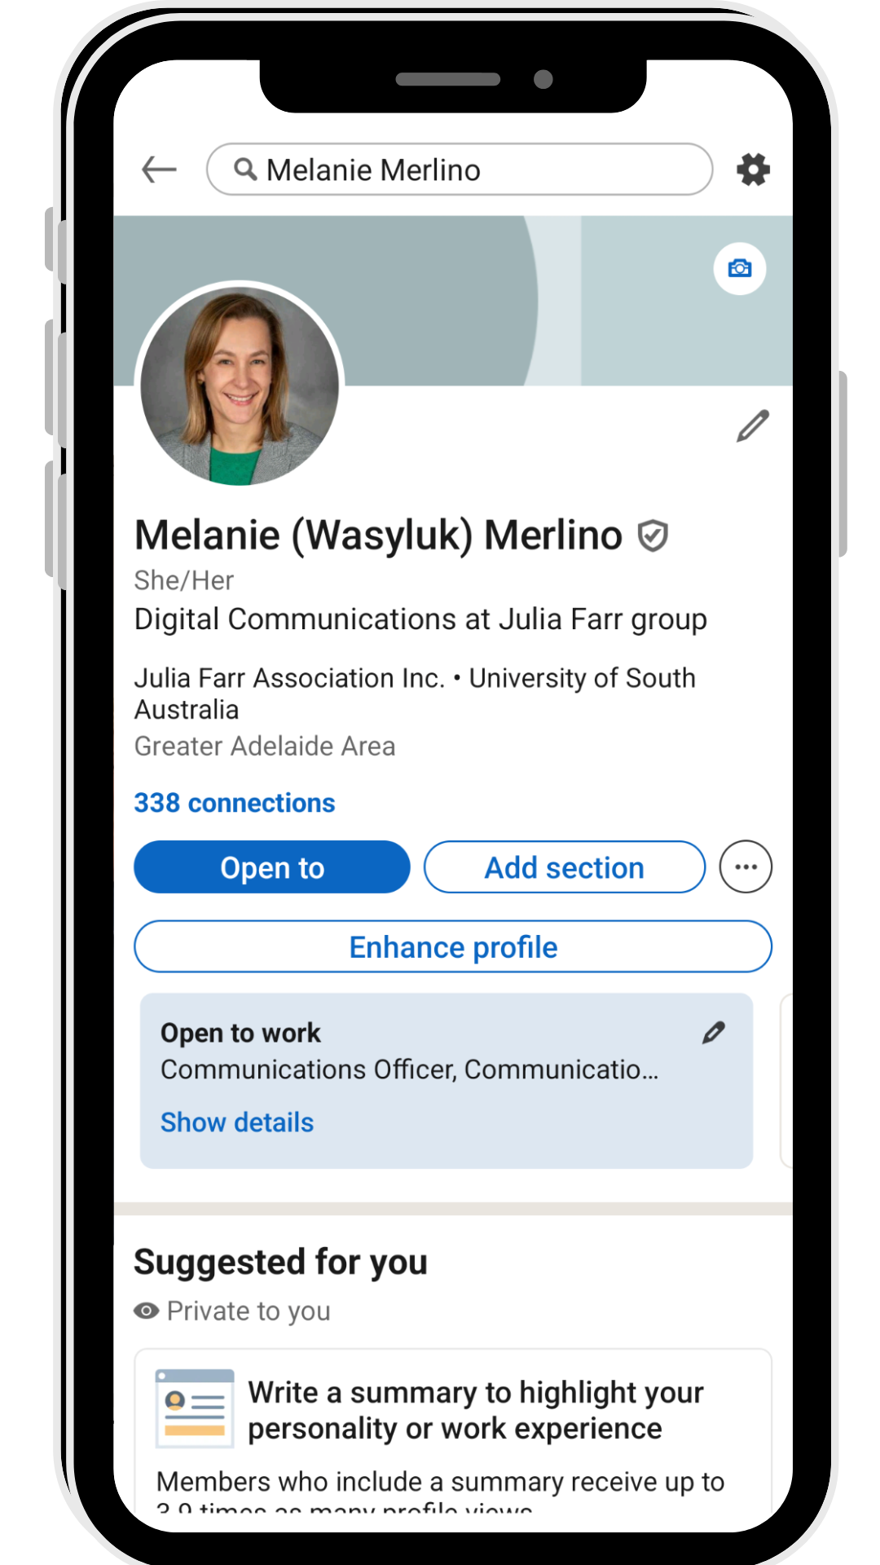


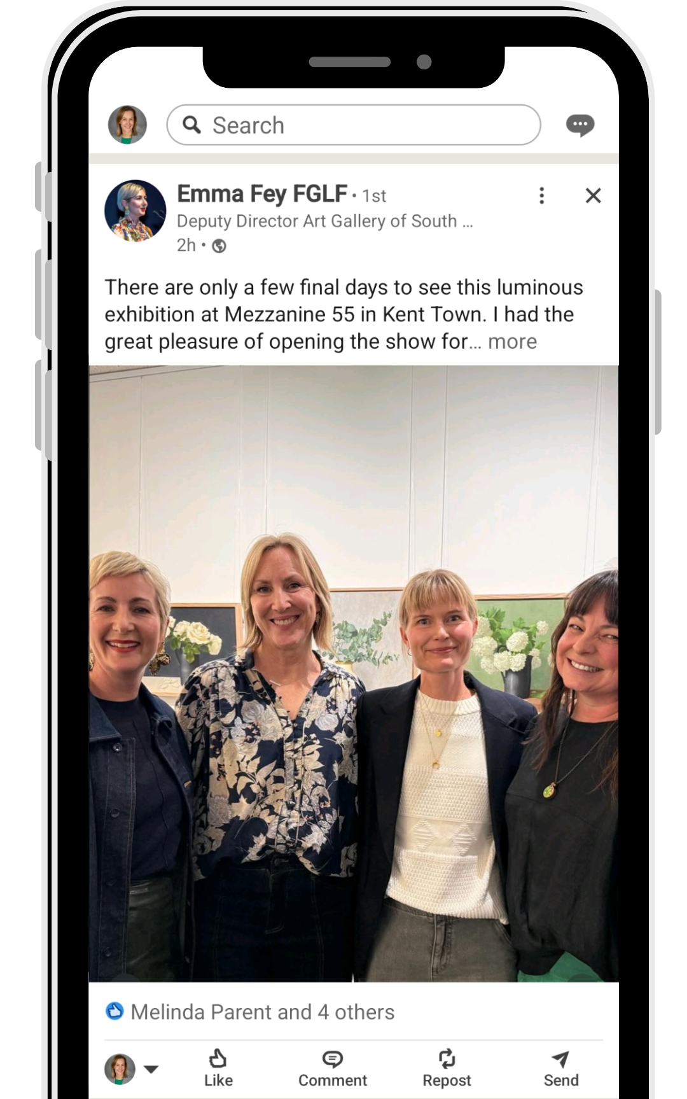


LinkedIn app

Slide 13

Types of LinkedIn accounts
Free accounts:
  Provide access to all the basic features.
Premium accounts:
  Seeing who viewed your profile.
  Sending messages to people you’re not connected to.
  More job-search features.
Notes:
Most people use the free version and it provides access to all the basic features
We’ll be focusing on what you can do with a free account in this workshop
Premium accounts are paid and offer extra tools like seeing who viewed your profile, sending messages to people you're not connected to (InMail), and more job-search filters
You can try Premium for free for one month, but it’s not necessary for most users

Slide 14

Who uses LinkedIn and why?
Employees to showcase expertise and experience.
People with disability sharing skills and leadership.
Students and early-career people building networks.
Volunteers and community advocates showing impact.
Employers sharing news and opportunities.

Slide 15

When LinkedIn might be useful
Share your interests and goals.
Find collaborators or mentors.
Explore volunteering or paid work.
Keep up with news in your field.
Share a project, event or resource.
A safer, more professional space than other platforms.
Notes:
Use LinkedIn when you want a professional space to talk about your interests and goals. It’s great for finding collaborators or mentors, and for exploring both volunteering and paid work without pressure. Following the right people keeps your feed full of relevant news. If you have a project, event or resource, LinkedIn helps it reach the right audience. Many people also choose LinkedIn because it gives more control over privacy and tone compared to other platforms.

Slide 16

When LinkedIn might not be useful
You don’t want a public profile right now.
You need private, peer-only discussion.
You’re overwhelmed by extra notifications.
Your goal is casual social chat, not professional topics.
Notes:
It’s fine to skip LinkedIn if you don’t want a public profile, need a private peer group, or you’re avoiding extra notifications right now. You can always create an account later or keep it minimal and private.

Slide 17
Building your LinkedIn profile

Slide 18
Creating an account
Go to linkedin.com and select ‘Create an account’.
Enter your email and create a strong password. Save it somewhere safe.
Add your name exactly how you want it to appear.
Verify your email by clicking the link they send you.
Notes:
Tip: Use your personal email

Slide 19
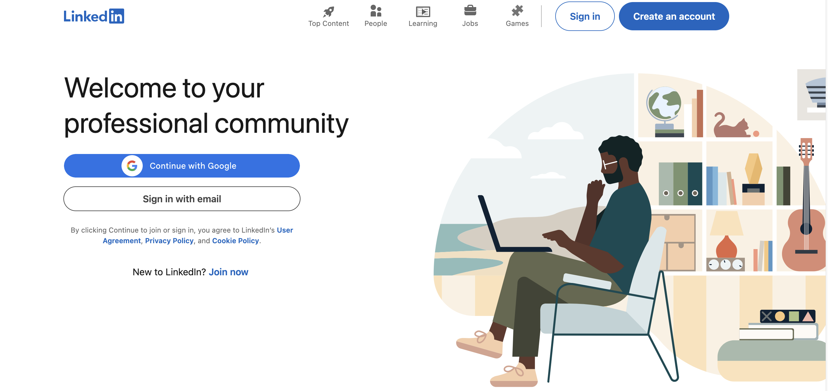
Creating an account (cont’d)

Slide 20
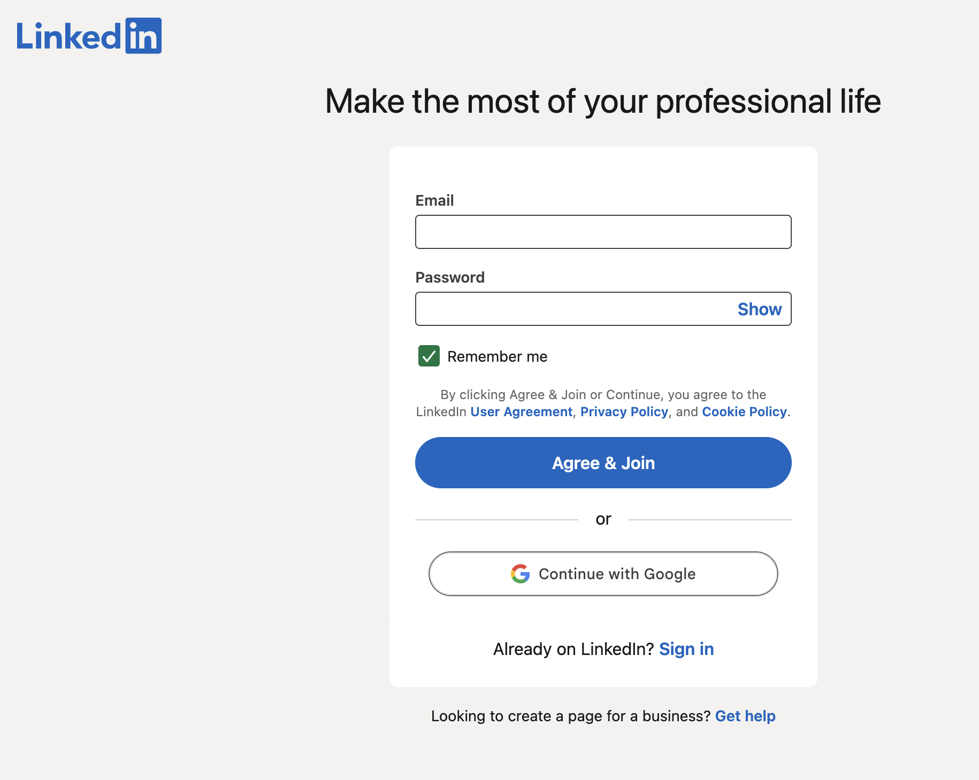
Creating an account: Step 2

Slide 21

What’s in a profile
Photo and headline.
About summary.
Experience, education, volunteering.
Skills and interests.

Slide 22
The profile photo
Profile photo

Slide 23

5 tips for a good profile photo
Face in clear light.
Simple background.
Frame and posture.
Clean image, not filters.
Wear solid colours, avoid distractions.
Privacy note:
If you’d rather not use a photo, that is valid. An initials avatar works.
Notes:
1) Face in clear light
Stand facing a window or soft light.
Avoid overhead lights and backlighting that turn you into a silhouette.
2) Simple background
Plain wall or uncluttered space.
Step 1–2 metres from the background so it blurs slightly.
3) Frame and posture
Shoulders to top of head in frame.
Look at the camera, relaxed jaw, small smile. No sunglasses, no busy hats.
4) Clean image, not filters
Use your phone’s rear camera, tap to focus on your eyes.
Don’t use heavy filters or “beauty” modes. They look fake and date fast.
5) What to wear
Solid colours, good contrast with the background.
Skip tiny patterns and logos that distract or shimmer on screen.
Accessibility and safety
If you’d rather not use a photo, that is valid. An initials avatar works.
If you upload an image elsewhere on LinkedIn, add short, accurate alt text.
reminder of the upcoming photo session

Slide 24
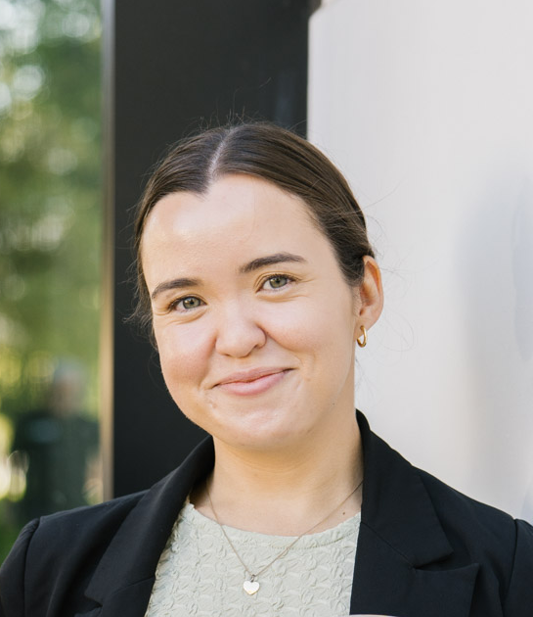
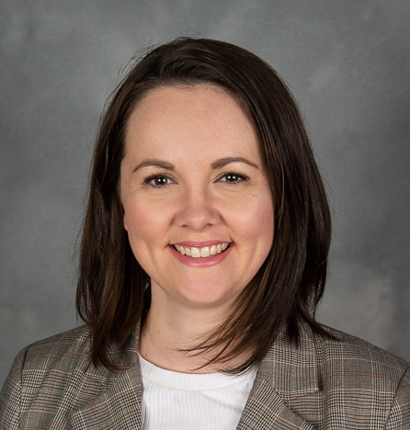
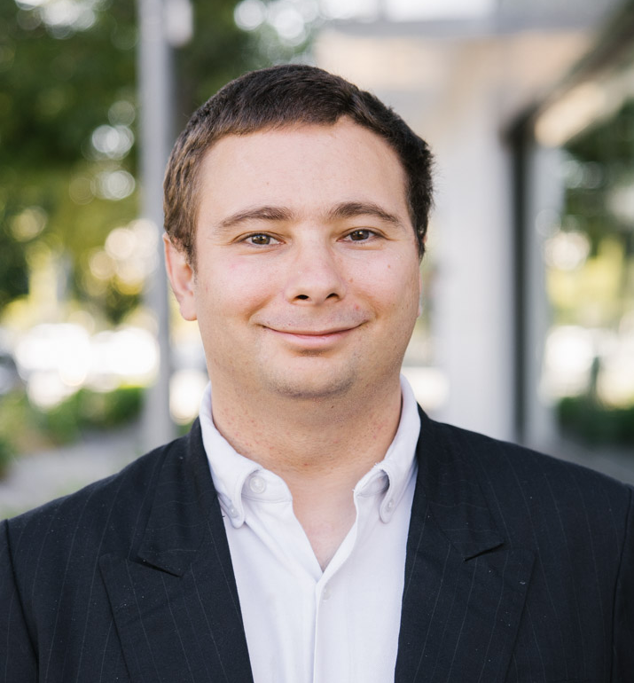
Example: Profile photos
Need a LinkedIn headshot?
Book your spot on Friday 30 January >>

Slide 25
The headline
Headline

Slide 26

The headline: Formats
Mission driven.
Value proposition.
Role + outcome.
Notes:
You can simply write your position title, but there are other formats you may wish to consider. Today we will look at three options.

Slide 27
The headline: Mission driven
Good for: | Advocates, volunteers, and community leaders.
Template: | Role or interest | key skills / causes | what you want
Example: | Disability advocate | community engagement, public speaking | building inclusive communities
Notes:
Now we will take a look at three headline templates you may wish to use: Mission Driven, Value Proposition, and Role + Outcome

Slide 28
The headline: Value proposition
Good for: | If you're new to LinkedIn or unsure what to write.
Template: | I help [audience] [achieve outcome] through [method].
Example: | I help councils improve access through community-led planning.

Slide 29
The headline: Role + outcome
Good for: | Showing impact, not tasks.
Template: | [Role] | [2-3 outcomes you deliver]
Example: | Content producer | clear messages | accessible stories

Slide 30
Activity: Practice writing a headline
Good for: | If you're new to LinkedIn or unsure what to write.
Template: | I help [audience] [achieve outcome] through [method].
Example: | I help councils improve access through community-led planning.
Activity
Practice writing a template using the
value proposition template.

Slide 31
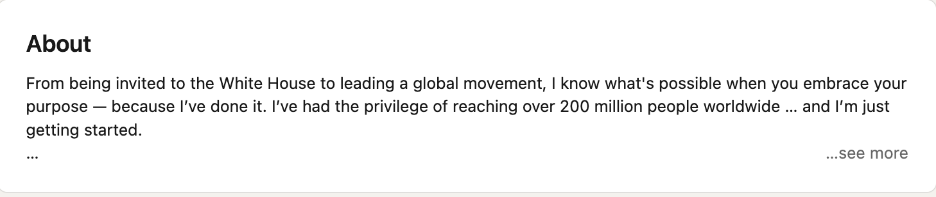
About / bio section

Slide 32

About: What to write
Lead with who you are and what you care about.
Show what you do (paid, volunteer, advocacy, etc).
Make your strengths obvious.
State what you’re looking for.
Keep it safe, clear, and human.
Notes:
1) lead with who you are and what you care about
1–2 lines: your focus, values, and the change you want to see.
Example: “I care about inclusive housing and practical solutions that give people more choice and control.”
2) show what you do (paid, volunteer, advocacy, caring)
1–2 lines: recent work, study, projects, or peer leadership.
Use plain English and outcomes.
Example: “I co-host a peer group and create easy-to-read resources used by local councils.”
3) make your strengths obvious
Add 3–5 strengths as a short list (not buzzwords).
Example: “Strengths: plain English writing, community engagement, accessible events, assistive tech basics.”
4) state what you’re looking for
1 line with a clear ask.
Example: “Open to short projects with councils and NGOs to improve accessibility.”
5) keep it safe, clear and human
Keep paragraphs short; use everyday words.
Leave out private details you don’t want public, jargon, and claims you can’t back up.
Optional: add contact preferences (e.g., “Best via LinkedIn messages”).

Slide 33
Activity: Practice writing a bio
“I care about [cause/values]. I’m working on [current roles/projects].
My strengths include [3–5 skills].
I’m looking for [type of opportunity/ collaboration].”

Slide 34
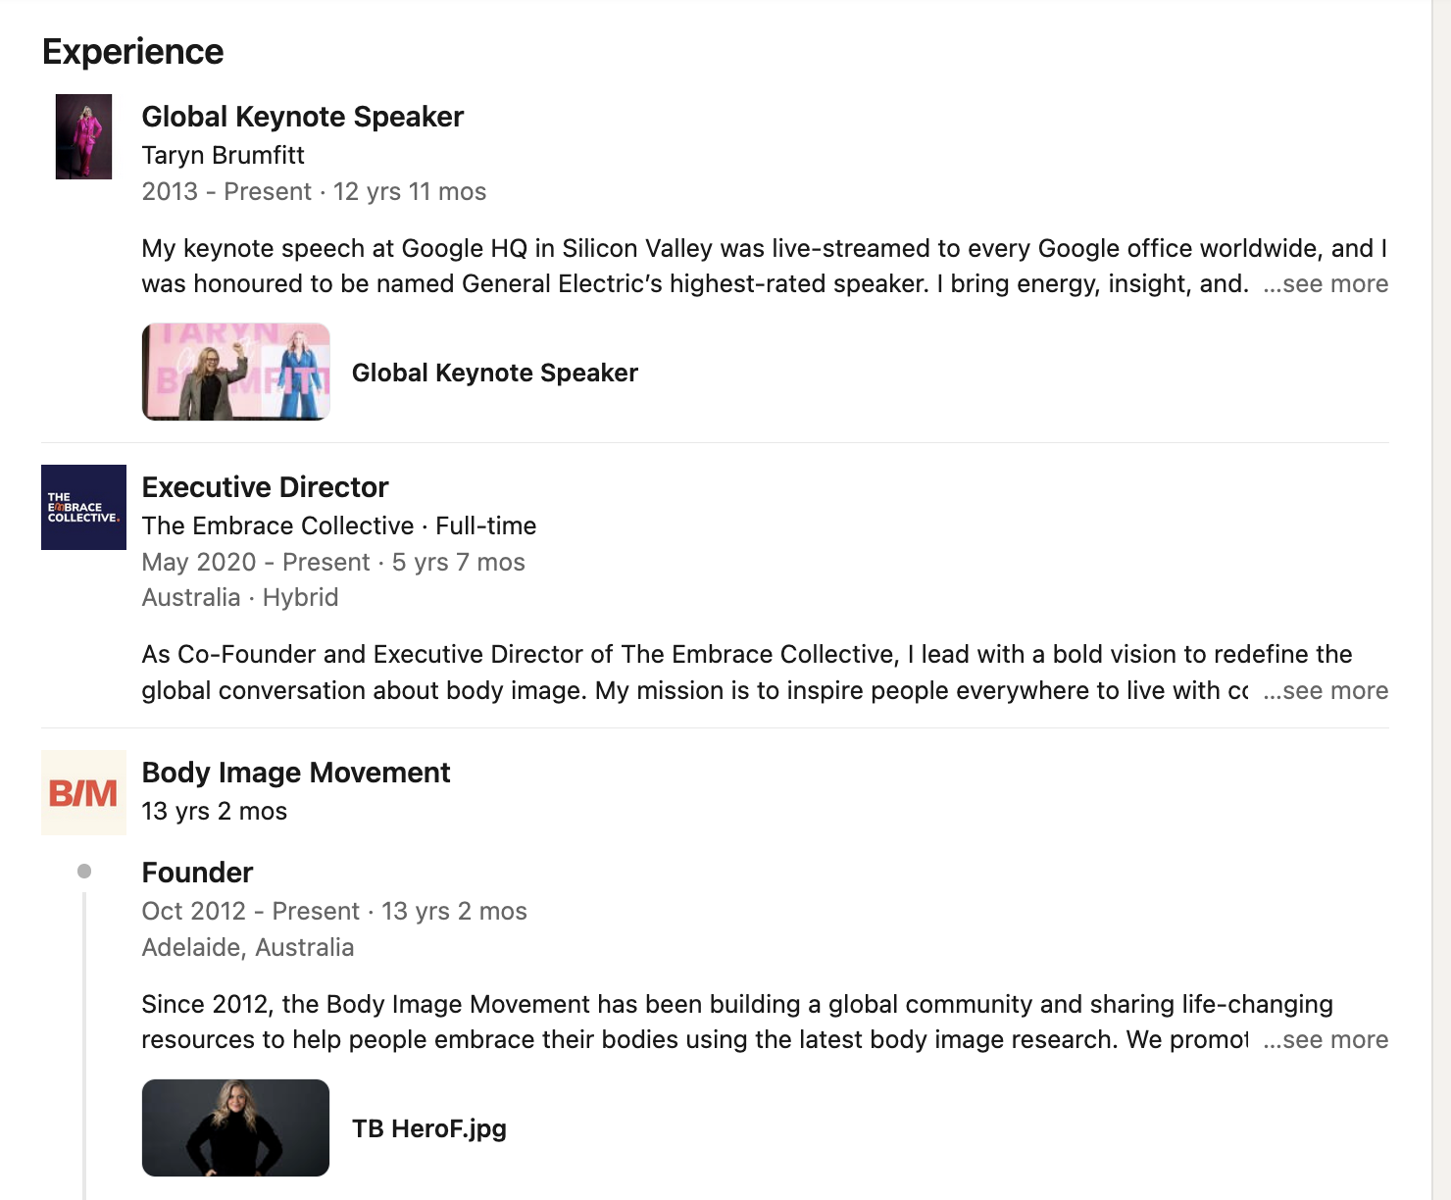
Experience section

Slide 35

5 tips for your ‘experience’ section
List roles and projects that show impact.
Write outcome-focused bullets (not task lists).
Show evidence where you can.
Add media for credibility.
Keep it safe and relevant.
Notes:
1) list roles and projects that show impact
Include paid work, volunteering, advocacy, peer leadership and caring. Use the most recent 3–5 entries.
2) write outcome-focused bullets (not task lists)
Each bullet = action + for who + result. Aim for 2–4 bullets per entry.
3) show evidence where you can
Add simple proof: numbers, time saved, audience reached, or a named outcome.
4) add media for credibility
Link a document, post, short video, or web page to the role (e.g., event flyer, resource, article).
5) keep it safe and relevant
Skip private details, internal acronyms, and jargon. Use plain English. If in doubt, leave it out.

Slide 36
Activity: Practice writing your experience
Step 1: Pick a role or project:
  Choose something recent: job, volunteering, advocacy, caring, study.
Step 2: Note the basics:
  Who you helped, what you did, the result, any number or proof.
Step 3: Write two bullets:
  Use the template: action + for who + result.
  Example: “Delivered Easy Read handout for council workshop; 40 participants reported the content was easier to use.”

Slide 37

Education and training section: Example

Slide 38
Education and training section: Tips
Include all learning, not just degrees.
Keep entries short and scannable.
Show practical skills.
Add proof when you have it.
Include community and library learning.
Keep it safe and relevant.
Notes:
1) include all learning, not just degrees
List uni/TAFE, short courses, micro-credentials, workshops, and certificates from libraries, community groups and NGOs. Recent and relevant first.
2) keep entries short and scannable
For each item, include: Provider | Course name | Year | Focus or outcome. Add one line on what you learned or built.
3) show practical skills
Highlight skills gained that relate to your goals, for example: plain English, event accessibility, assistive tech basics, digital safety, Canva basics.
4) add proof when you have it
If you have a certificate, link or upload it. If not, add a brief outcome such as “completed 6-week program” or “assessed task: produced Easy Read guide.”
5) include community and library learning
Add workshops from your local library, community centre, neighbourhood house, or state library programs. These count and often show current, hands-on skills.
6) keep it safe and relevant
Skip student numbers or private details. Only list items that support your goals or values.

Slide 39
Example: Education and training
Example:
Adelaide City Library | Intro to Canva | 2025
Learned basic layout and high-contrast design. Applied to accessible event flyers.

Slide 40
Staying safe and in control on LinkedIn

Slide 41

Safety and control
Choose who can see your profile.
Hide contact details if you want.
Turn off “share profile updates” while editing.
Control who can message you.

Slide 42
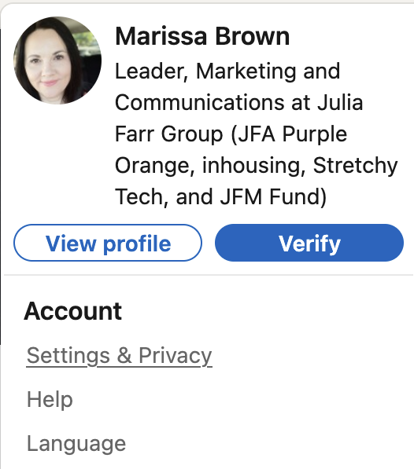
Accessing settings

Slide 43
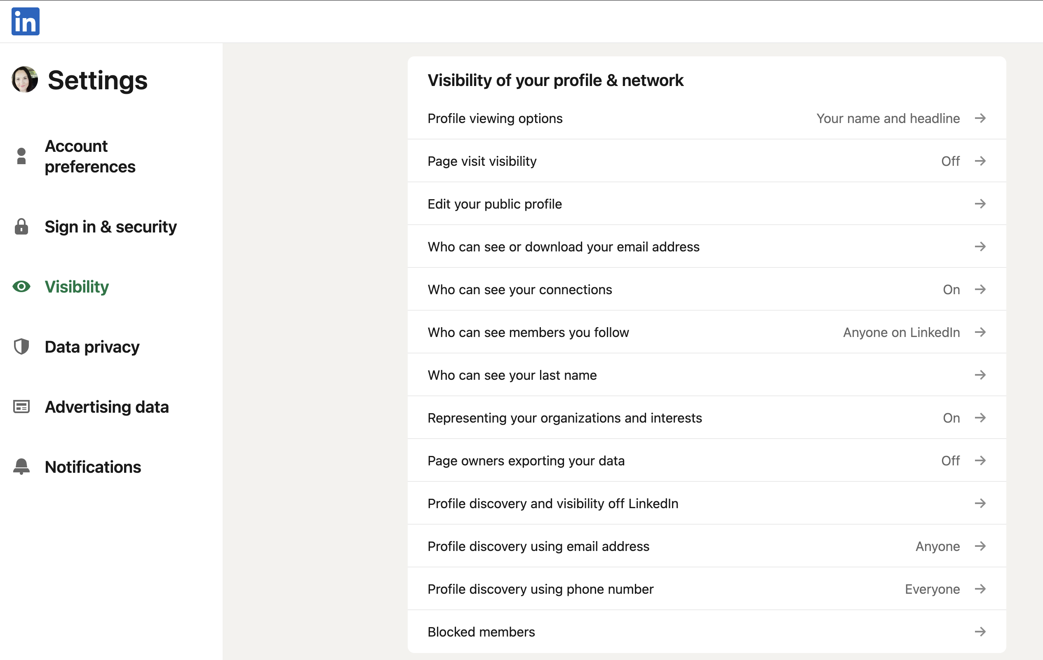
Profile viewing options

Slide 44
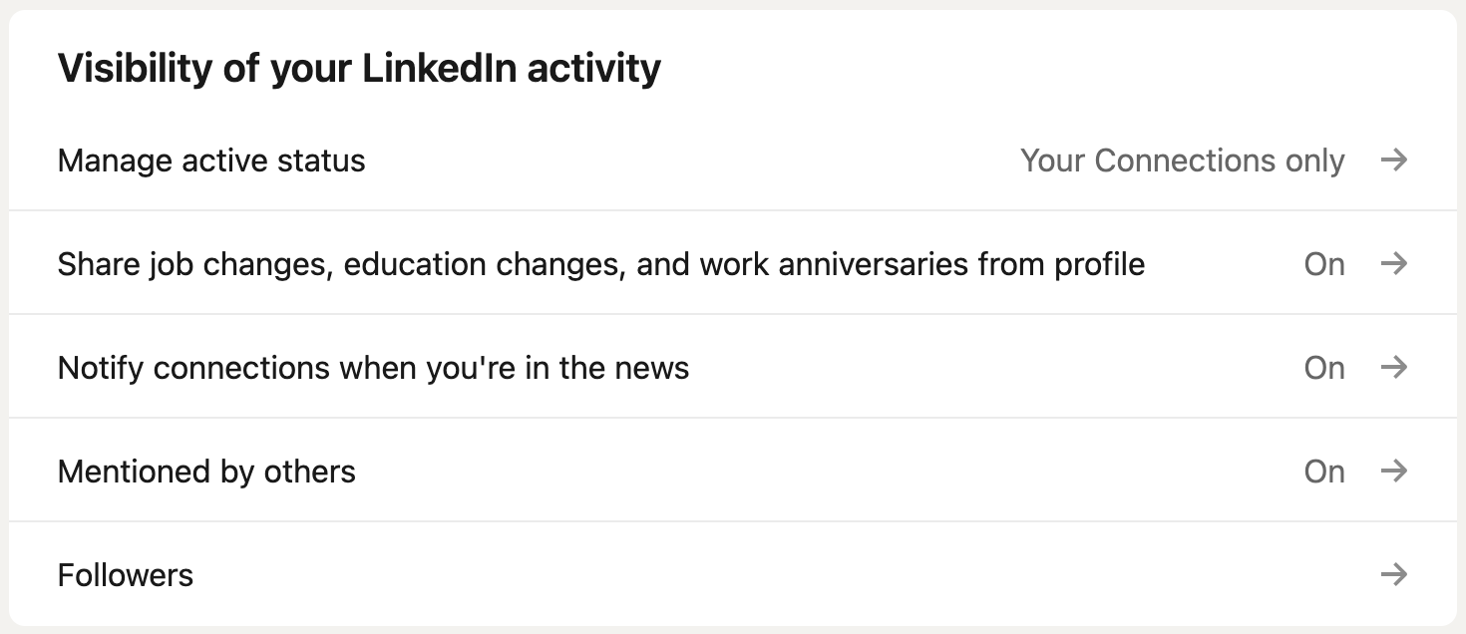
Profile viewing options (cont’d)

Slide 45
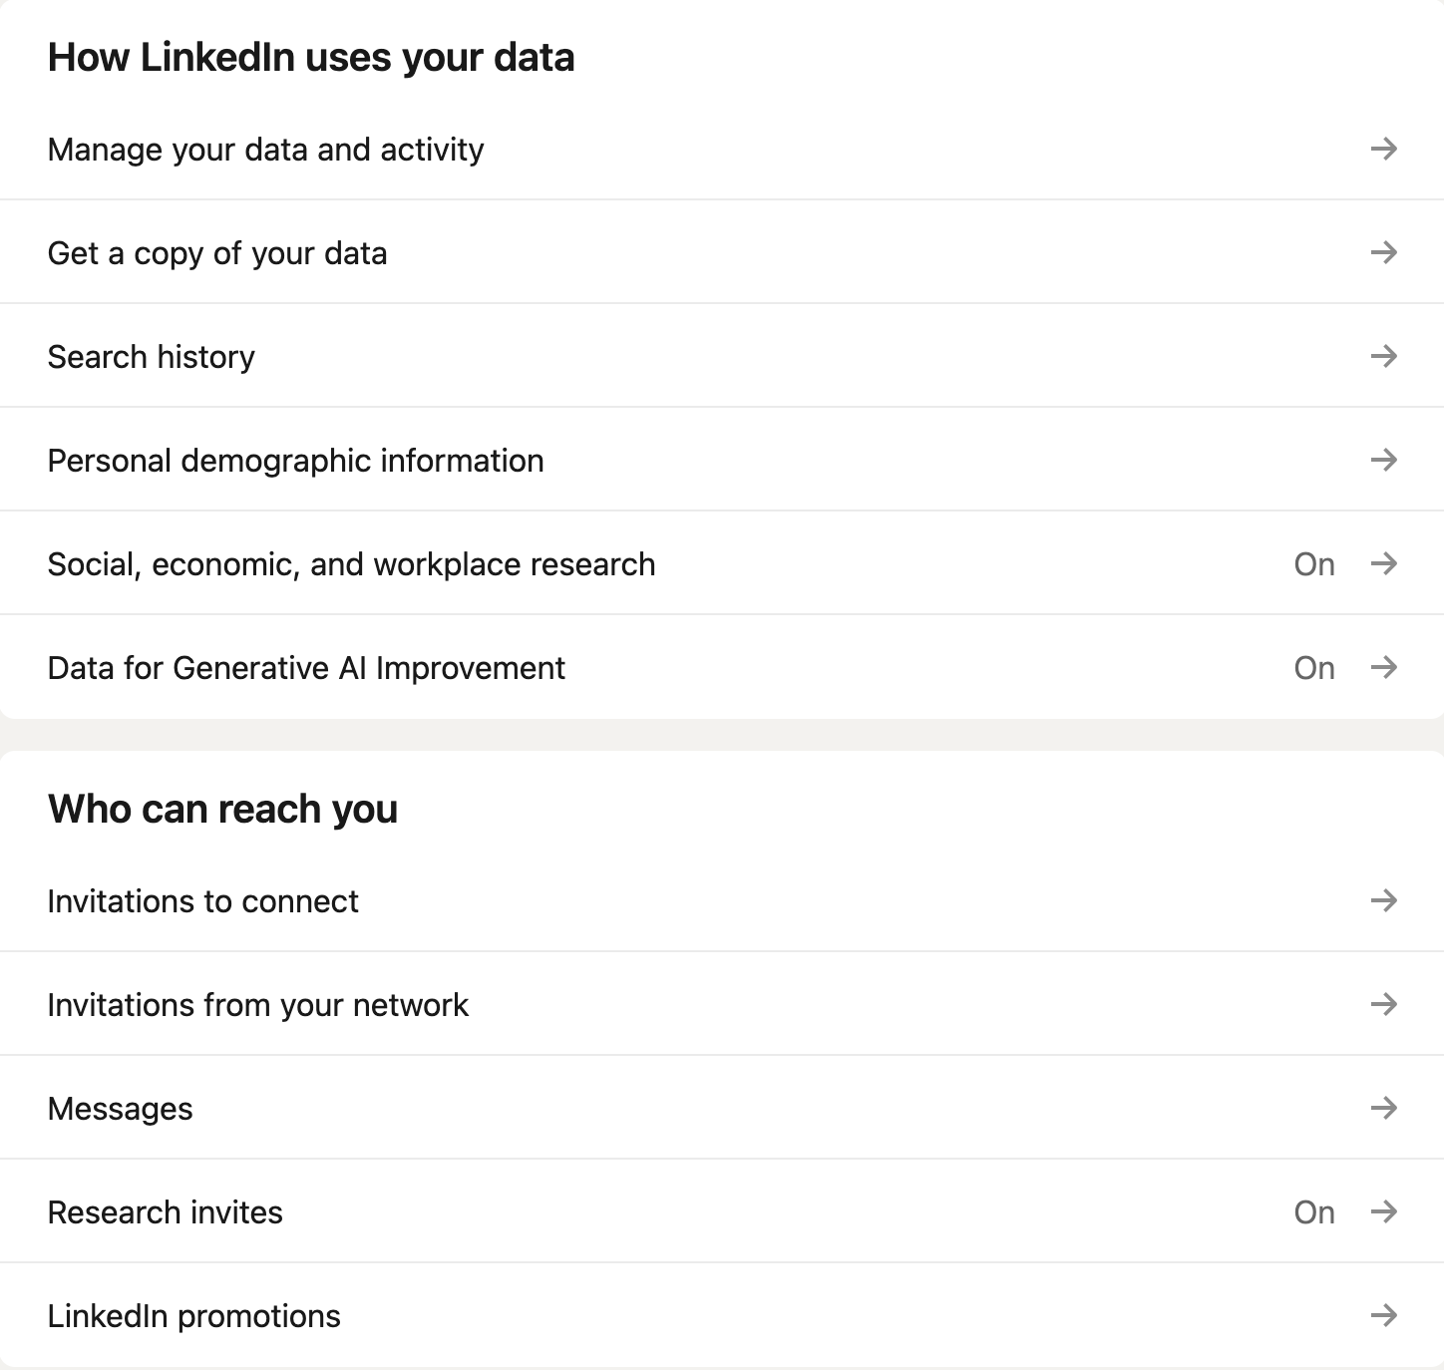
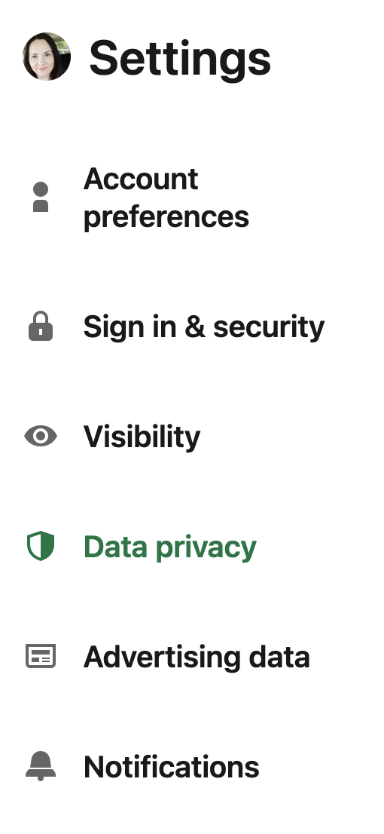
Data privacy settings

Slide 46
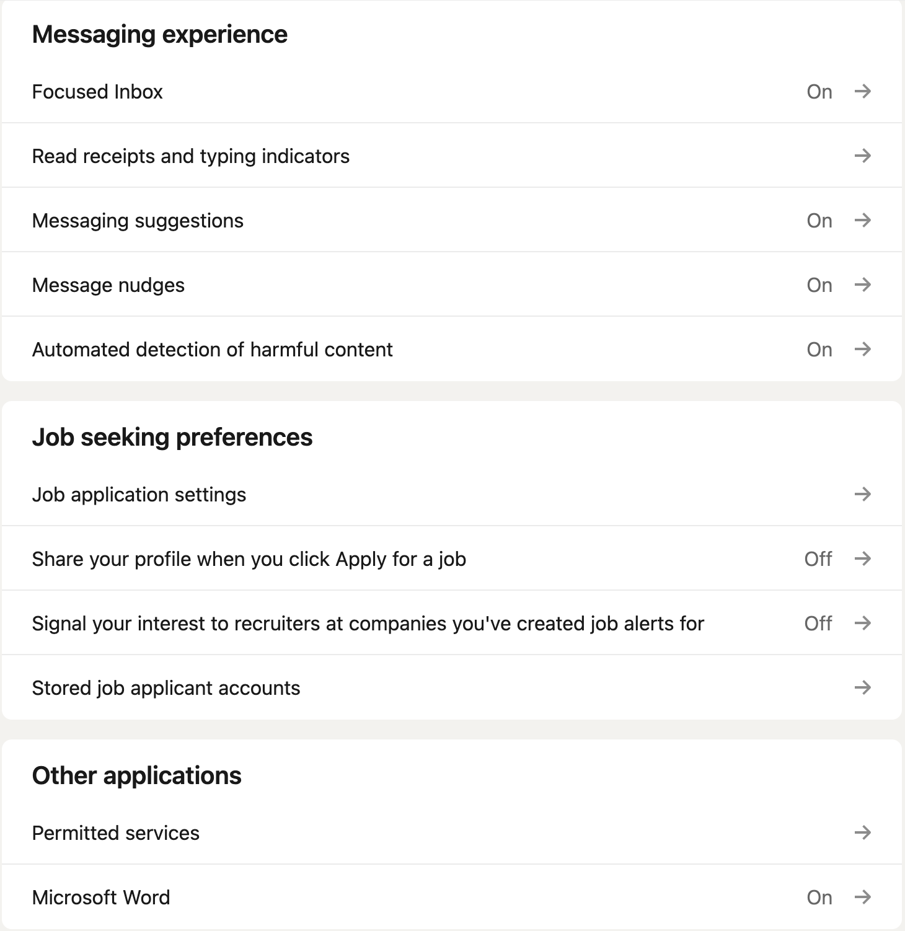
Data privacy settings (cont’d)

Slide 47
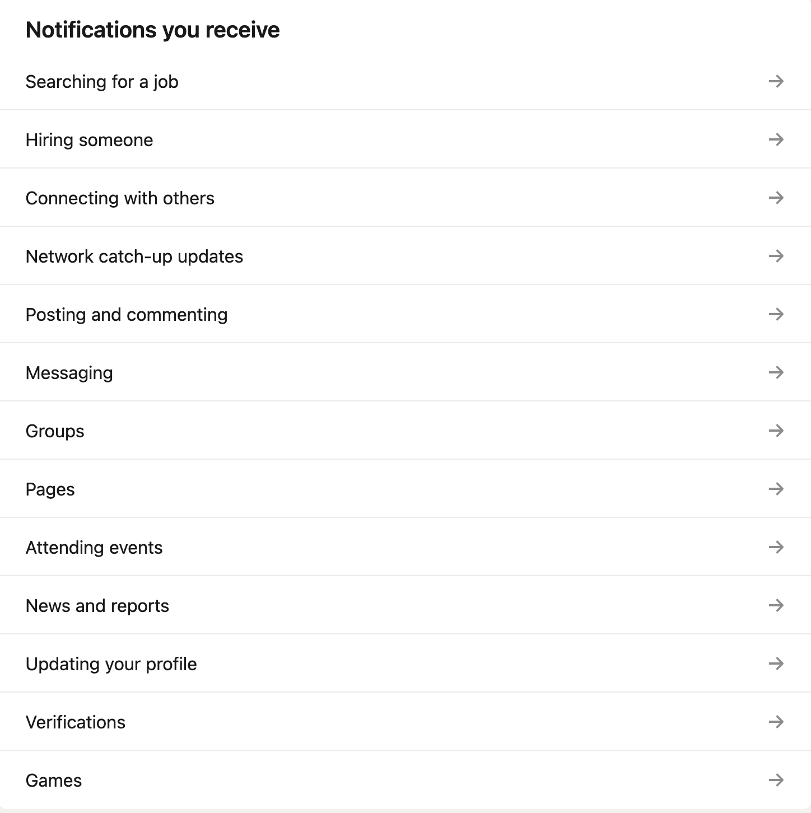
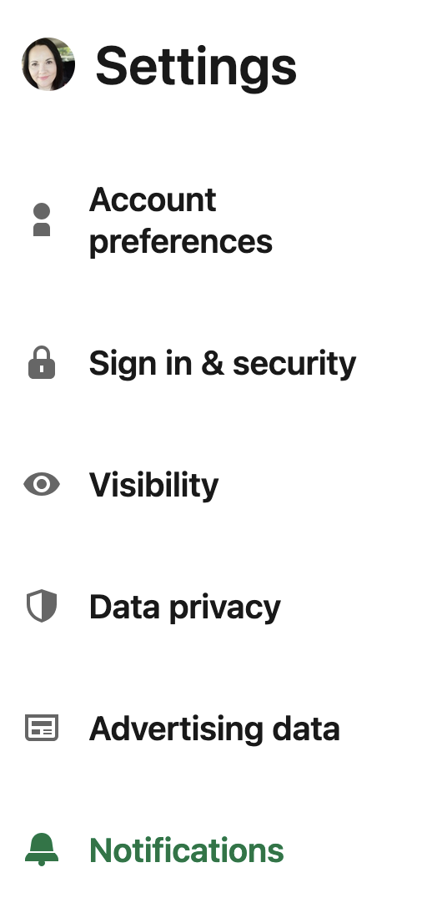
Managing notifications

Slide 48

Boundaries that protect you
Share only what you are comfortable sharing.
Neutral places and timeframes.
Don’t share personal info (birthday, address, etc).
Ignore, block or report when needed.

Slide 49

Who can see your posts, profile, and comments?
Audience is set per post.
  Options: only you (draft), connections, followers, public.
Shares and reactions can spread your post further.
Posts in Groups: visible to group members.
Notes:
When you start a post, you can choose the audience. For most people, ‘Connections’ or ‘Followers’ is enough. If you select ‘Public’, anyone can see it, including people who are not logged in.
When others react, comment or share, your post can appear in their networks too.
If you post inside a Group, only members of that Group see it.
Tip: if you’re unsure, save a draft or choose a smaller audience first.

Slide 50
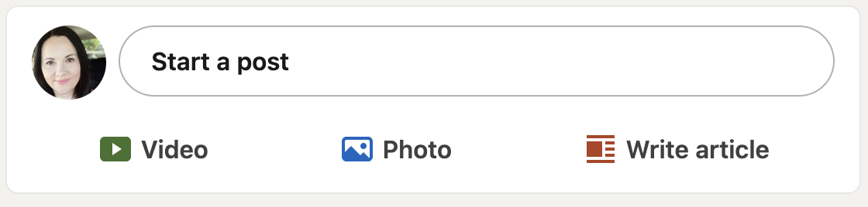
How to choose who sees your post: Step 1
Step 1:
Go to your profile feed and select ‘start a post’

Slide 51
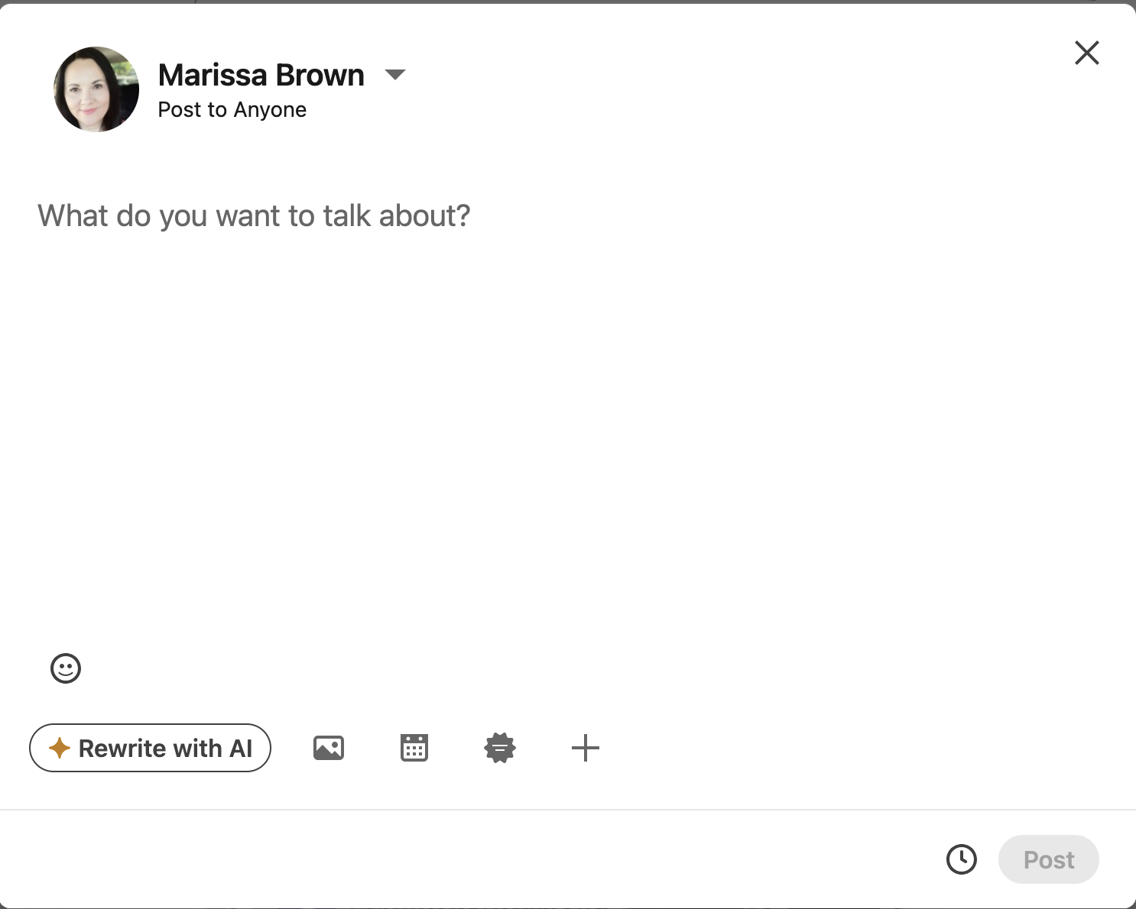
How to choose who sees your post: Step 2
Step 2:
Click the drop-down arrow next to your name

Slide 52
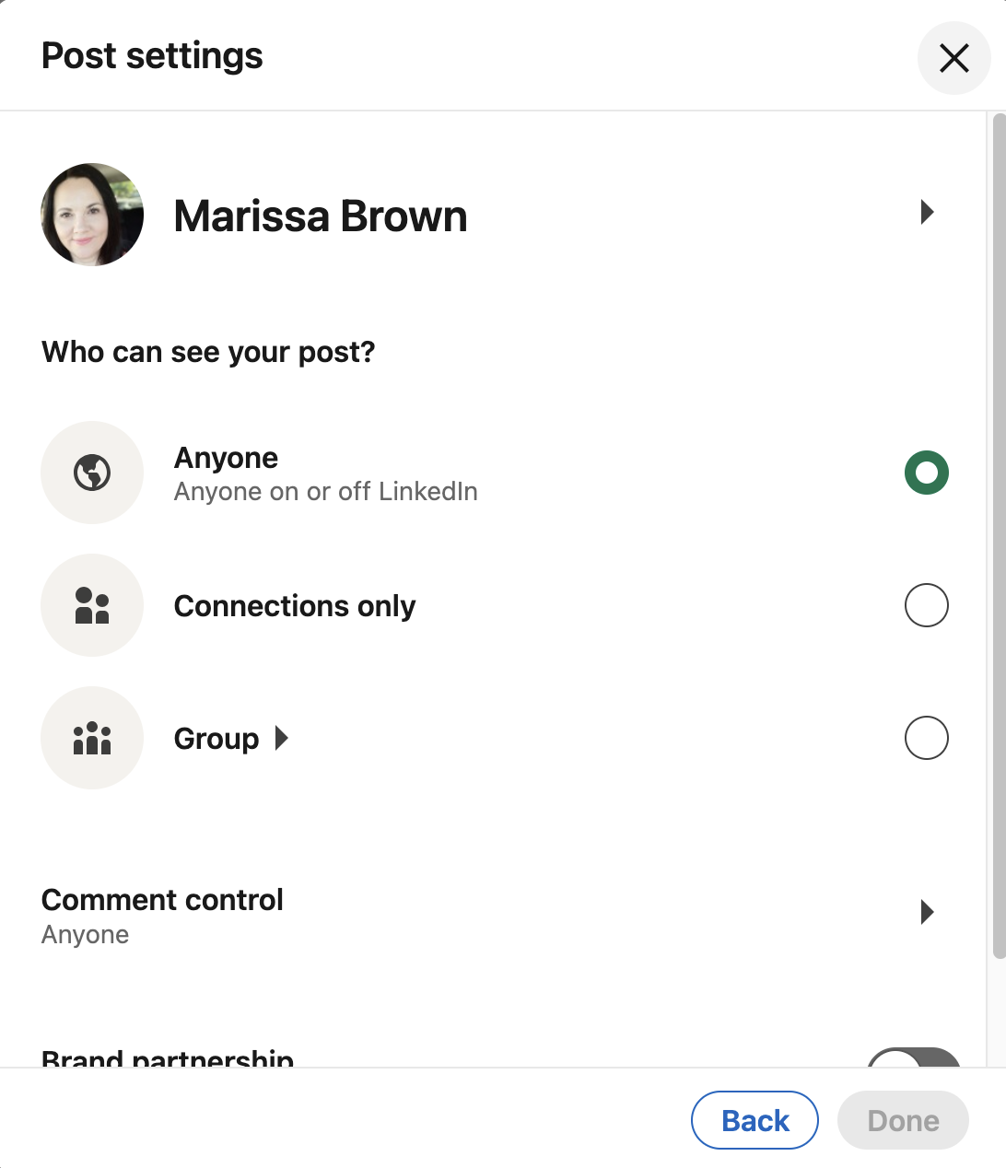
How to choose who sees your post: Step 3
Step 3:
Select who can see and comment on your post

Slide 53
Question: Safety and control
What do you do to ensure you’re safe and in control on social media?

Slide 54
Using LinkedIn

Slide 55
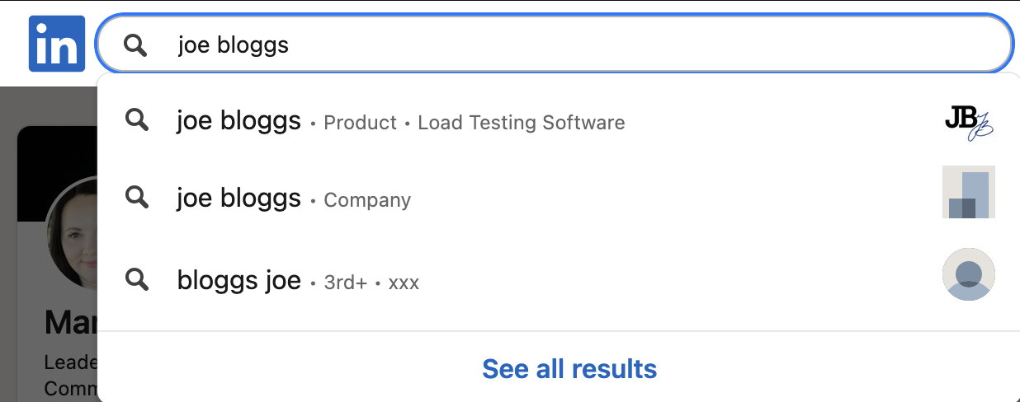
How to connect: Step 1
Step 1:
Go to the search bar and type in the person or organisation you are looking for

Slide 56
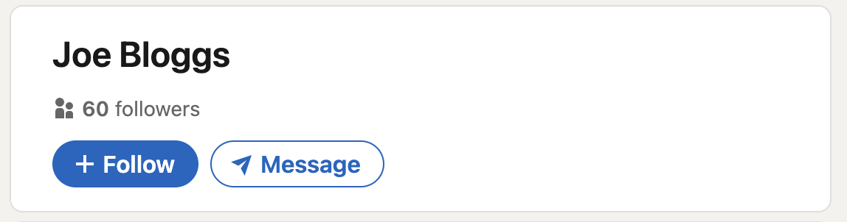
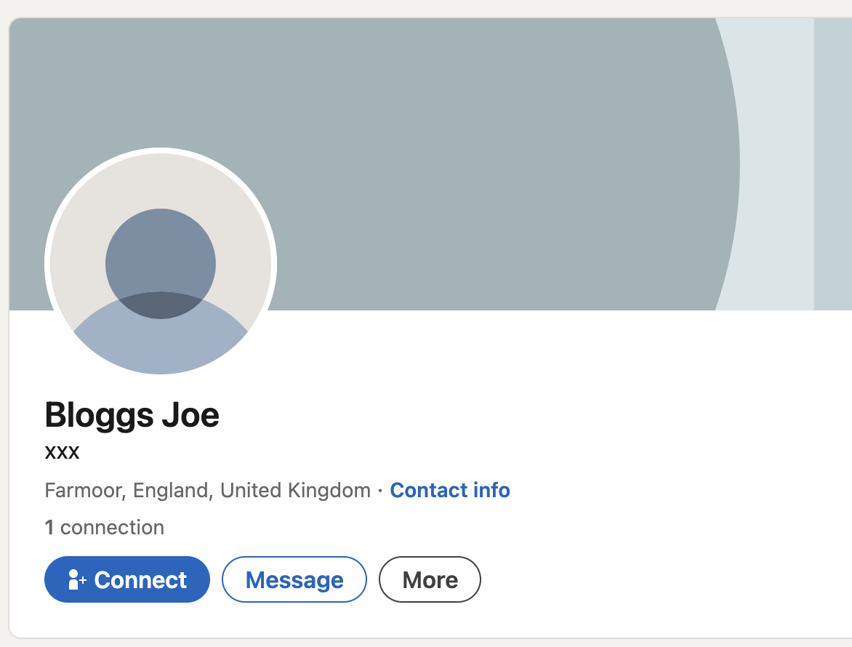
How to connect: Step 2
Step 2:
Click the ‘Follow’ button (for companies or creators)
or
Click the ‘Connect’ button (for people)

Slide 57
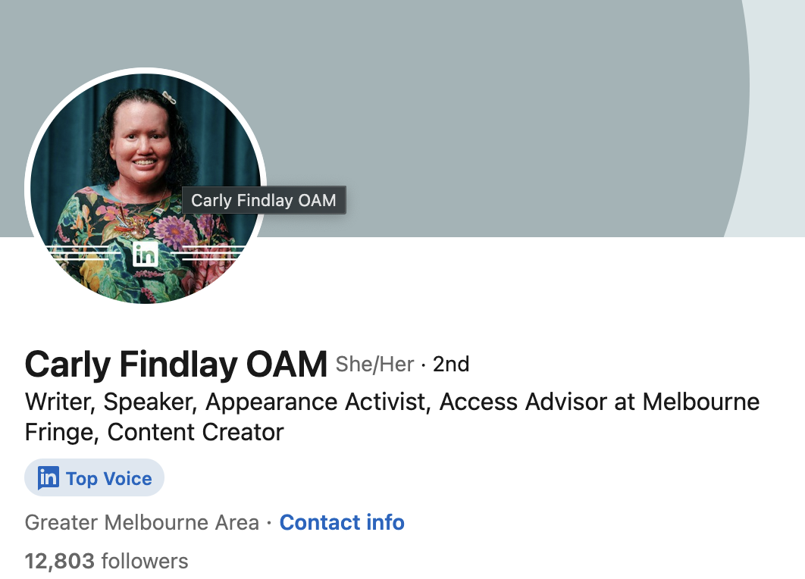
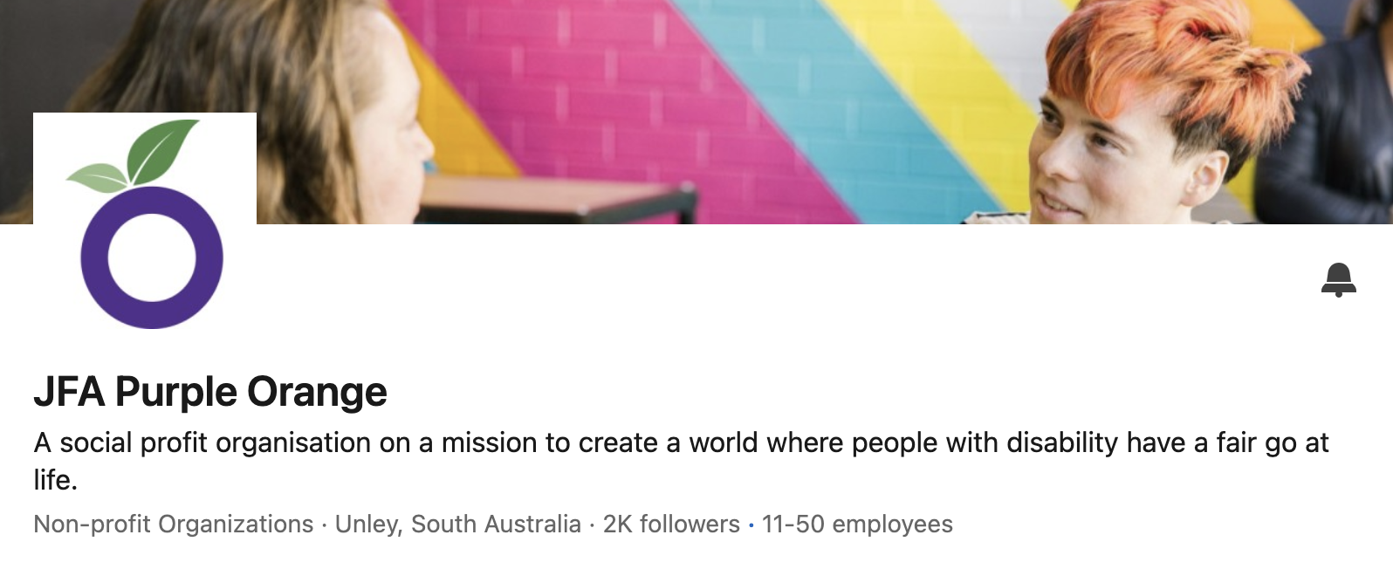
Disability orgs and creators on LinkedIn

Slide 58
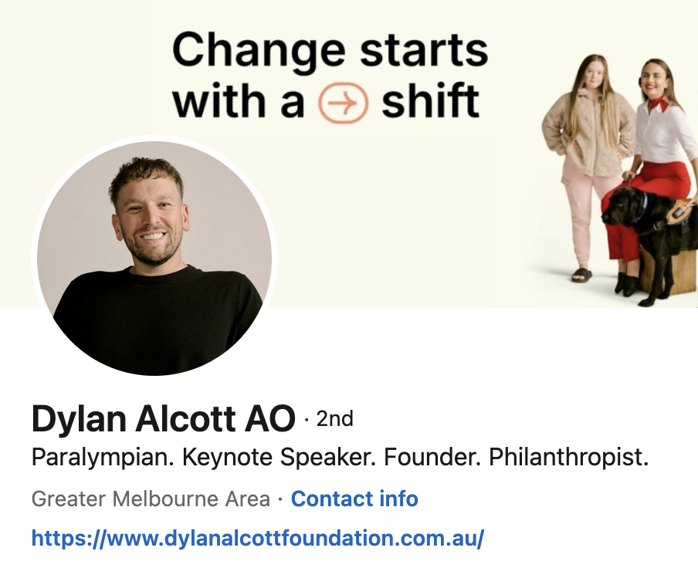
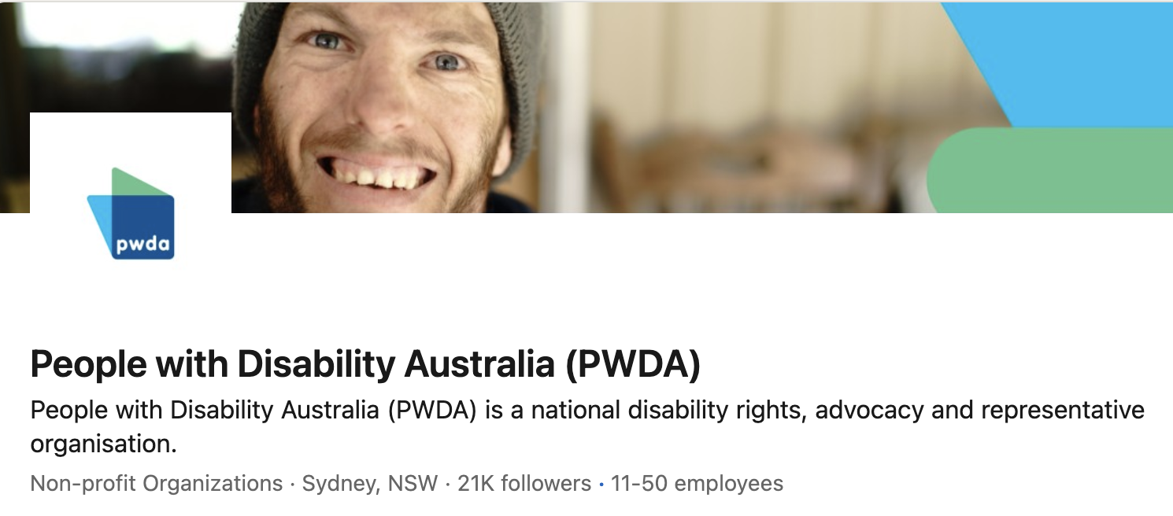
Disability orgs and creators on LinkedIn (cont’d)

Slide 59
LinkedIn post tips
Do:
Lead with a clear hook, then 2–4 short lines.
Add one image or a short video.
Write in plain English.
Make it professional.
Include a specific call to action.
Use 2–4 relevant hashtags (CamelCase).
Check accessibility (i.e. alt text; captions, colours, etc).
Don’t:
Post dense tiles with tiny text.
Tag people without consent.
Share personal, private or identifying details.
Use multiple emojis.
Rely on buzzwords or acronyms.
Overpost – weekly or fortnightly is fine.
Skip replies.

Slide 60


Example: Event post

Slide 61

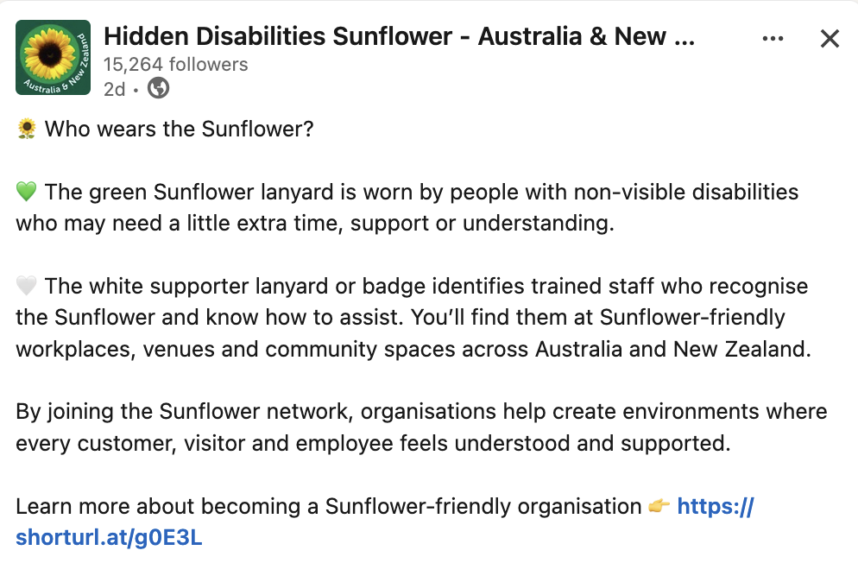
Example: Information sharing post

Slide 62
Question: Post ideas
What could you post about?

Slide 63

Using LinkedIn messaging
On a free account, you can message your direct connections.
On a premium account, you can also send “InMail” to people you're not connected with.
You may paid messages called sponsored messages – labeled with ‘Sponsored’.

Slide 64
Respectful and safe LinkedIn messaging
Be clear and get consent.
  Script: “Hi Sam, I enjoyed your post on accessible events. Do you mind if I ask you a quick question about captions?”
Set boundaries and keep it professional.
  Script: “Thanks for the info. I think I have everything I need. Thank you for your time.”
Protect privacy and safety.
  Script: “I’m not comfortable sharing that. I’ll end the conversation here.”
Notes:
Be clear and get consent. Say why you’re reaching out in one line and ask if it’s a good time to chat.
Set boundaries and keep it professional. No pressure, no spam, no late-night pinging. If the conversation drifts, park it.
Protect privacy and safety. Don’t share personal details or client info. If a message feels off, stop. Use mute, report or block.

Slide 65


LinkedIn accessibility features
Screen reader support across core tasks.
Alt text for images.
Captions for video.
Live visual assistance.
Read more about LinkedIn’s accessibility features.
Notes:
Screen reader support across core tasks (profile, skills, recommendations), documented and tested with JAWS, NVDA and Narrator.
Alt text for images when you upload, so posts are readable for screen reader users.
Captions for video: upload an SRT file; viewer supports captions and high-contrast playback. Mobile also offers auto-captions.
Live visual assistance via Be My Eyes for blind and low-vision members.
Accessibility Conformance Reports (ACRs) published for transparency against global standards.

Slide 66
Finding opportunities

Slide 67
Finding job opportunities: Step 1
Step 1:
Click the ‘jobs’ (briefcase) icon in the top toolbar.

Slide 68
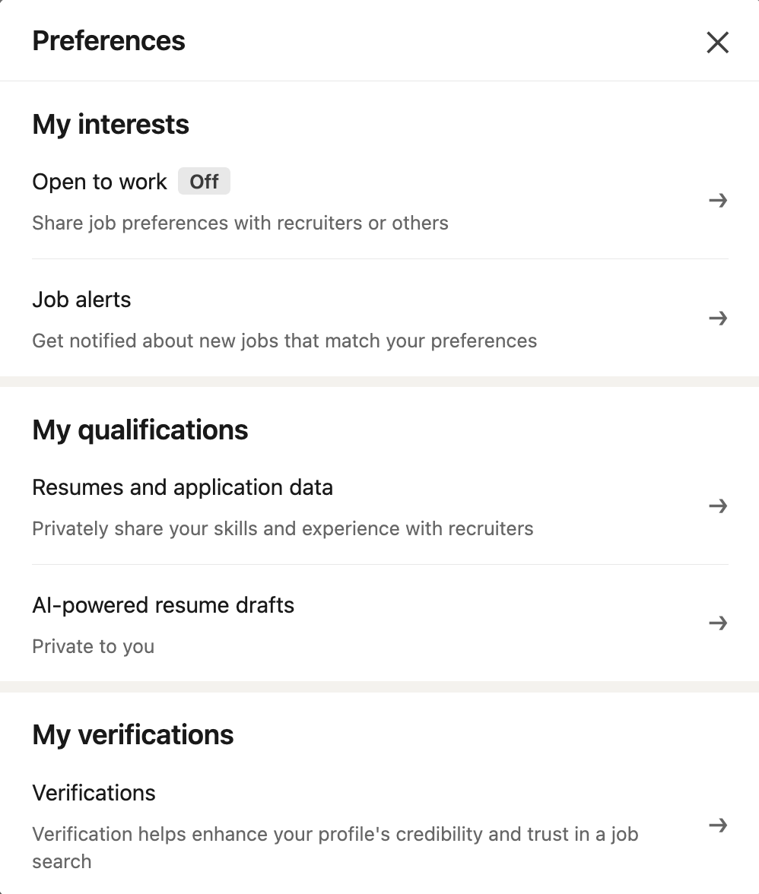
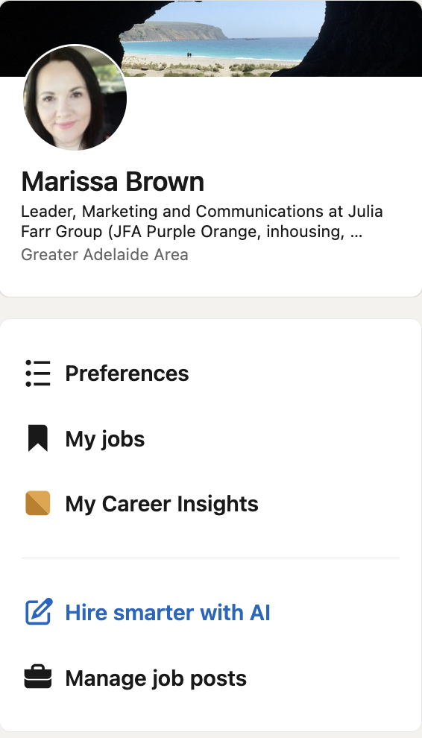
Finding job opportunities: Step 2
Step 2:
Set your preferences.

Slide 69

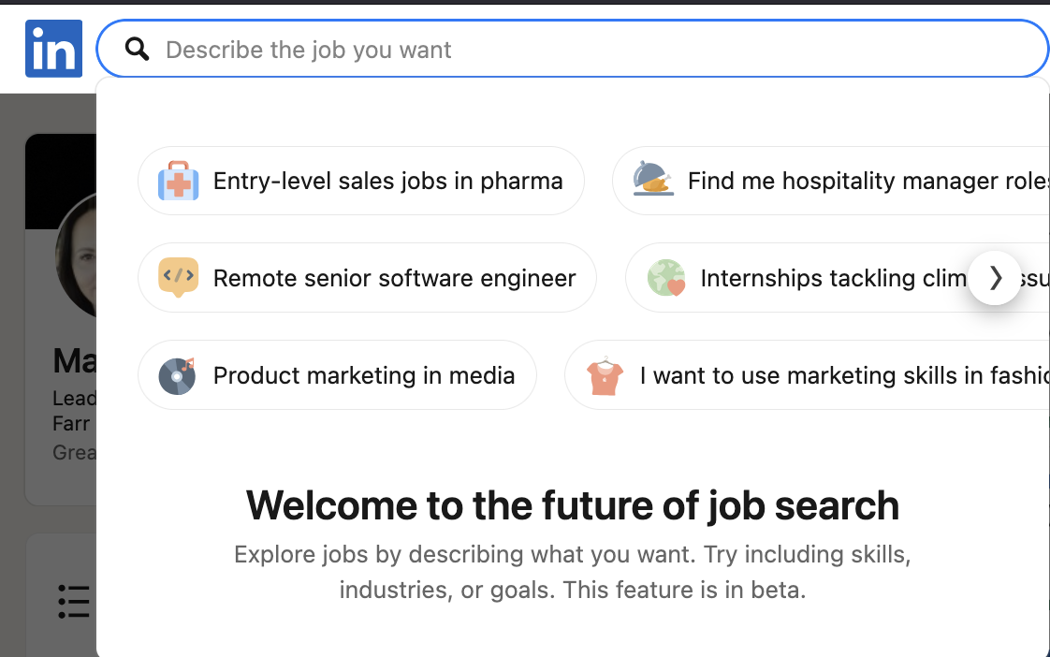
Finding job opportunities: Step 3
Step 3:
Search for available jobs using the search bar.

Slide 70
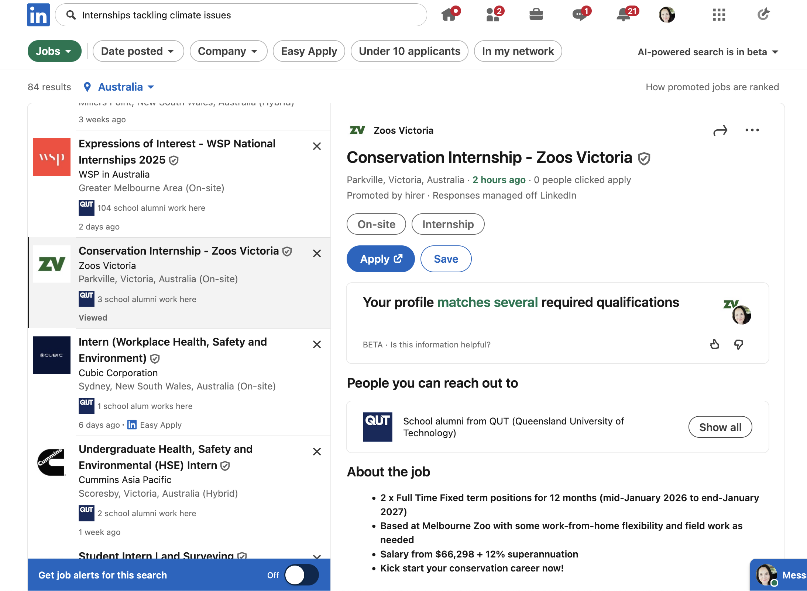
Finding job opportunities: Step 4 & 5
Step 4:
Click on the jobs you’re interested in and follow the application instructions.
Step 5:
Set up a job alert for similar jobs.

Slide 71
Learning opportunities: LinkedIn learning
A wide range of courses on many different topics.
A free one-month trial.
LinkedIn Learning may be free with a public library card – check with your library.
Learn more about how to use LinkedIn (video tutorials).

Slide 72
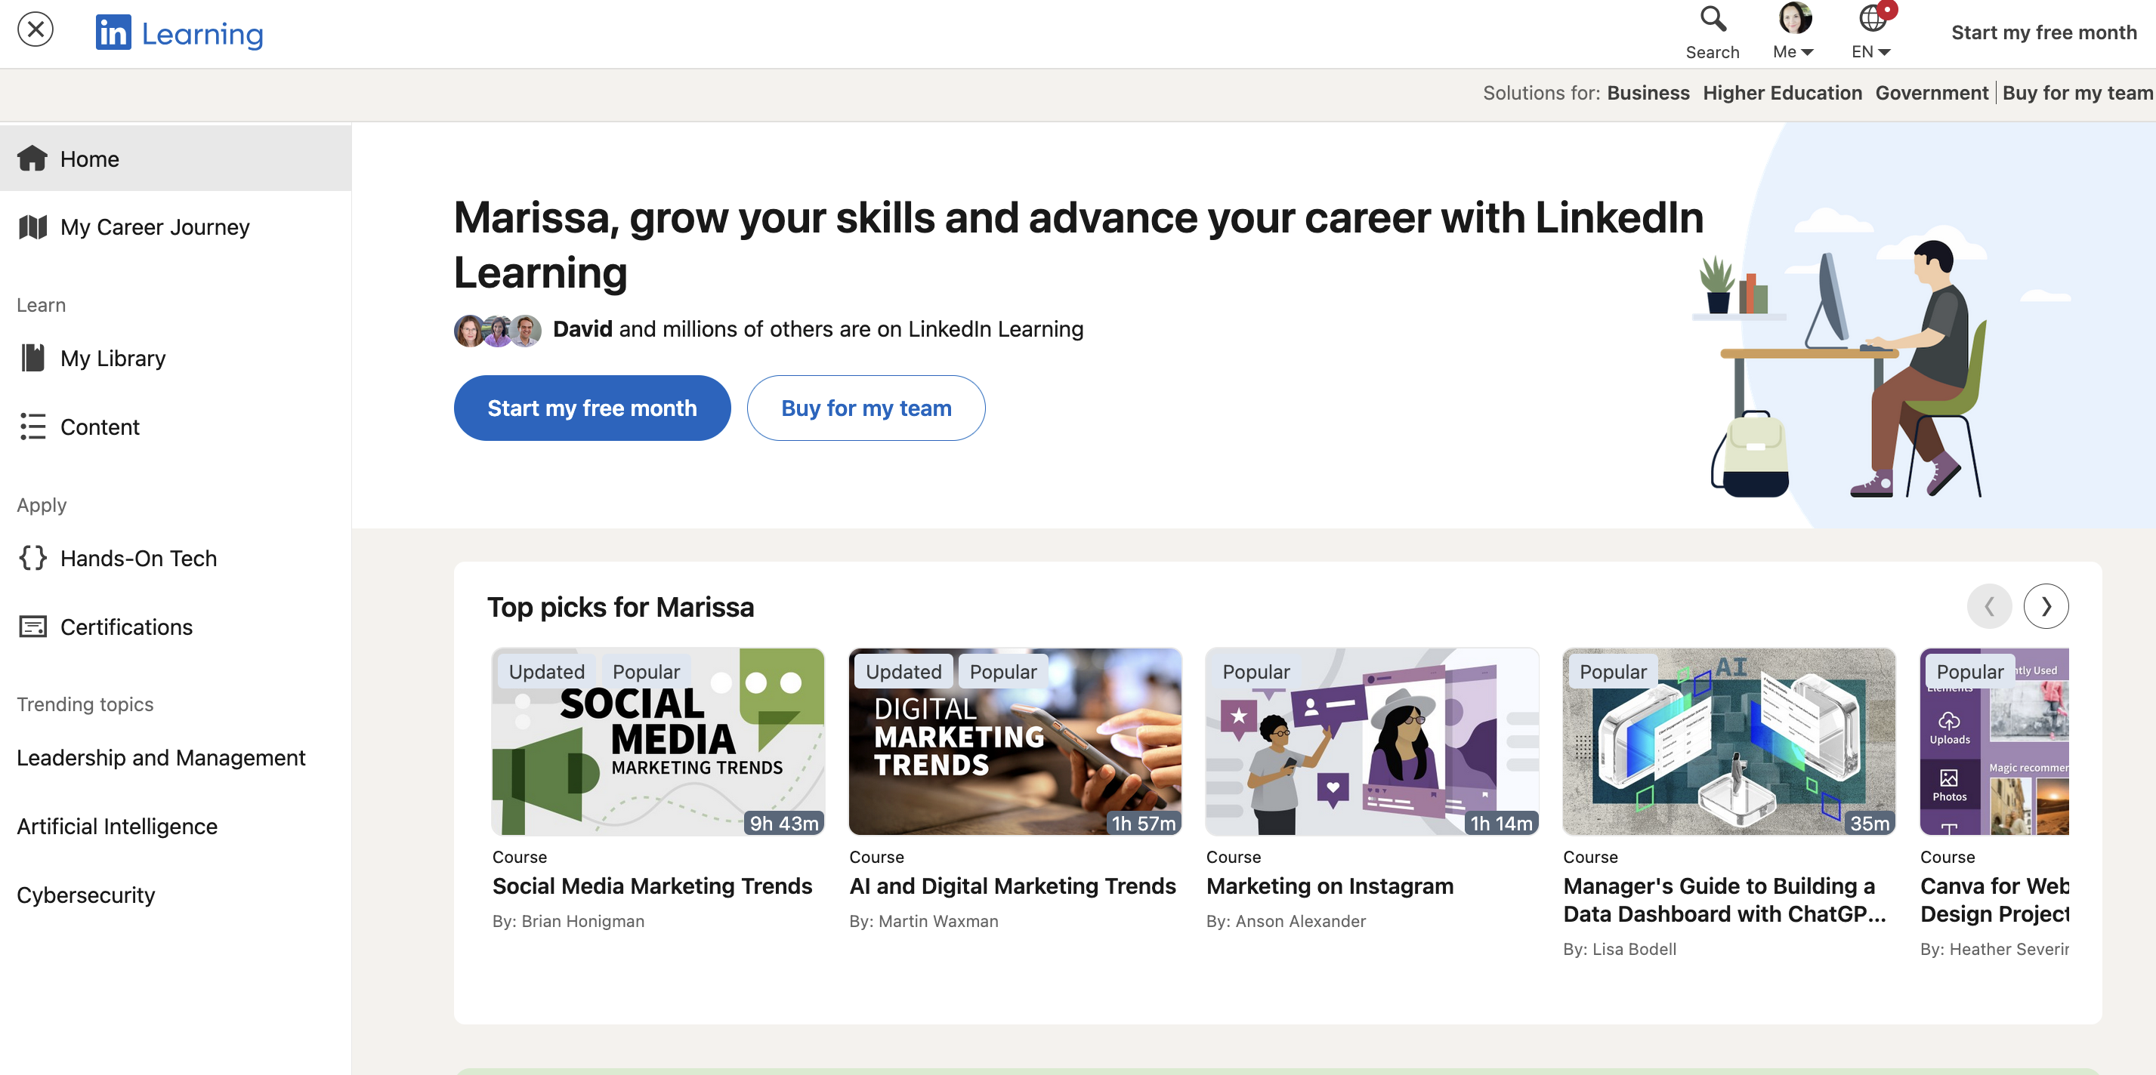
LinkedIn Learning: Free trial
Visit LinkedIn learning

Slide 73

LinkedIn Learning: Library login
Visit LinkedIn Learning (Library Login)

Slide 74
Wrap-up and next steps

Slide 75
What did we cover?
What is LinkedIn (and what it isn’t)?
Building your LinkedIn profile.
Staying safe and in control on LinkedIn.
Using LinkedIn.
Finding opportunities.

Slide 76

Links and resources
We will email you a copy of the recording.
Slides and resources available on the JFA Purple Orange website.

Slide 77

Register for upcoming free events
28 January:
Practice, film and edit your own vox pop (in-person, Unley)
30 January:
Get your professional headshot taken (in-person, Unley)

Slide 78
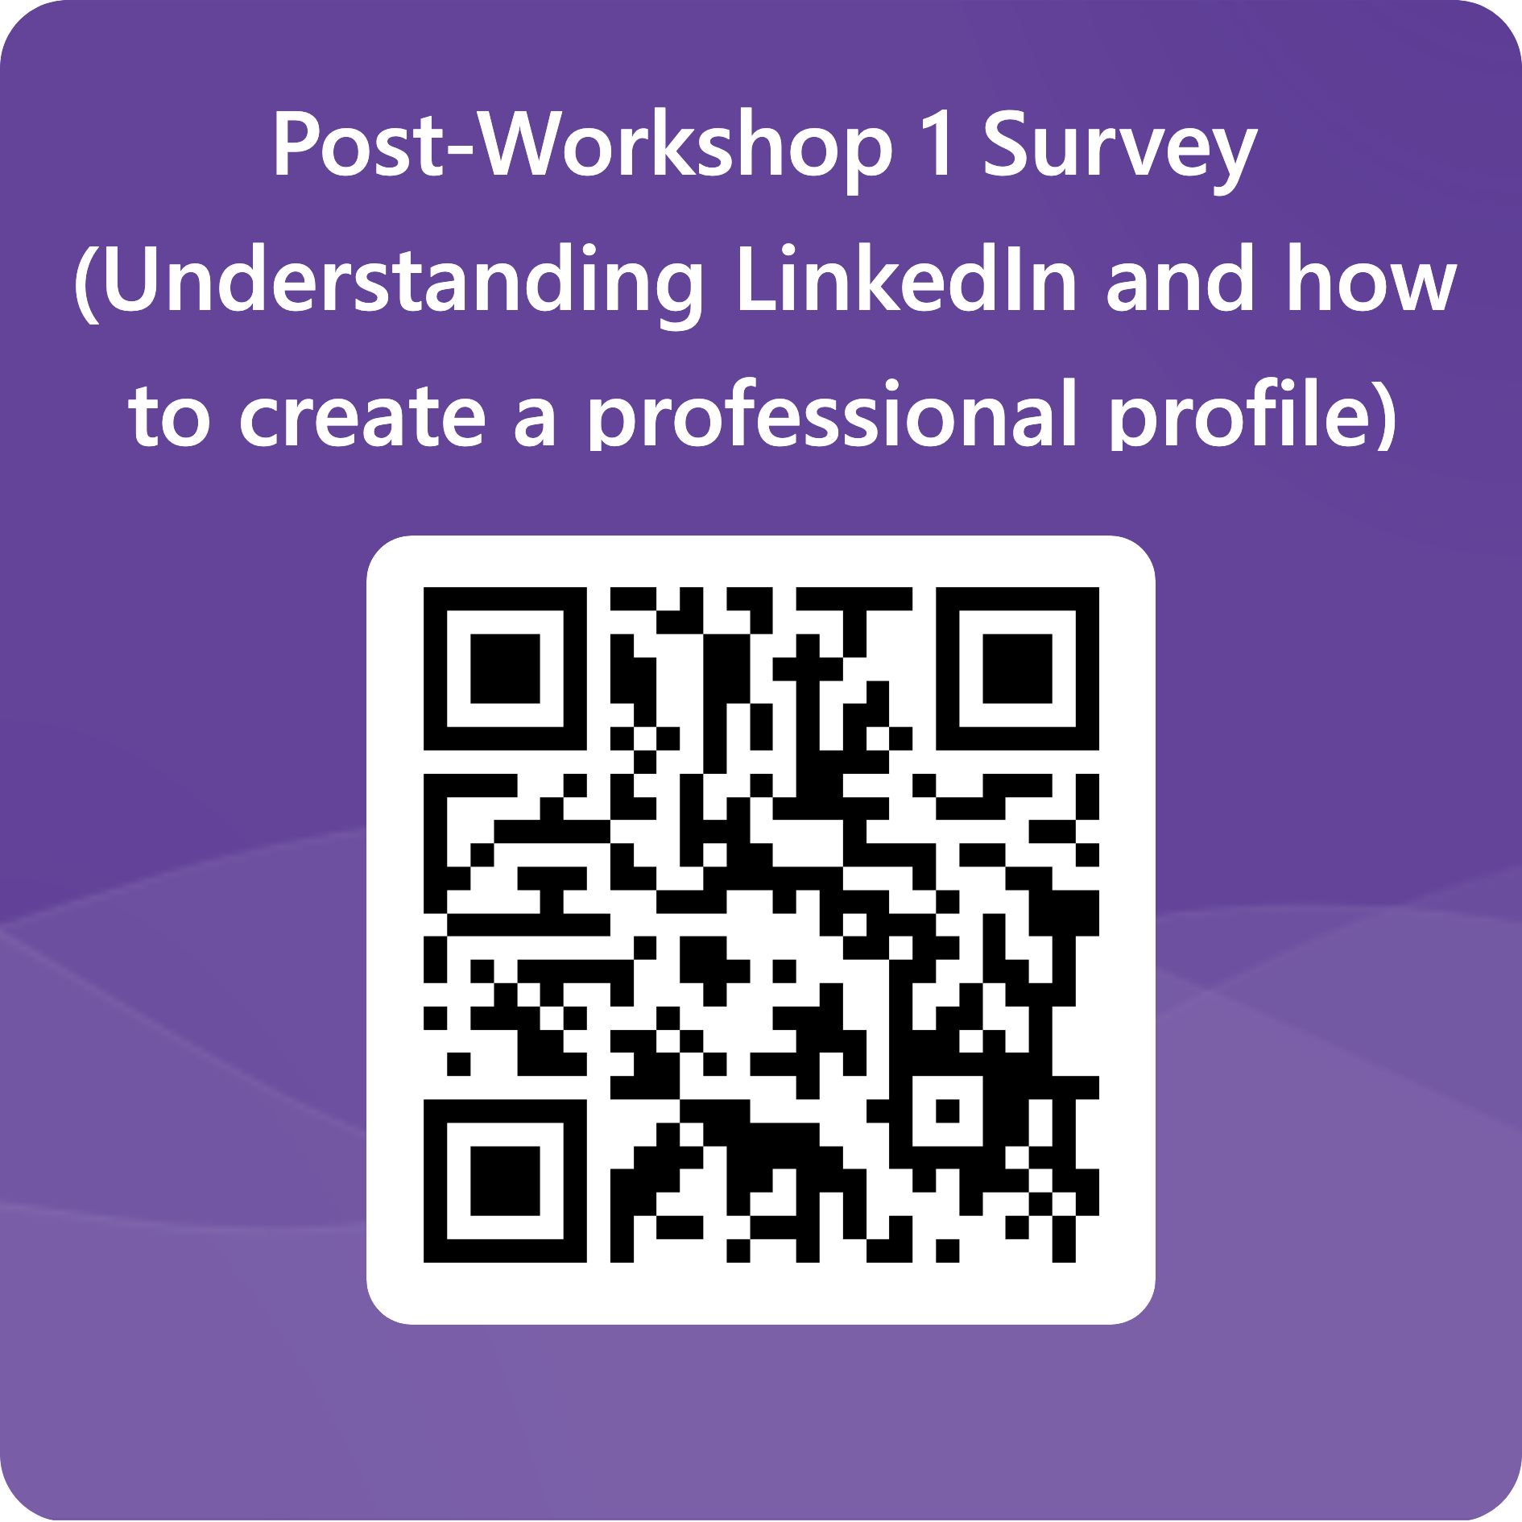
Thank you!
Thanks for attending and participating!
Contact us with any follow up questions:
  Email: media@juliafarr.org.au
  Call: 08 8373 8388
Please fill in our feedback survey:

