Slide 1
Social Media for Advocacy and Storytelling
Workshop Series 1
Workshop 1: Basics of Social Media and Online Safety

Slide 2

Welcome
PRESS RECORD
Acknowledgement of Country
Recognition of disability community
Meet today’s presenters:
Mel Merlino
Nick Roach
Housekeeping: mute/unmute, raise your hand to speak, use the chat
Today’s session will be recorded
Notes:
Acknowledgement of Country
JFA Purple Orange acknowledges the Traditional Owners of Country throughout Australia. We work on many Aboriginal lands, including Kaurna Country, where our head office is located. We extend our respect to all Aboriginal peoples on the lands where we work, live, and learn. We are committed to walking together and building relationships grounded in the self-determination of First Nations peoples.
Recognition of the disability community
We recognise that JFA Purple Orange exists to advance the rights of people with disability.
All our work aims to create a more inclusive world where people with disability have access to the same opportunities as everyone else
An introduction to your presenters today – Mel Merlino and Nick Roach
We have a live captioner with us today
General information – cameras, muting/unmuting, raise hand to speak, use chat to ask questions, Zoom accessibility features
This session will be recorded to share with participants afterwards
Links to resources will be shared after the session.

Slide 3

What We Will Cover
Social media and advocacy
About social media platforms
Hashtags, tags, likes and shares
An algorithm and what it does
Protecting your privacy
What to do if something goes wrong
Tips to avoid overwhelm
Notes:
Let’s have a look at what we will cover in today’s session
We will have a look at what social media is, how it works and why you would use it for advocacy
We’ll be covering quite a bit of ground, but don’t worry too much about remembering everything as we will share the recording afterwards so that you can go back over anything that you might have missed.

Slide 4
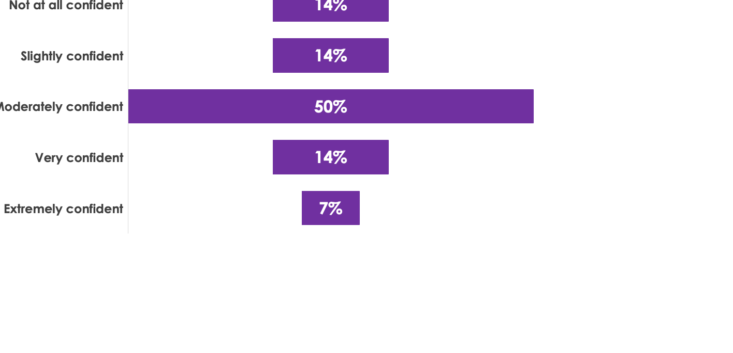
How Confident Are You?
Notes:
We asked you all to indicate how confident you feel about understanding and using social media – as you can see we have a range of confidence levels, with some feeling not at all confident through to others feeling moderately to extremely confident
This will be an introduction to social media so for those of you who feel very confident, you may be covering familiar ground
Please feel free to ask questions as we go – Nick will be monitoring the chat

Slide 5

What is Advocacy?
Advocacy means standing up for your rights
It can also mean standing up for others
Advocacy can be big or small
It aims to create positive change – in people, communities, or society
Your voice matters
Notes:
Advocacy is about making sure people with disability are heard, included, and respected.
It can look different: writing a post, signing a petition, or speaking at an event.
Everyday acts count — even sharing your own experience online is advocacy.
Example: A short Facebook post about accessibility issues on buses is still advocacy, because it pushes for change.

Slide 6
Question
Do you want to share a time when you advocated for yourself or others?
Notes:
Now that we’ve looked at what advocacy means and how it’s about standing up for your rights, or for the rights of other people,
would anyone in the group like to share a time when they advocated for themselves or for someone else?

Slide 7

What is Social Media?
Social media = websites and applications (apps) where people share and connect
You can post words, photos, or videos
Other people can like, share, or comment
It’s how many people get their news and information
Notes:
Social media is about connection — people use it to share everyday life, opinions, or causes.
In January 2024, there were approximately 20.8 million social media users in Australia – this is about 76% of the population
Australians
Most popular platforms in Australia: Facebook, Instagram, TikTok, LinkedIn, and X (Twitter).
This makes it one of the strongest ways for individuals to raise their voices, especially around advocacy.

Slide 8
Why Social Media for Advocacy?
Free & easy access
Tell your story, your way
Reach many people
Connection with others
Stand up for your rights
Two-way conversation
Challenge stereotypes
Notes:
Social media is one of the easiest ways for individuals to speak up — no special tools needed, just a phone or a computer.
Free and easy to access: It is free, and easy (for most) to access
Tell your story, your way: Share your story in a way that feels right for you
Reach many people: Posts can travel far, reaching people you’ve never met — helpful for those in regional or remote areas.
Connection with others: Meet and connect with others (build community, reduce isolation)
Stand up for your rights
Two-way conversation: Have a conversation with others
Challenge stereotypes and shift attitudes
Advocacy on social media has already shifted policies and community attitudes in Australia.
Example: Carly Findlay’s posts about appearance diversity have reached thousands and started conversations nationwide.

Slide 9









Social Media Channels
Facebook | Instagram | TikTok | X (Twitter) | LinkedIn
Groups Events Peer support | Photos Reels Stories | Short videos Trends | Fast news Political commentary | Work Professional profiles
Post and share photos, videos, links | Post and share photos and videos | Post short form videos and photo collections | Post and interact with short messages called ”tweets” | Share work content, connect with colleagues and find job opportunities
Notes:
Here are some key social media platforms – it doesn’t include everything, but these are some of the most popular ones
These platforms serve different purposes.
Instagram stories – are temporary content – tend to be less polished, on-the-go type of content
TikTok - you can create videos up to 10 minutes long by recording directly in the app, or upload videos up to 60 minutes long from your camera roll.
X -character limit for most users is 280 characters per tweet, unless you have a Premium account which allows longer tweets
You can use them as an application on a mobile phone – while you can use most of them on a desktop, they are mostly designed for easy mobile use
Key words to remember in relation to social media: Posts, likes, shares, hashtags.

Slide 10
Question
What is your favourite social media platform? Why?
Notes:
Before we jump into looking at the different platforms, I would really love to know if anyone has a favourite social media platform.
If you feel comfortable answering this question, please feel free to put your hand up and tell us which one you love and why. Or you can pop your answer in the chat.

Slide 11
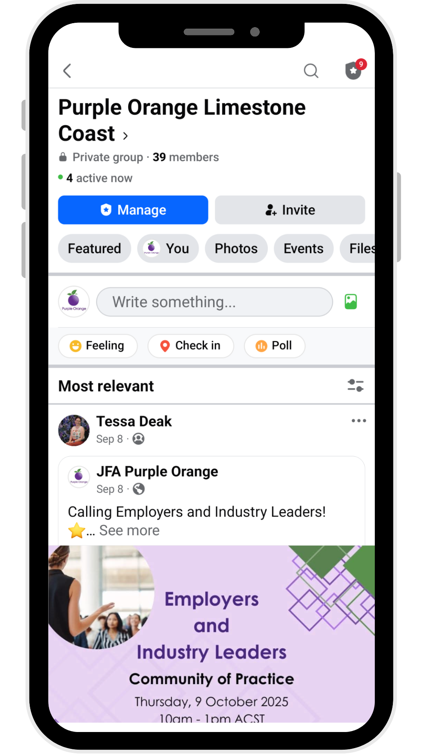
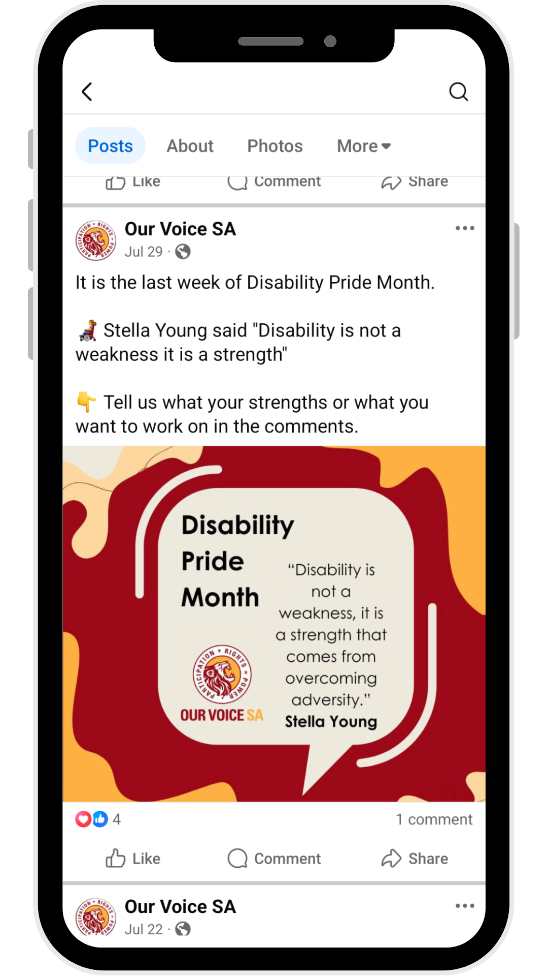
Facebook
Notes:
Facebook: Groups, Events, Peer support
In addition to posting photos, information, videos and stories, people can also connect through groups (private and public) and events
On the image to the left, we have circled some post engagement options – like, comment and share
Let’s take a look at Facebook on desktop and have a look at posts and engagement options

Slide 12
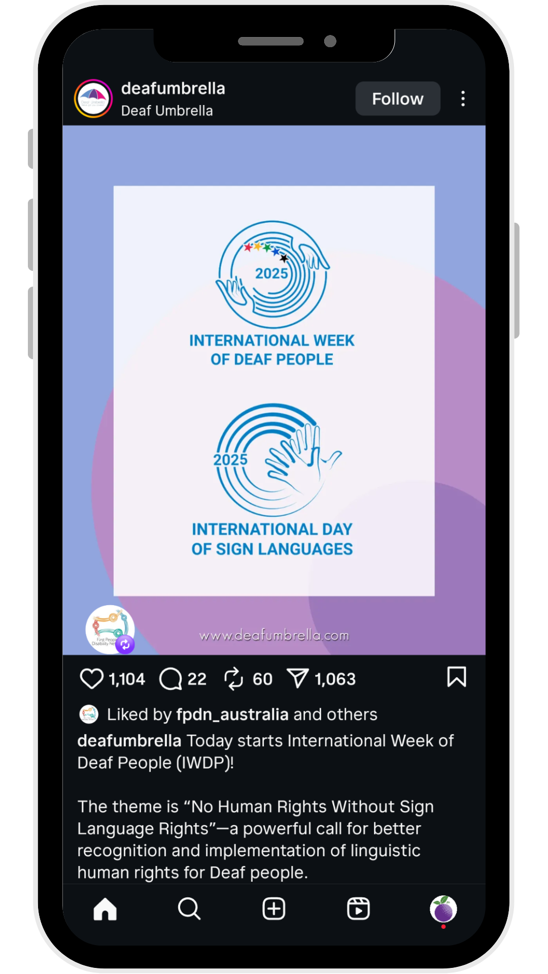
Instagram
Notes:
On Instagram, it’s common to share photos, reels (videos) and stories
Just like Facebook, you can engagement with content in different ways - by liking, by commenting, reposting and sharing
We have circled the engagement options on the image on the left
Let’s take a look at Instagram on desktop and have a look at posts and engagement options

Slide 13
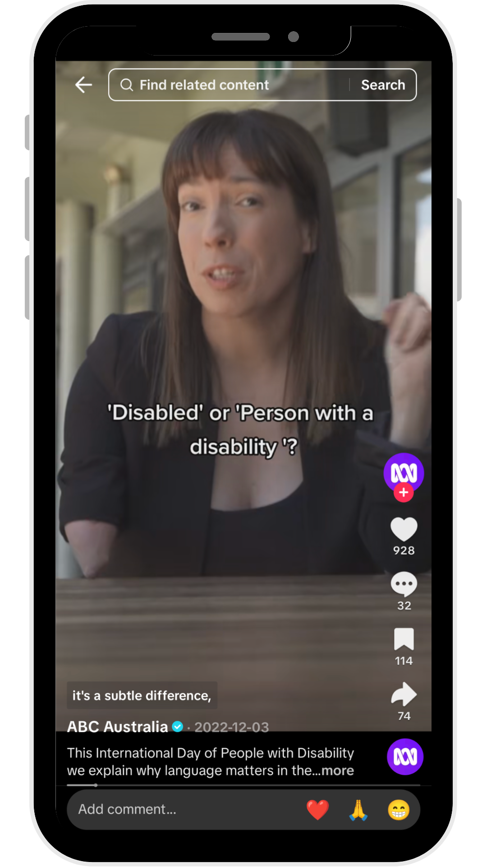
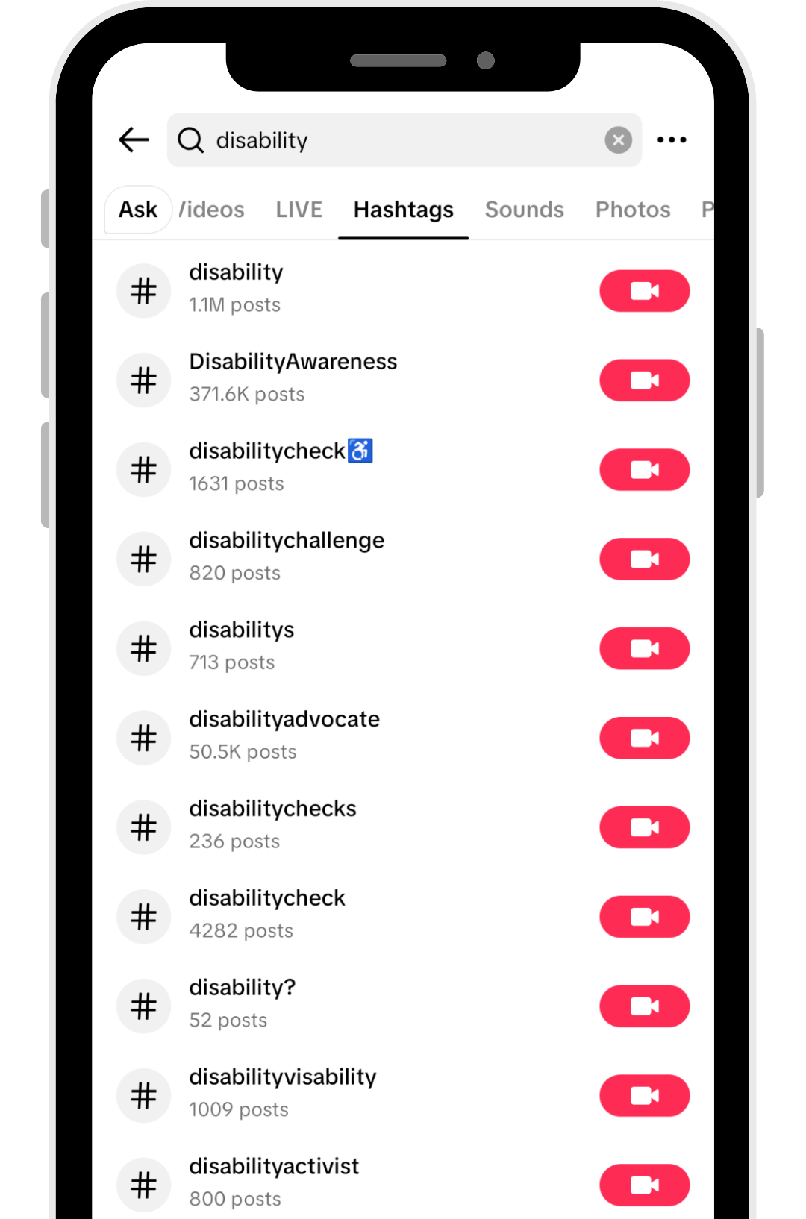
TikTok
Notes:
On TikTok, people commonly share short videos, and sometimes photo carousels
You’ll find a lot of trend-driven content on TikTok
Let’s take a look at TikTok on desktop and have a look at posts and engagement options

Slide 14
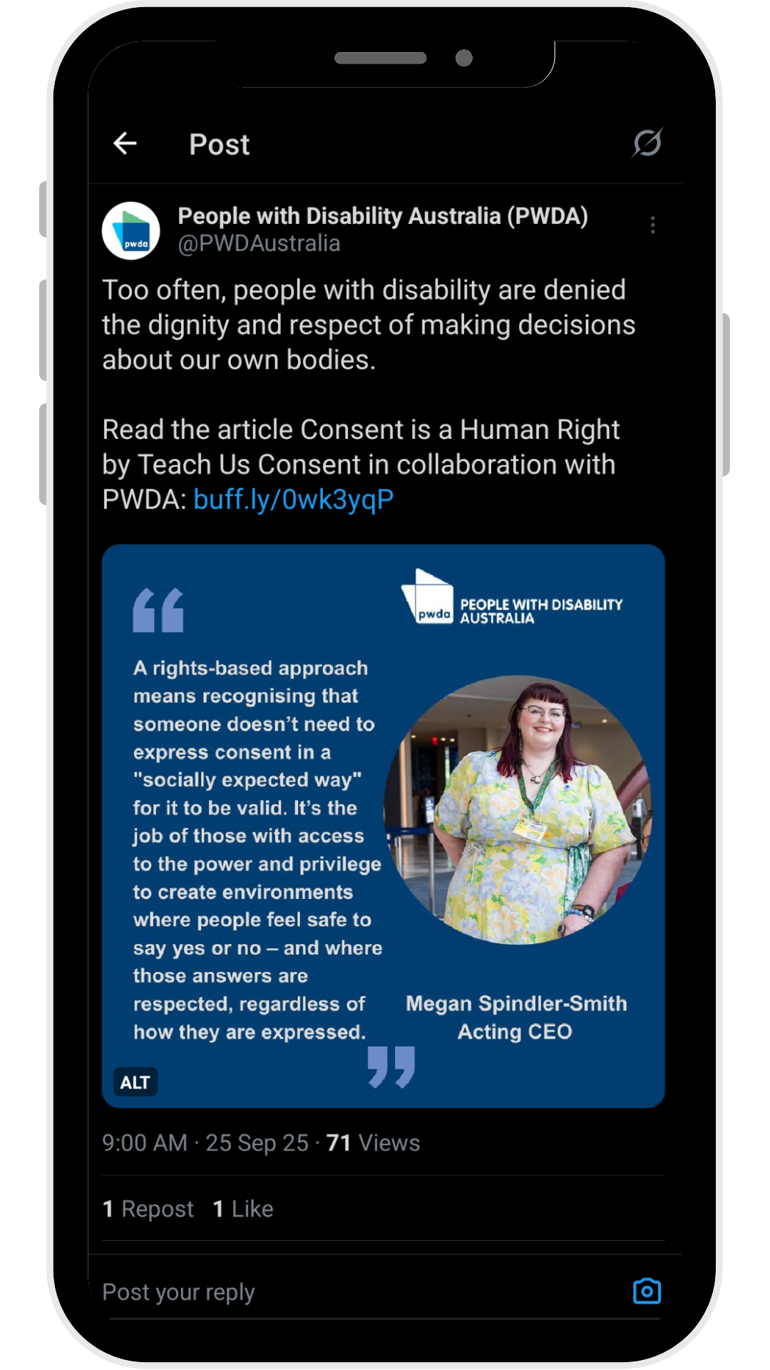
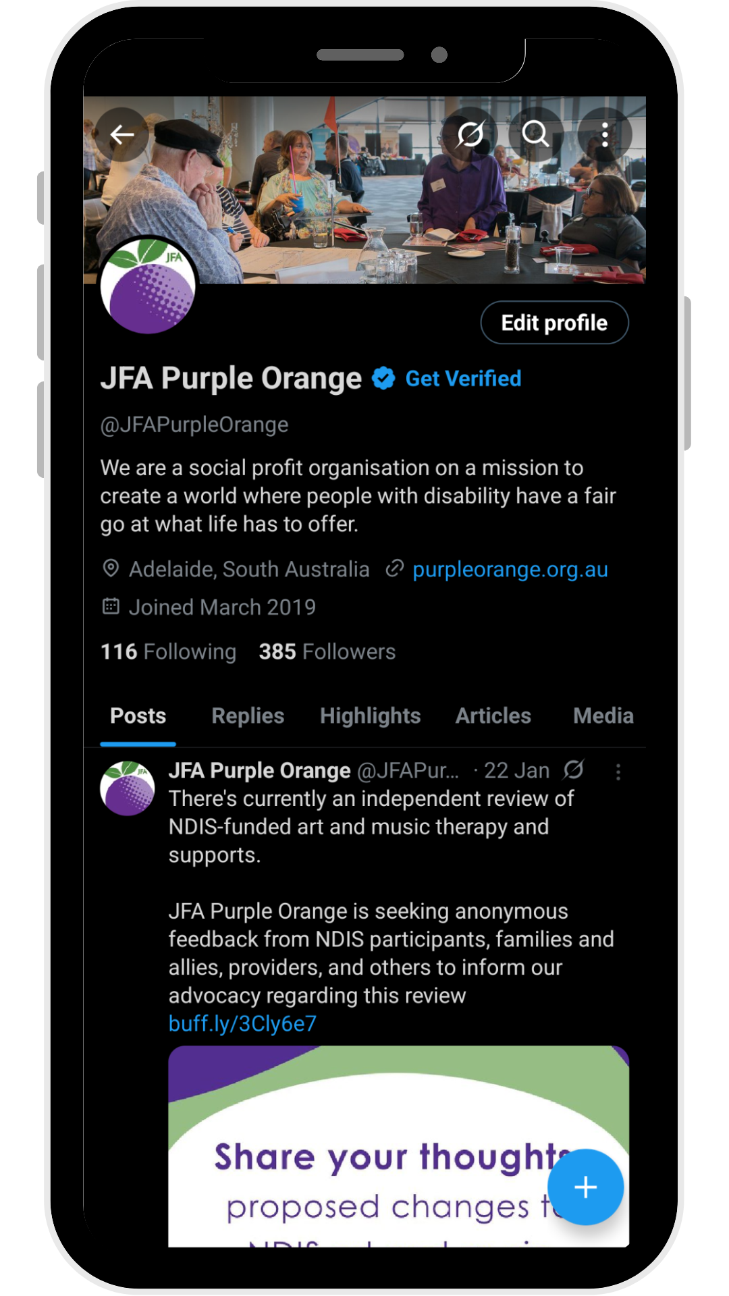
X (Twitter)
Notes:
On X (formerly known as Twitter), people most commonly share short text-based posts sometimes with photos and videos
X is used by political activists, journalists and advocates to share current news and information
Let’s take a look at X on desktop and have a look at posts and engagement options

Slide 15
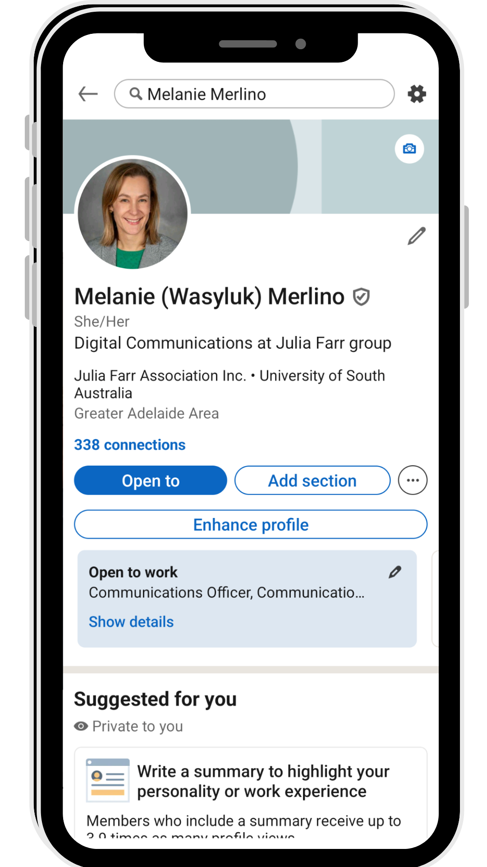
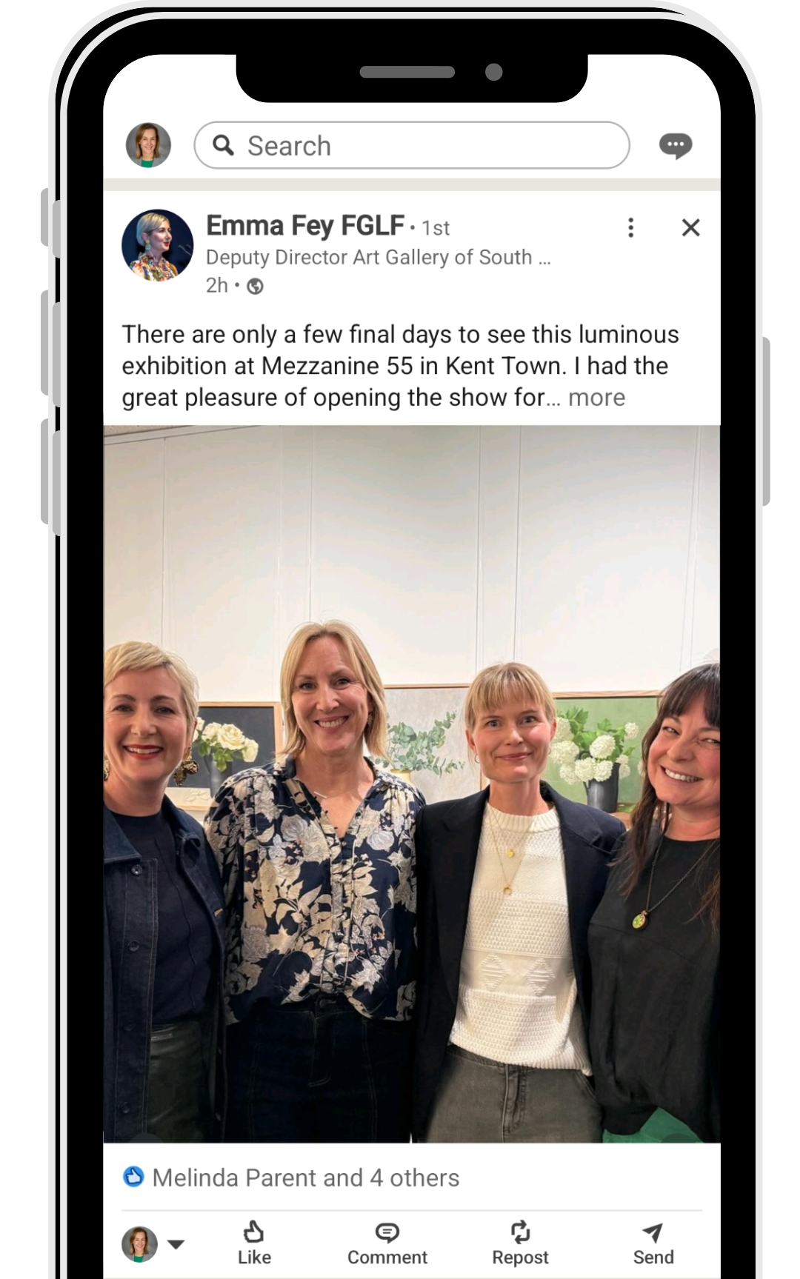
LinkedIn
Notes:
On LinkedIn, people share professional, industry specific content
People use it to connect with other professionals in their industry and they use it to promote the work they do
People tend to use a format that works for what they are posting about – this could be a link, photo, or video
Let’s take a look at LinkedIn on desktop and have a look at posts and engagement options

Slide 16

What is an Algorithm?
You can’t see an algorithm
It is a formula that the social media platform uses to decide what you will see in your feed
How does the algorithm decide what you see?
Content you search
Who you follow
How long you look at certain content
Notes:
You can’t see an algortithm, but they decide what shows up in your feed based on your behaviour, your clicks and your likes.
The emotion in a post, especially videos, can have a big impact on the algorithm - extreme emotions have a bigger impact on reach – anger, sadness, excitement

Slide 17
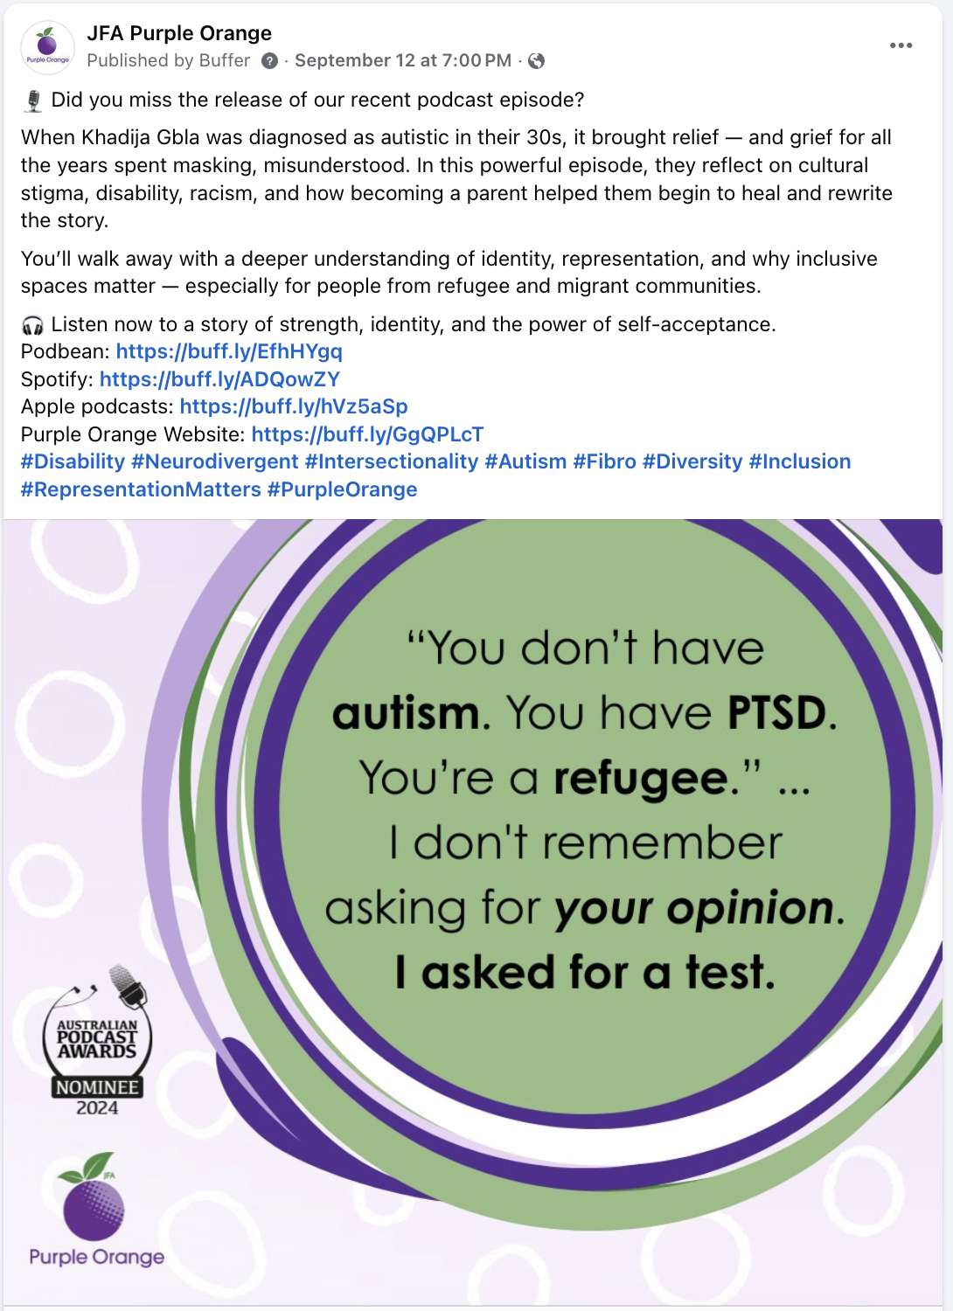

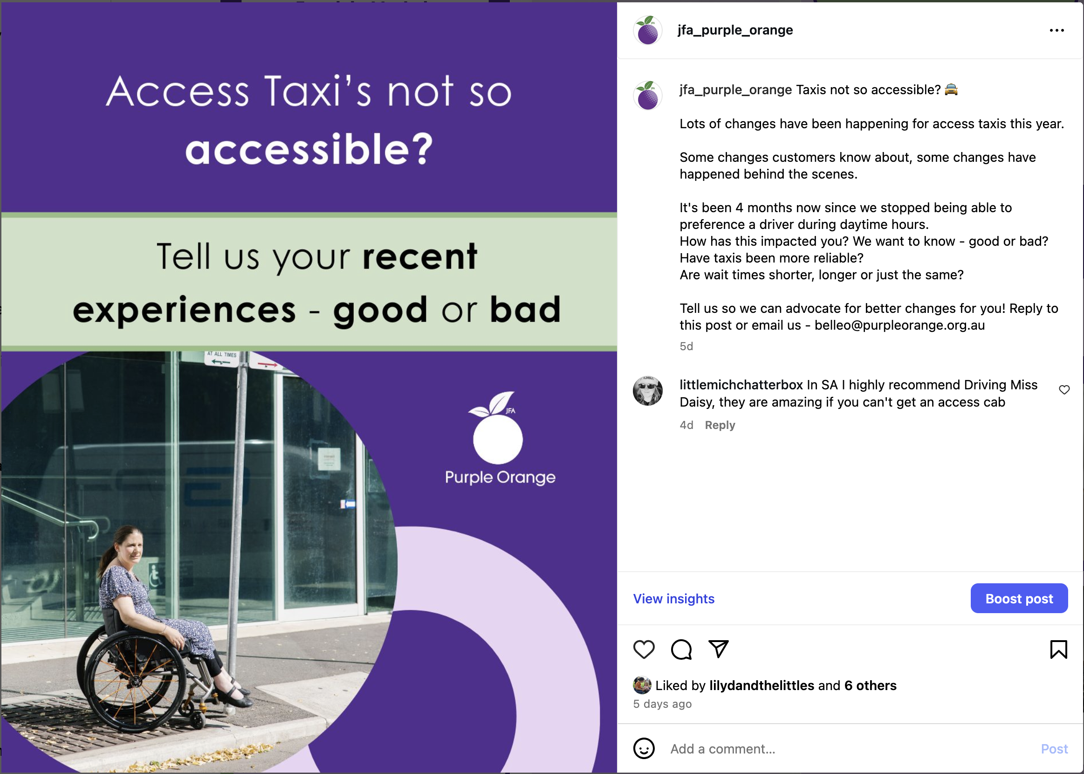
Examples of Social Media Advocacy
Notes:
Here are some examples of Purple Orange’s advocacy posts on different platforms

Slide 18
Question
Would you like to share an example of any advocacy you have done, or that you would like to do?
Notes:
Is there a message or a story you would like to share?
It could be about disability.
It could be about inclusion and how society could be more inclusive.
If not, maybe you would like to think about something that is important to you that you would like to post about on social media.

Slide 19

Staying Safe Online
Notes:
Here is a video which explains how you can stay safe when using social media: https://youtu.be/vPlWDFtP0T0

Slide 20
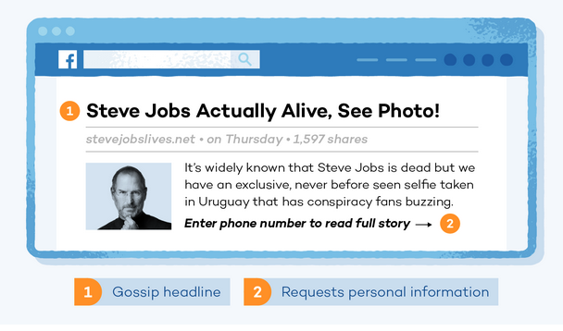
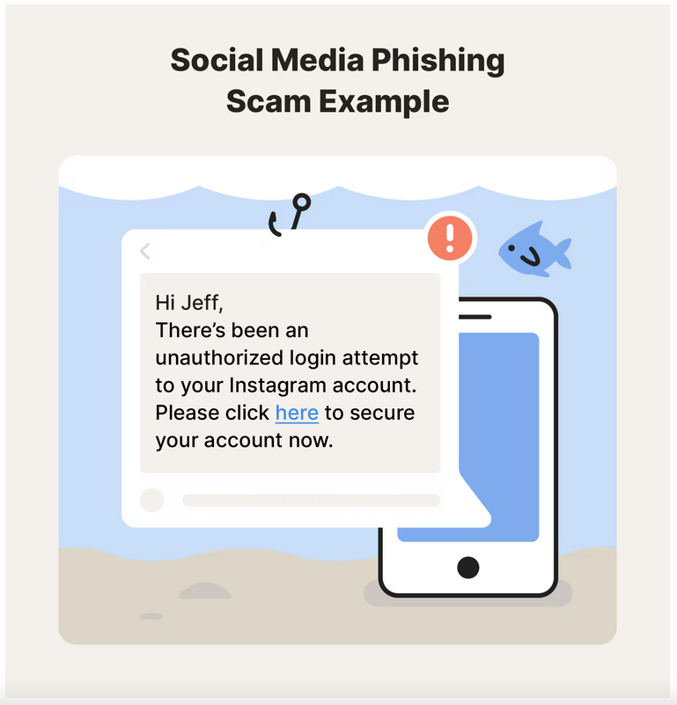

Staying Safe Online
Watch out for scams and trolls (ScamWatch)
Notes:
Here are some examples of posts and messages that could be scams

Slide 21
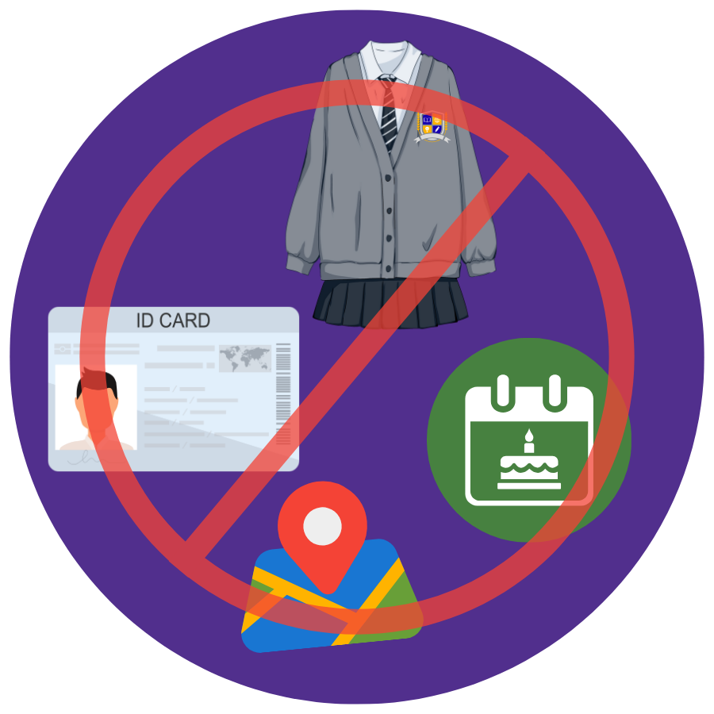
Staying Safe Online
Don’t share personal information:
Birthday
Address or location
ID
New rule: Must be 16+ to sign up (Dec 2025)
Notes:
Avoid sharing personal and identifying information
From 10 December 2025, age-restricted social media platforms will have to take reasonable steps to prevent Australians under the age of 16 from creating or keeping an account.
- Source: https://www.esafety.gov.au/about-us/industry-regulation/social-media-age-restrictions

Slide 22
Staying Safe Online
Choose a secure password including letters, numbers and symbols:
Example 1 (not secure): Taylor1989
Example 2 (secure): Sw33tP0t@To23$
Switch on 2-factor authentication
Decide if you want to limit who sees your content
Notes:
Have a look at these two examples of passwords and note the letters, symbols and numbers they contain
Switching on 2-factor authentication (2-step verification) is a way of keeping your accounts more secure – we will provide links to resources about this
If you want to reach many people, you may decide not to limit your content to just friends

Slide 23

Security: Protect Your Stuff
Notes:
Here is a video which summarises some of the steps you can take to protect yourself when using social media: https://youtu.be/ue1r_63GkIw

Slide 24

Staying Safe Online
Notes:
Here is a video which explains how it is important to know and use the settings on your social media accounts: https://youtu.be/ALJk5416mNM

Slide 25
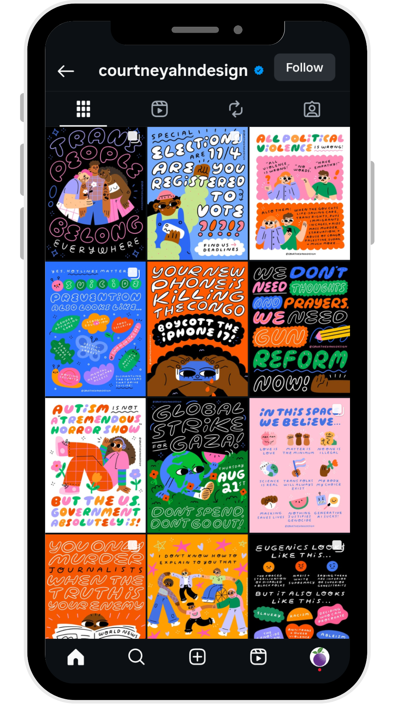
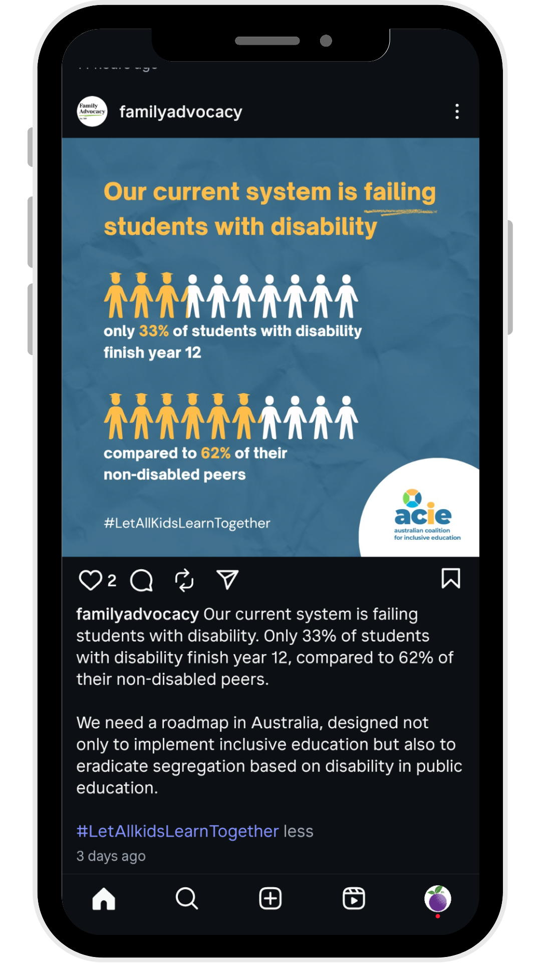
Public vs Private
Share what feels safe for you
Ask: Would I feel OK if a stranger saw this?
Reminder: You don’t have to show your face to advocate.
Learn about the privacy settings for the social media you use
Notes:
Share what feels safe for you: Advocacy doesn’t mean telling everything about your life
Always ask yourself: Would I feel OK if a stranger saw this?
Tip: If you are unsure, run your post by someone you trust.
Remember: you don’t need to show your face to advocate.
Example: Family Advocacy uses infographics and Courtney Ahn Design uses beautiful typographic posts no faces needed.
Learn about the privacy settings on the social media platforms that you choose to use – we have provided links to find more information

Slide 26
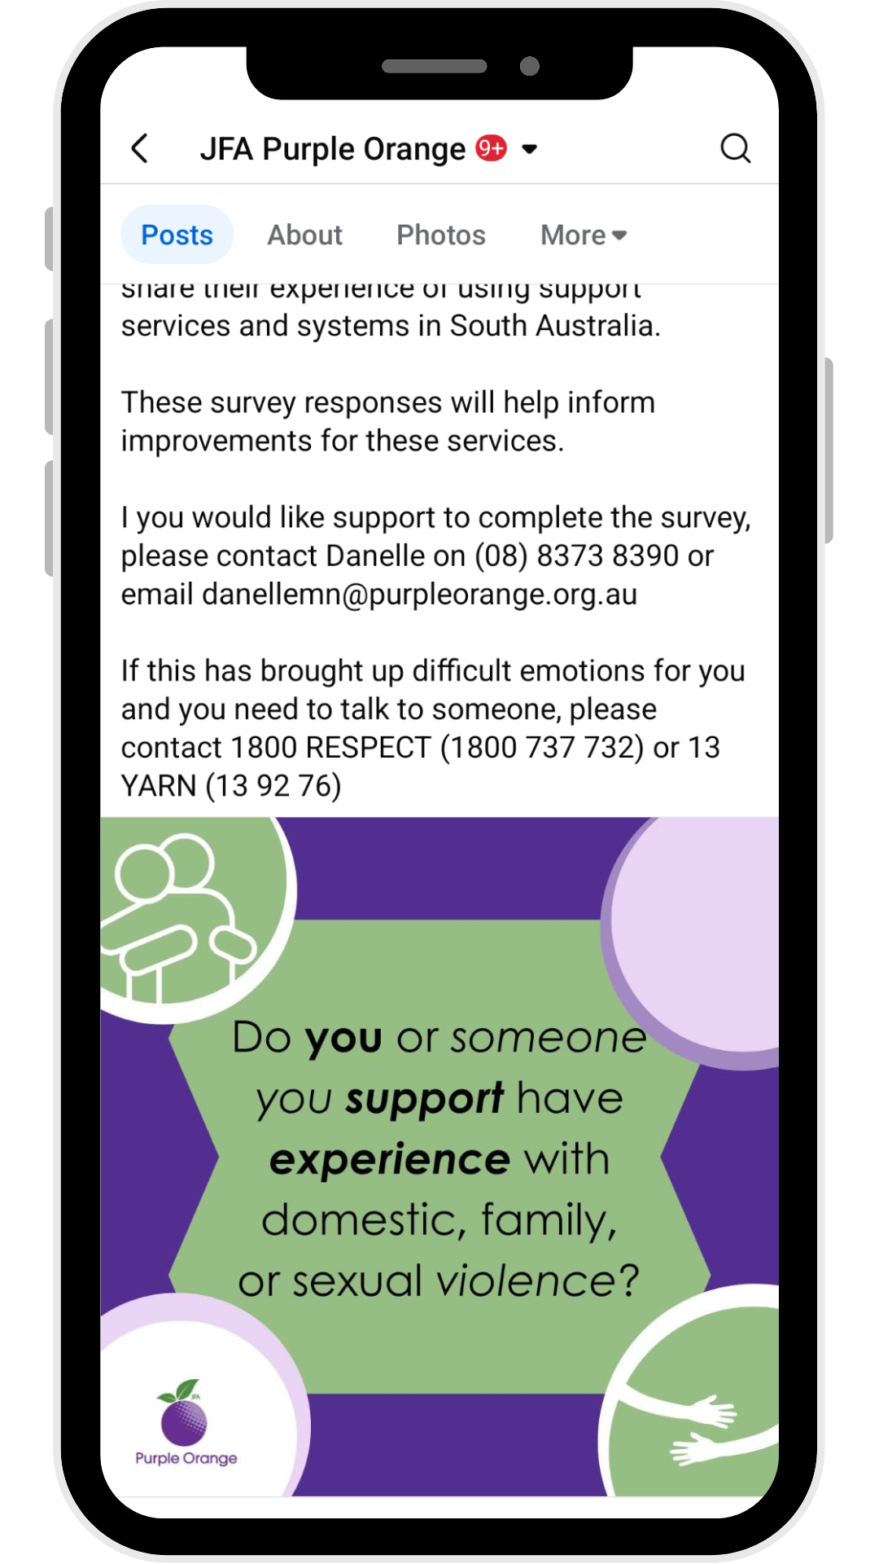
Public vs Private
Don’t post when you are upset or angry
Always ask before posting photos of others
Think before you post – hard to take back
Include a content warning, if appropriate
Notes:
When not to post:
If you are upset, unsure or angry – take time to think.
If it could impact your safety, job or housing.
If it involves others who have not agreed to be included.
Remember that once you post something, it’s hard to take back – we will have a look in the following slides how to edit or delete posts
If your post will feature another person, always ask for their permission to be included
If your content is about a sensitive topic, include a content warning (could use the words “trigger warning”) – see the example post we have included

Slide 27

Public vs Private
If something goes wrong:
Edit or delete
Screenshot abuse
Ask for help
Report it (eSafety Commissioner, Australian Cyber Security Centre)
Notes:
Sometimes when you post, you might accidentally post something that you didn’t mean to
There are things you can do when this happens
You can edit or delete a post (we will show you what to look for when editing or deleting posts on social media)
You can take a screenshot of abuse which will help you to report it – make sure you know how to take a screenshot on your device
Ask someone you trust to help you
Report it – you can report abuse to the eSafety Commissioner and you can report cyber crime to the Australian Cyber Security Centre

Slide 28
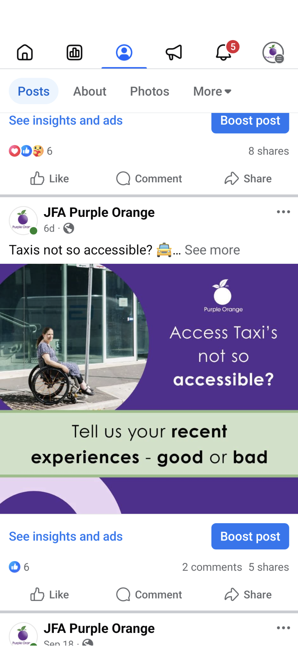
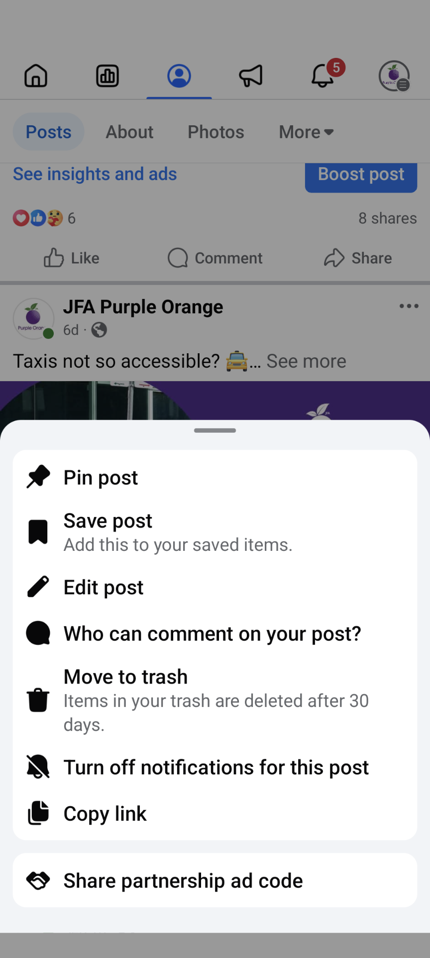
Edit or delete on Facebook
Notes:
When editing or deleting posts on Facebook, look for three horizontal dots – these will reveal options to edit or delete the post
Please be aware that people may see the post before you have a chance to edit or delete it

Slide 29
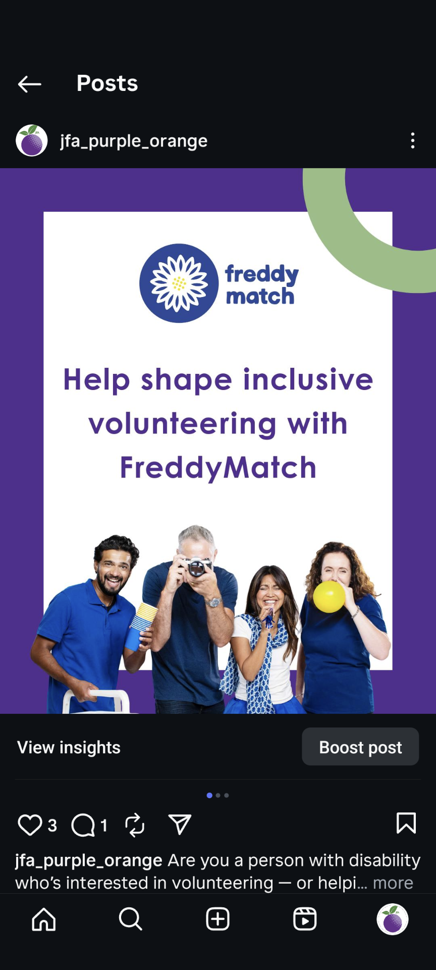
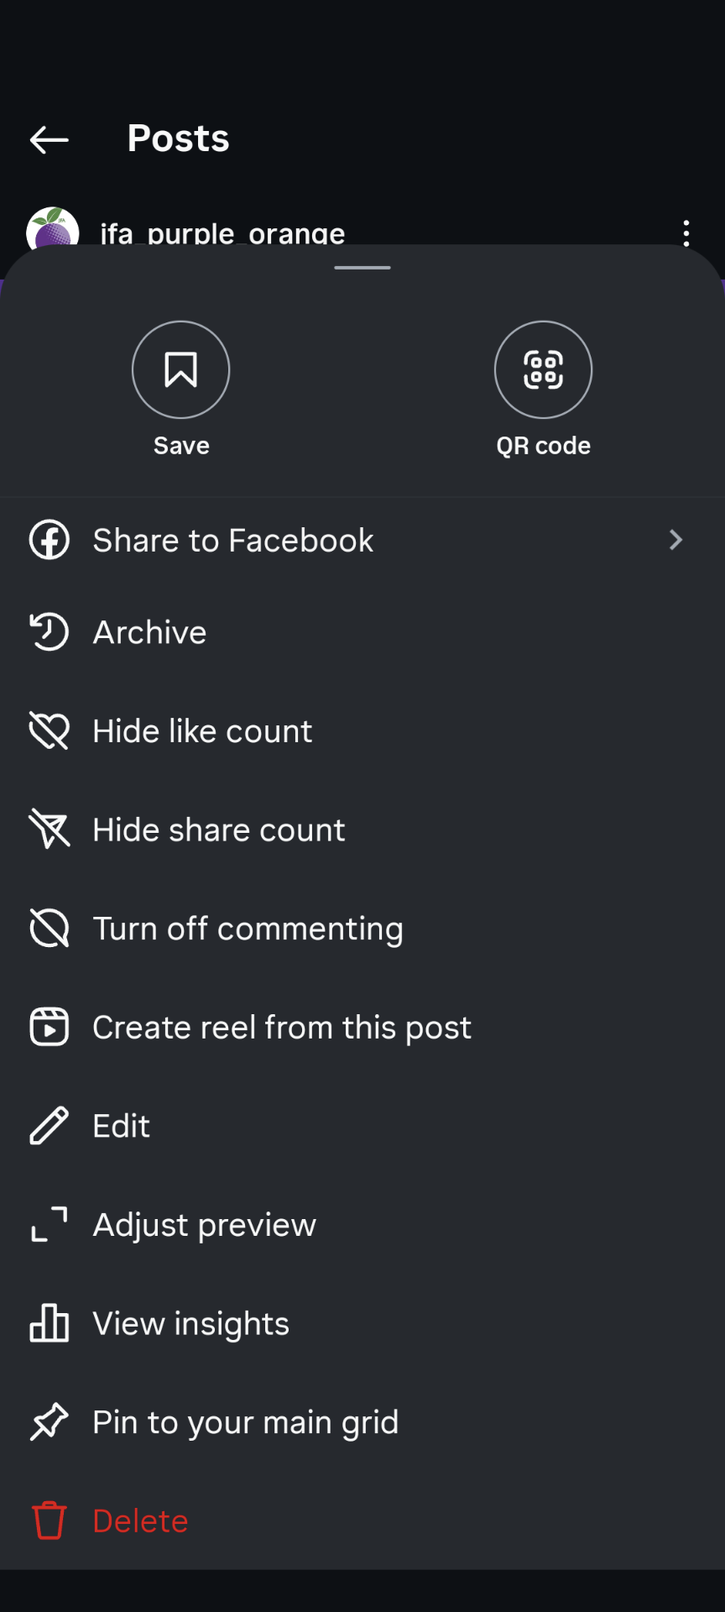
Edit or delete on Instagram
Notes:
When editing or deleting posts on Instagram, look for the vertical ellipsis (three dots on top of each other) – these will reveal options to edit or delete the post
Please be aware that people may see the post before you have a chance to edit or delete it

Slide 30
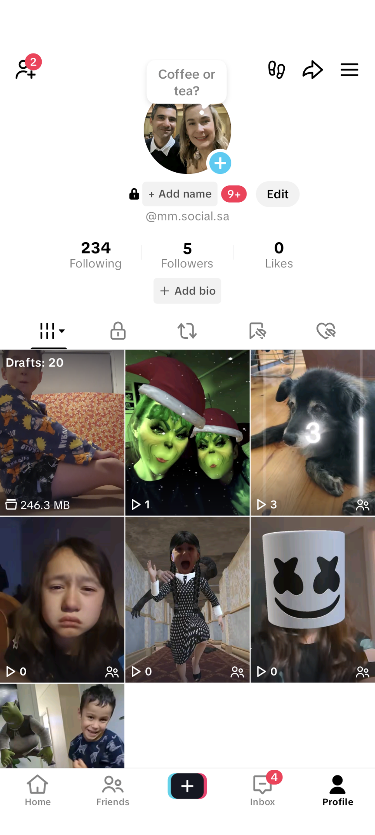
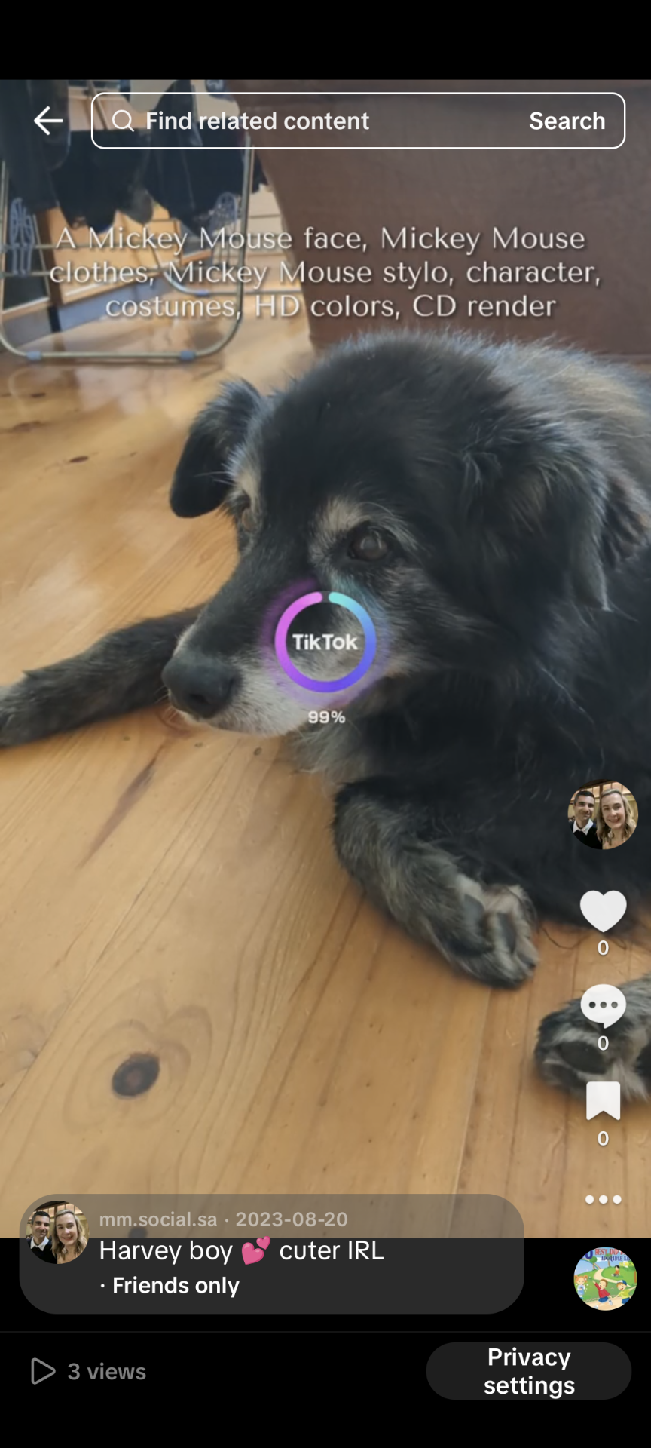
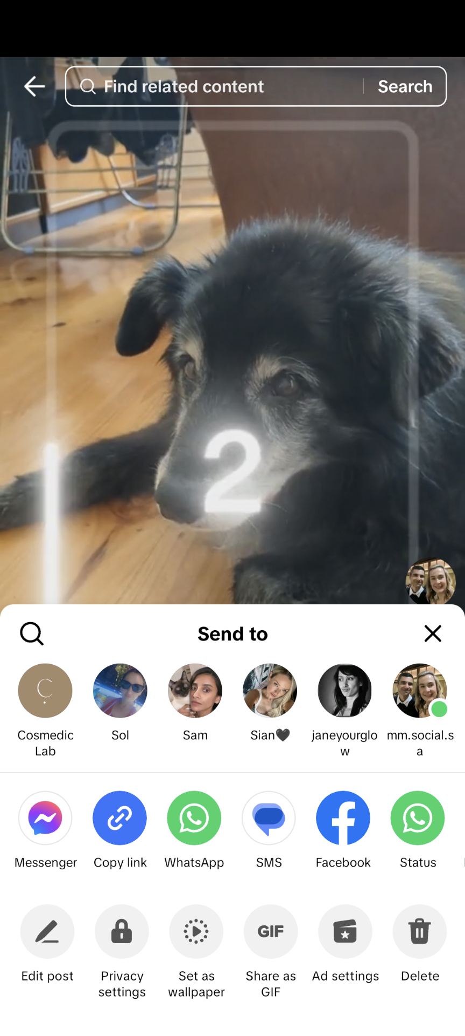
Edit or delete on TikTok
Notes:
When editing or deleting posts on TikTok, look for the three horizontal dots – these will reveal options to edit or delete the post
Please be aware that people may see the post before you have a chance to edit or delete it

Slide 31
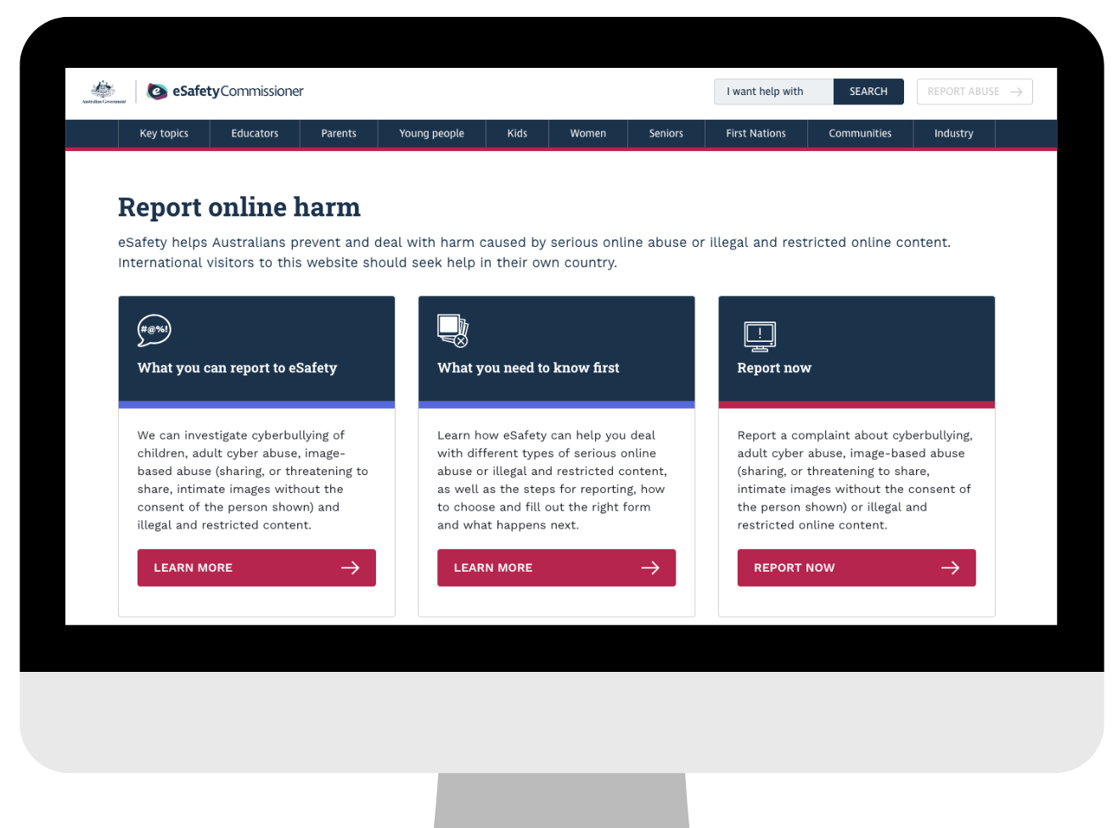
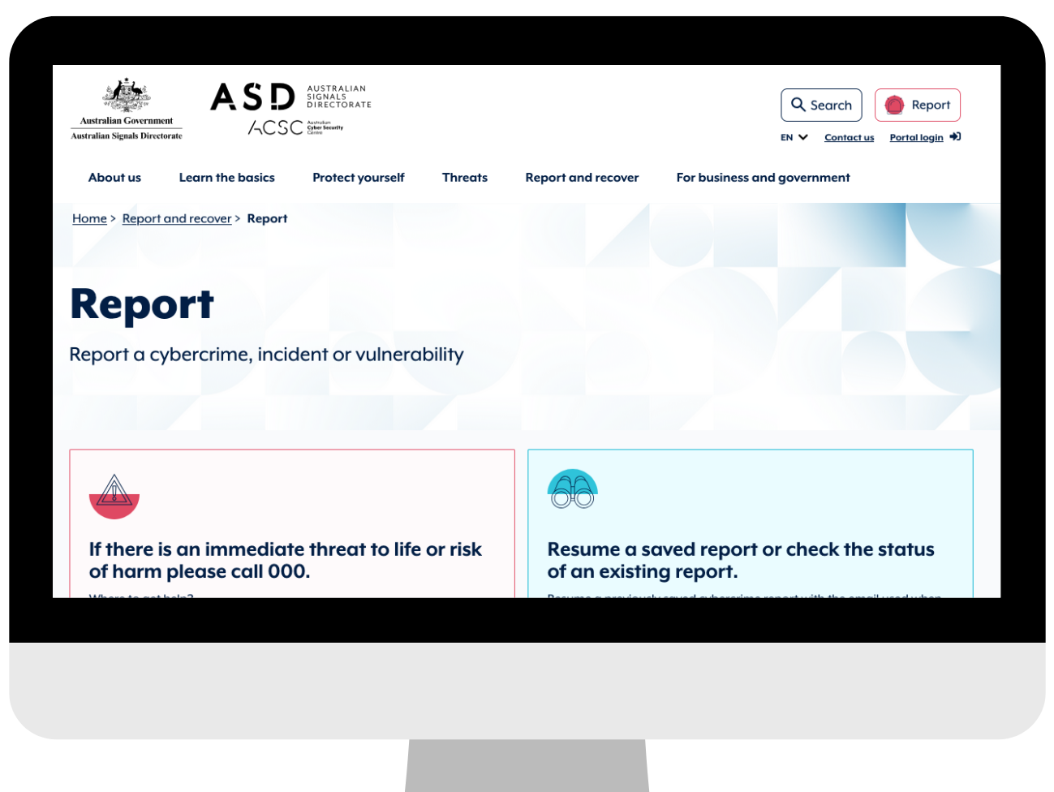
Report abuse or illegal content
Report abuse to the eSafety Commissioner
Report cyber crime to the Australian Cyber Security Centre)
Notes:
Report abuse and online harm to the eSafety Commissioner
Report cyber crime to the Australian Cyber Security Centre
We will include links in our resources

Slide 32
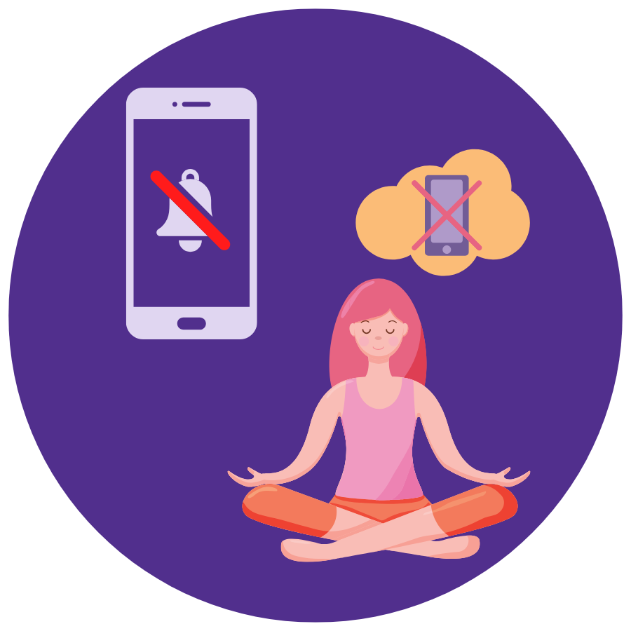
Question
Is there anything you like to do if you start to feel overwhelmed or stressed out on social media?
Notes:
The next thing we’re going to consider are the things you can do to stop yourself from feeling overwhelmed by social media.
You could find yourself feeling overwhelmed by notifications, by the types of content you see in your feed, or even by advertising that doesn’t match your interests.
Have you ever found yourself feeling stressed by social media? And if you have, would you like to share what you do to manage that feeling?

Slide 33
Managing Overwhelm
Turn off notifications
Use ”quiet mode” or scheduled downtime
Mute or block people or accounts that are overwhelming
Notes:
Social media should be useful, not stressful.
If you need time out, you can turn off your notifications – we will show you what to look for when you change these in settings

Slide 34
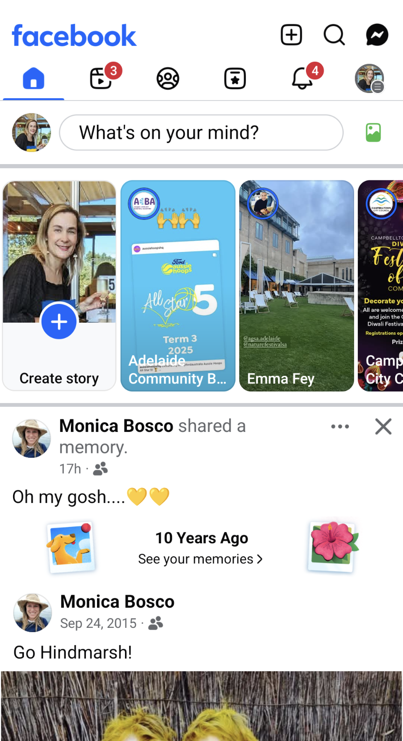
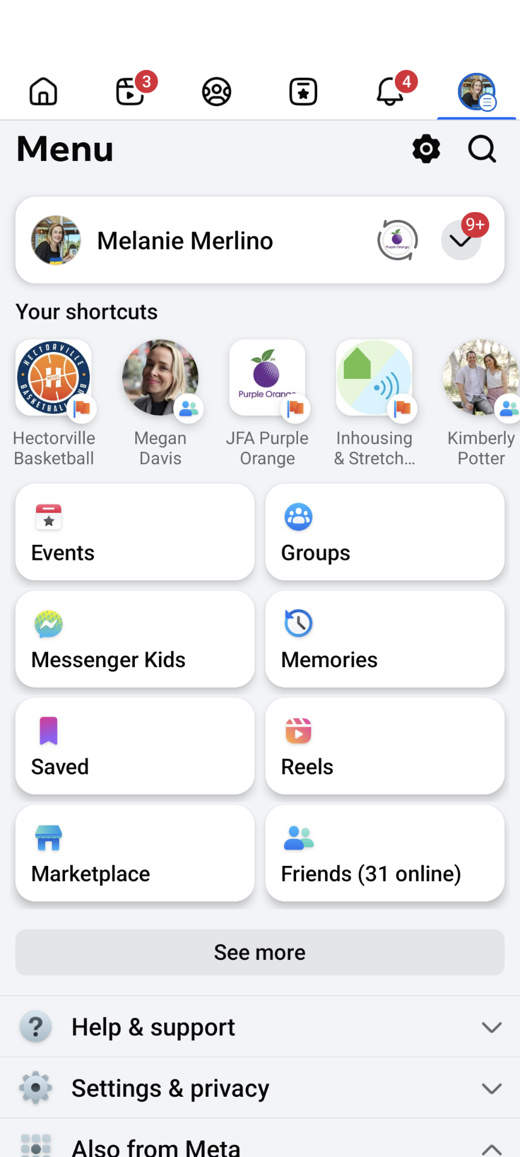
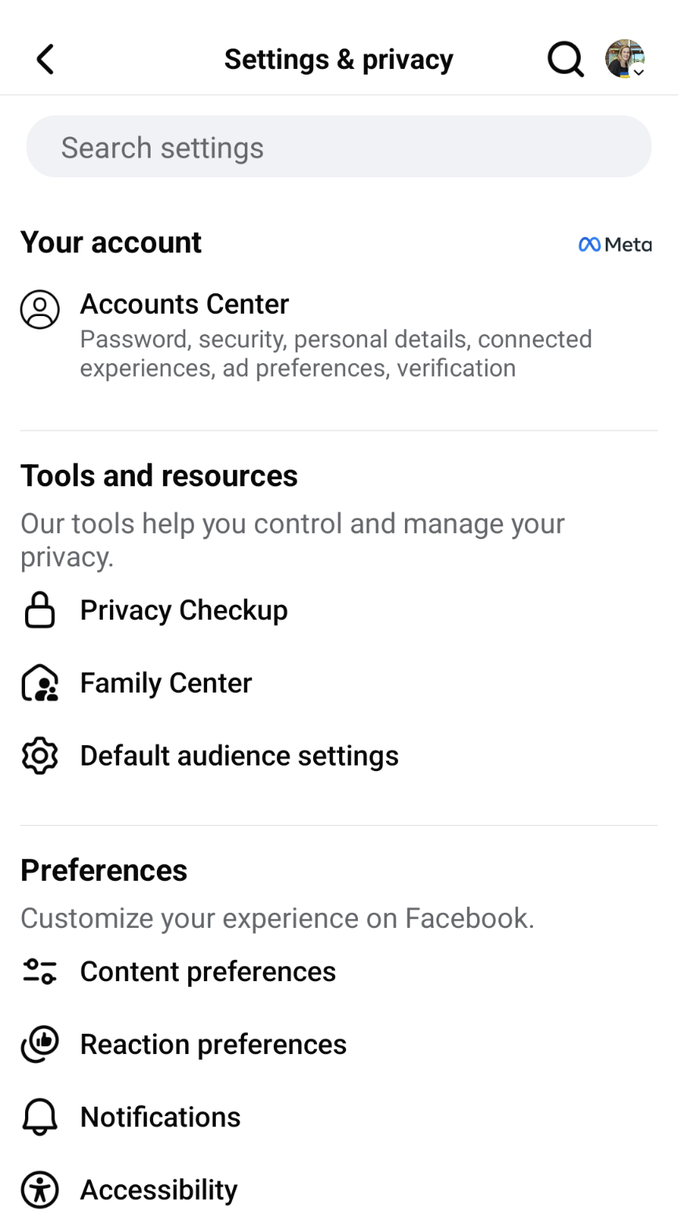
Turn off notifications
Notes:
It’s common to use the cog icon to indicate settings – look for this when you want to change your notifications settings, or update your privacy settings and more

Slide 35
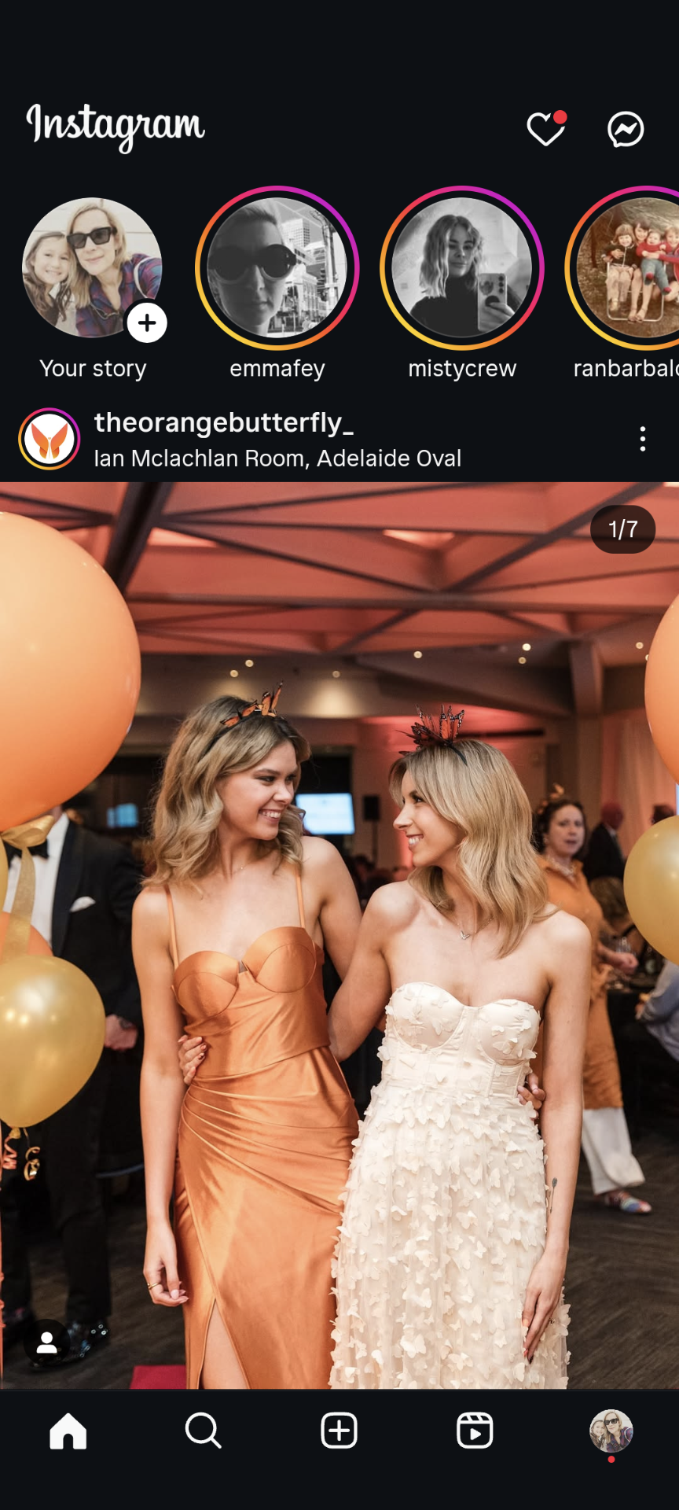
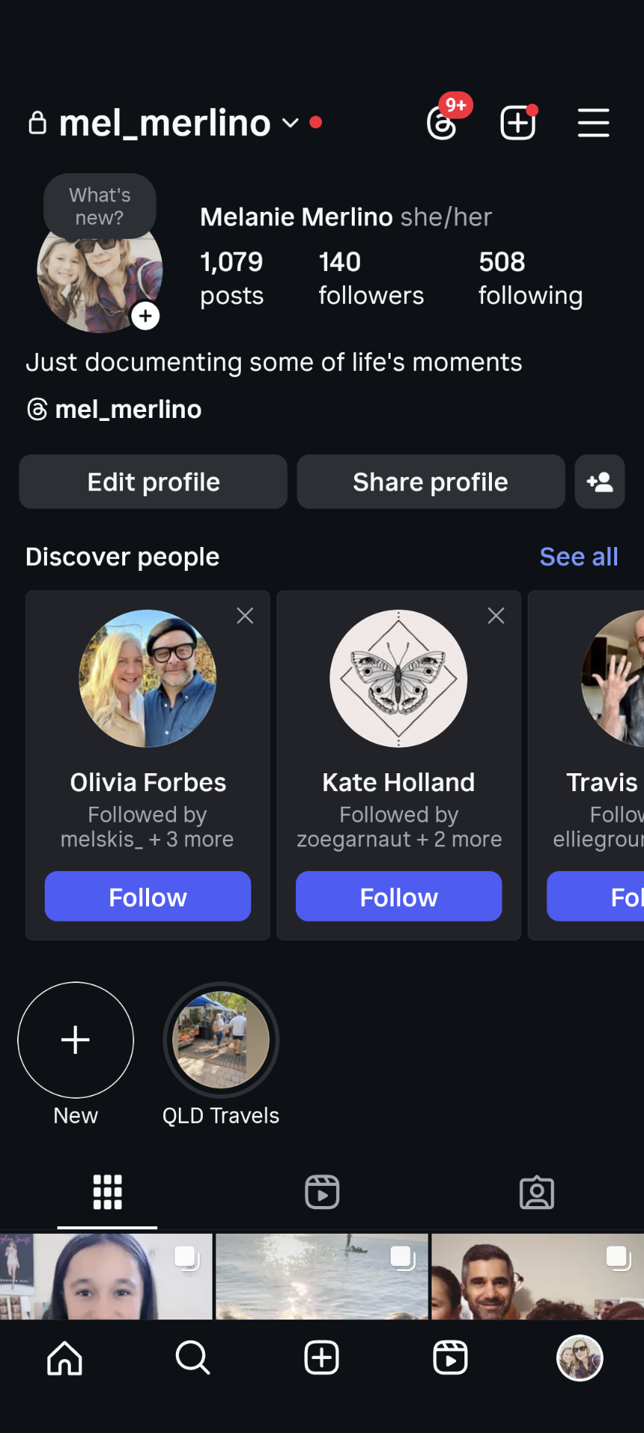
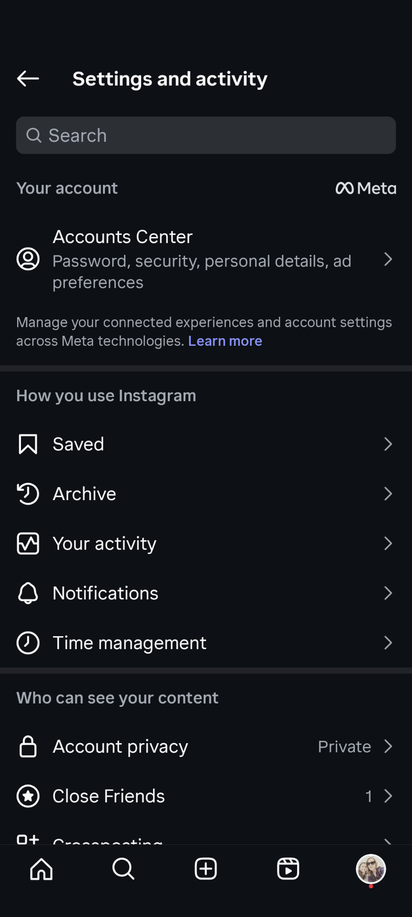
Turn off notifications
Notes:
In Instagram, they use a hamburger menu (three stacked lines) to indicate a menu – look for this when you want to change your notifications settings, or update your privacy settings and more

Slide 36
Managing Overwhelm
Take breaks from posting or scrolling
Reminder: You don’t need to reply to every comment
Get support if you feel sad:
Beyond Blue 1300 224 636 (talk to counsellor)
Lifeline 13 11 14
Notes:
Taking breaks is normal – even advocates step back sometimes.

Slide 37

Accessible and Organised
Use accessibility features:
Captions
Alt text
Plain language
Notes:
Advocacy is stronger when it’s accessible.
There are some things you can do to make your posts and the content you share more accessible

Slide 38
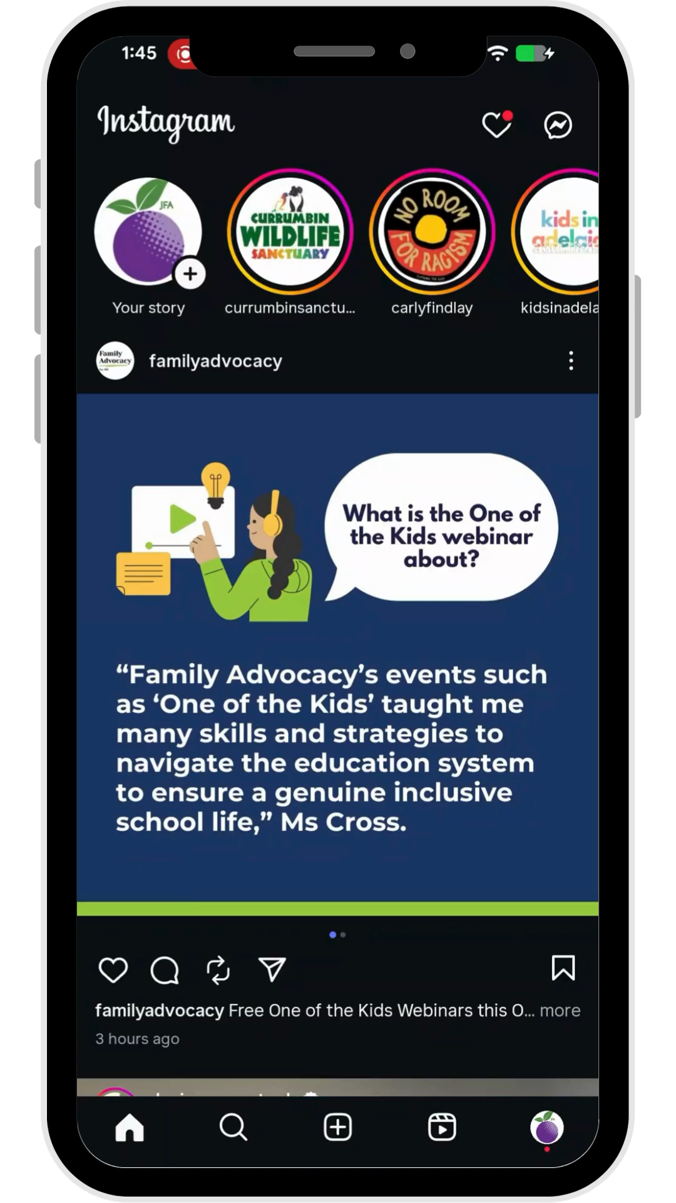
Accessible and Organised
Save and pin posts you like so you can find them
Follow people who help you feel good
Notes:
When you find posts that inspire you or have a message you would like to share, you can save them and pin posts so you
Here is a short video showing how to save your posts

Slide 39
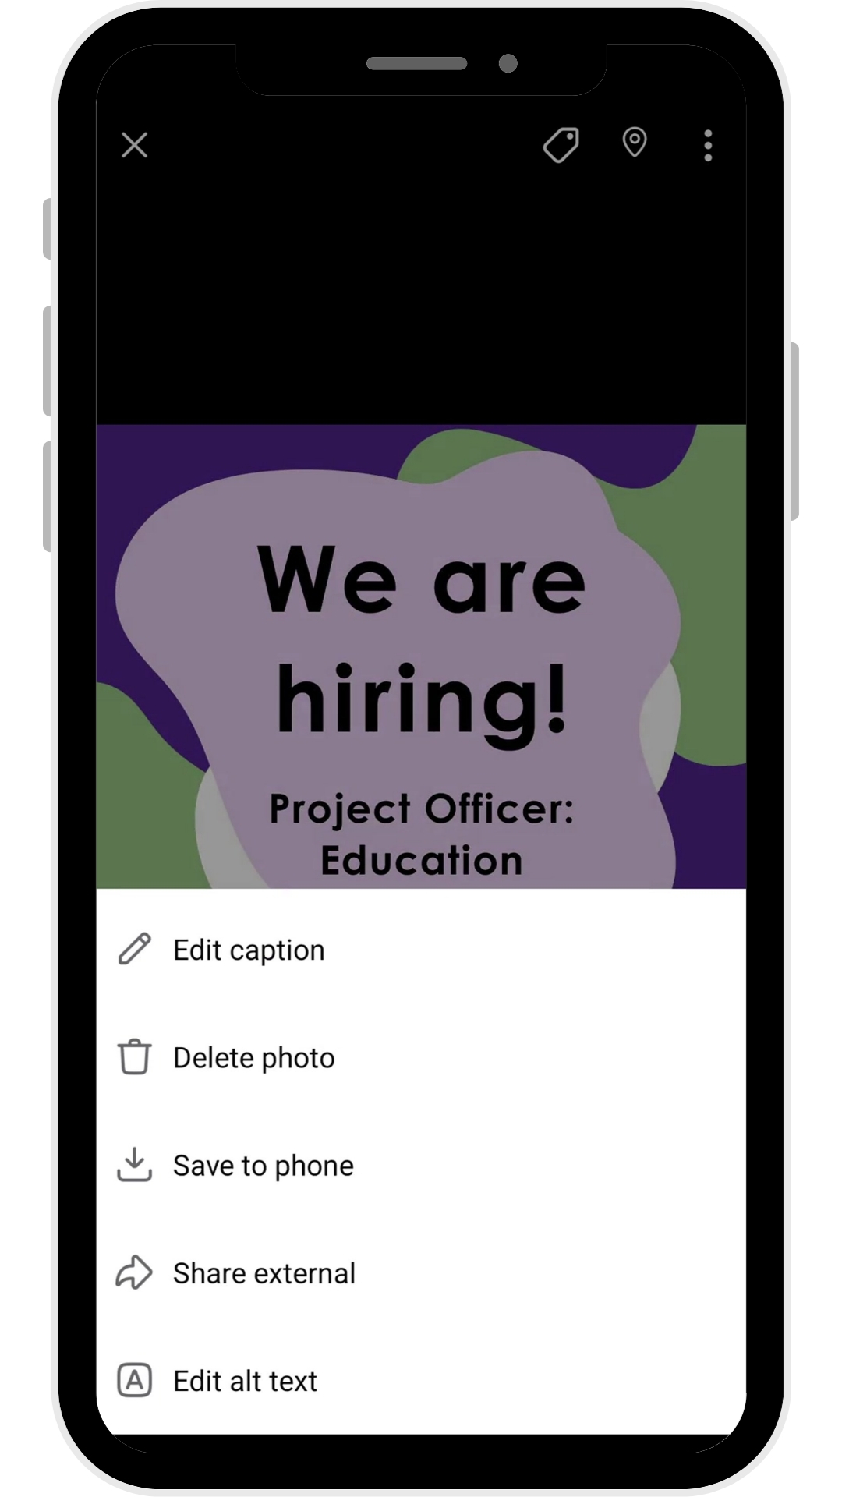
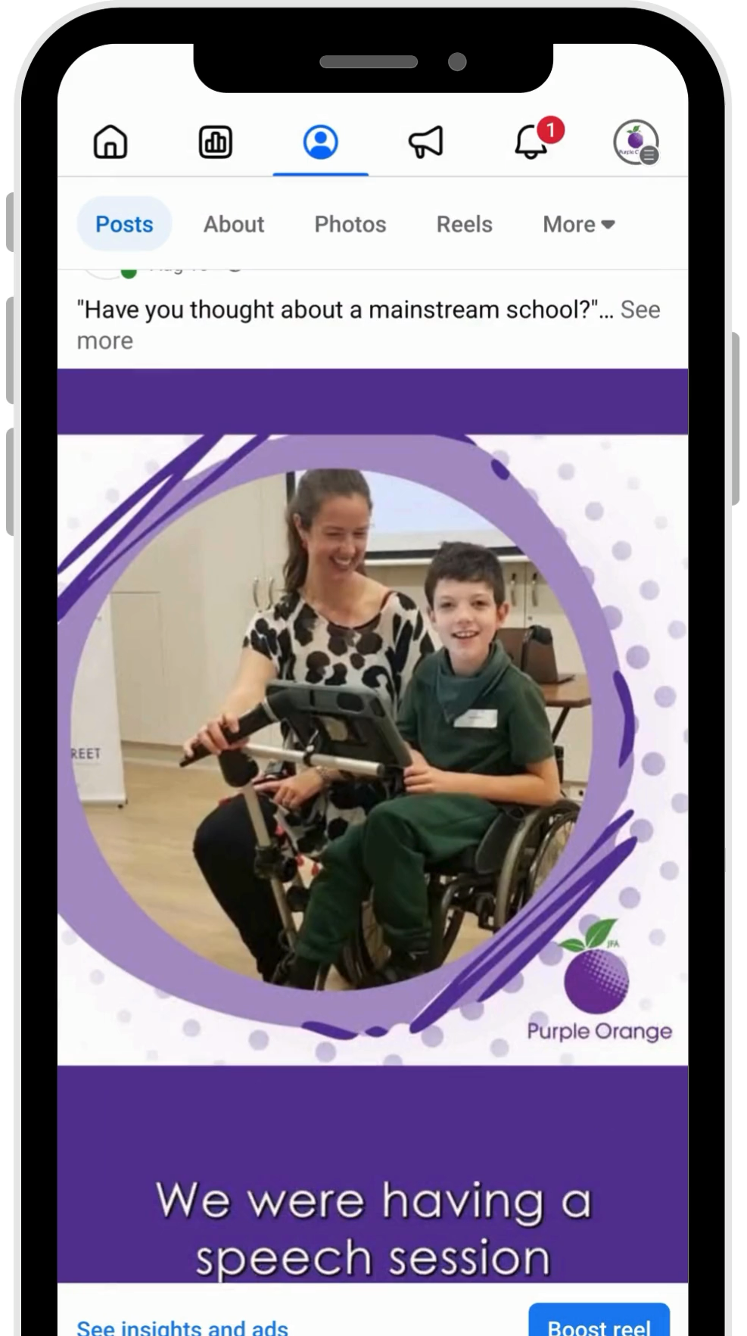

Accessible and Organised
Notes:
Here are some examples of content that use captions, alt text, and plain English

Slide 40
Question
Are there any social media channels that you would like to start using?
Notes:
Now that we have looked at some of the different social media platforms and how they work, are there any that you would like to start using?

Slide 41


Wrap-Up and Next Steps
Key points:
Choose social media that works for you
Share safely
Stay in control
Use accessibility tools
Next workshop: Advocates, Storytelling and Creating Content (Mon 20 October)
Notes:
Reminder: Everyone’s advocacy journey is different.
We encourage you to practice safely and share at their own pace.

Slide 42
Wrap-Up and Next Steps
Fill in quick survey

