Slide 1
Learn to create your own Vox Pop
Workshop Series 2
Part 2: Editing your Vox Pop

Slide 2

Welcome
PRESS RECORD
Acknowledgement of Country
Recognition of disability community
Meet today’s presenter:
Carey Scheer
Housekeeping: mute/unmute, raise your hand to speak, use the chat
Today’s session will be recorded
Notes:
Acknowledgement of Country
JFA Purple Orange acknowledges the Traditional Owners of Country throughout Australia. We work on many Aboriginal lands, including Kaurna Country, where our head office is located. We extend our respect to all Aboriginal peoples on the lands where we work, live, and learn. We are committed to walking together and building relationships grounded in the self-determination of First Nations peoples.
Recognition of the disability community
We recognise that JFA Purple Orange exists to advance the rights of people with disability.
All our work aims to create a more inclusive world where people with disability have access to the same opportunities as everyone else
An introduction to your presenter today – Carey Scheer
We have a live captioner with us today
General information – cameras, muting/unmuting, raise hand to speak, use chat to ask questions, Zoom accessibility features
This session will be recorded to share with participants afterwards
Links to resources will be shared after the session.

Slide 3
Workshop goals
Part One:
Understand what a vox pop is and why people use them
Plan a clear question and ask it with confidence
Learn to film one using just your phone
Get consent the right way
Part Two:
Learn basic editing to shape a short story using VN Video Editor (mobile phone / Iphone app)

Slide 4
Final Vox Pop
Notes:
This is a vox pop I made around the office.
I got a mix of men and women
A mix of ages
I made the intro the leading question
For the outro, I decided to just end with a question that I felt the answers evoked.
I personally do not enjoy being a character in my own films. I am a bit shy. I prefer being more behind the scenes, so I didn’t put myself in here. If I wanted to be more of a character in my material, I could have filmed myself first saying something like, AI seems to be every where these days. I am using it more and more, but I’m not sure if its going to make life better or worse. Let’s see what my colleagues have to say.

Slide 5
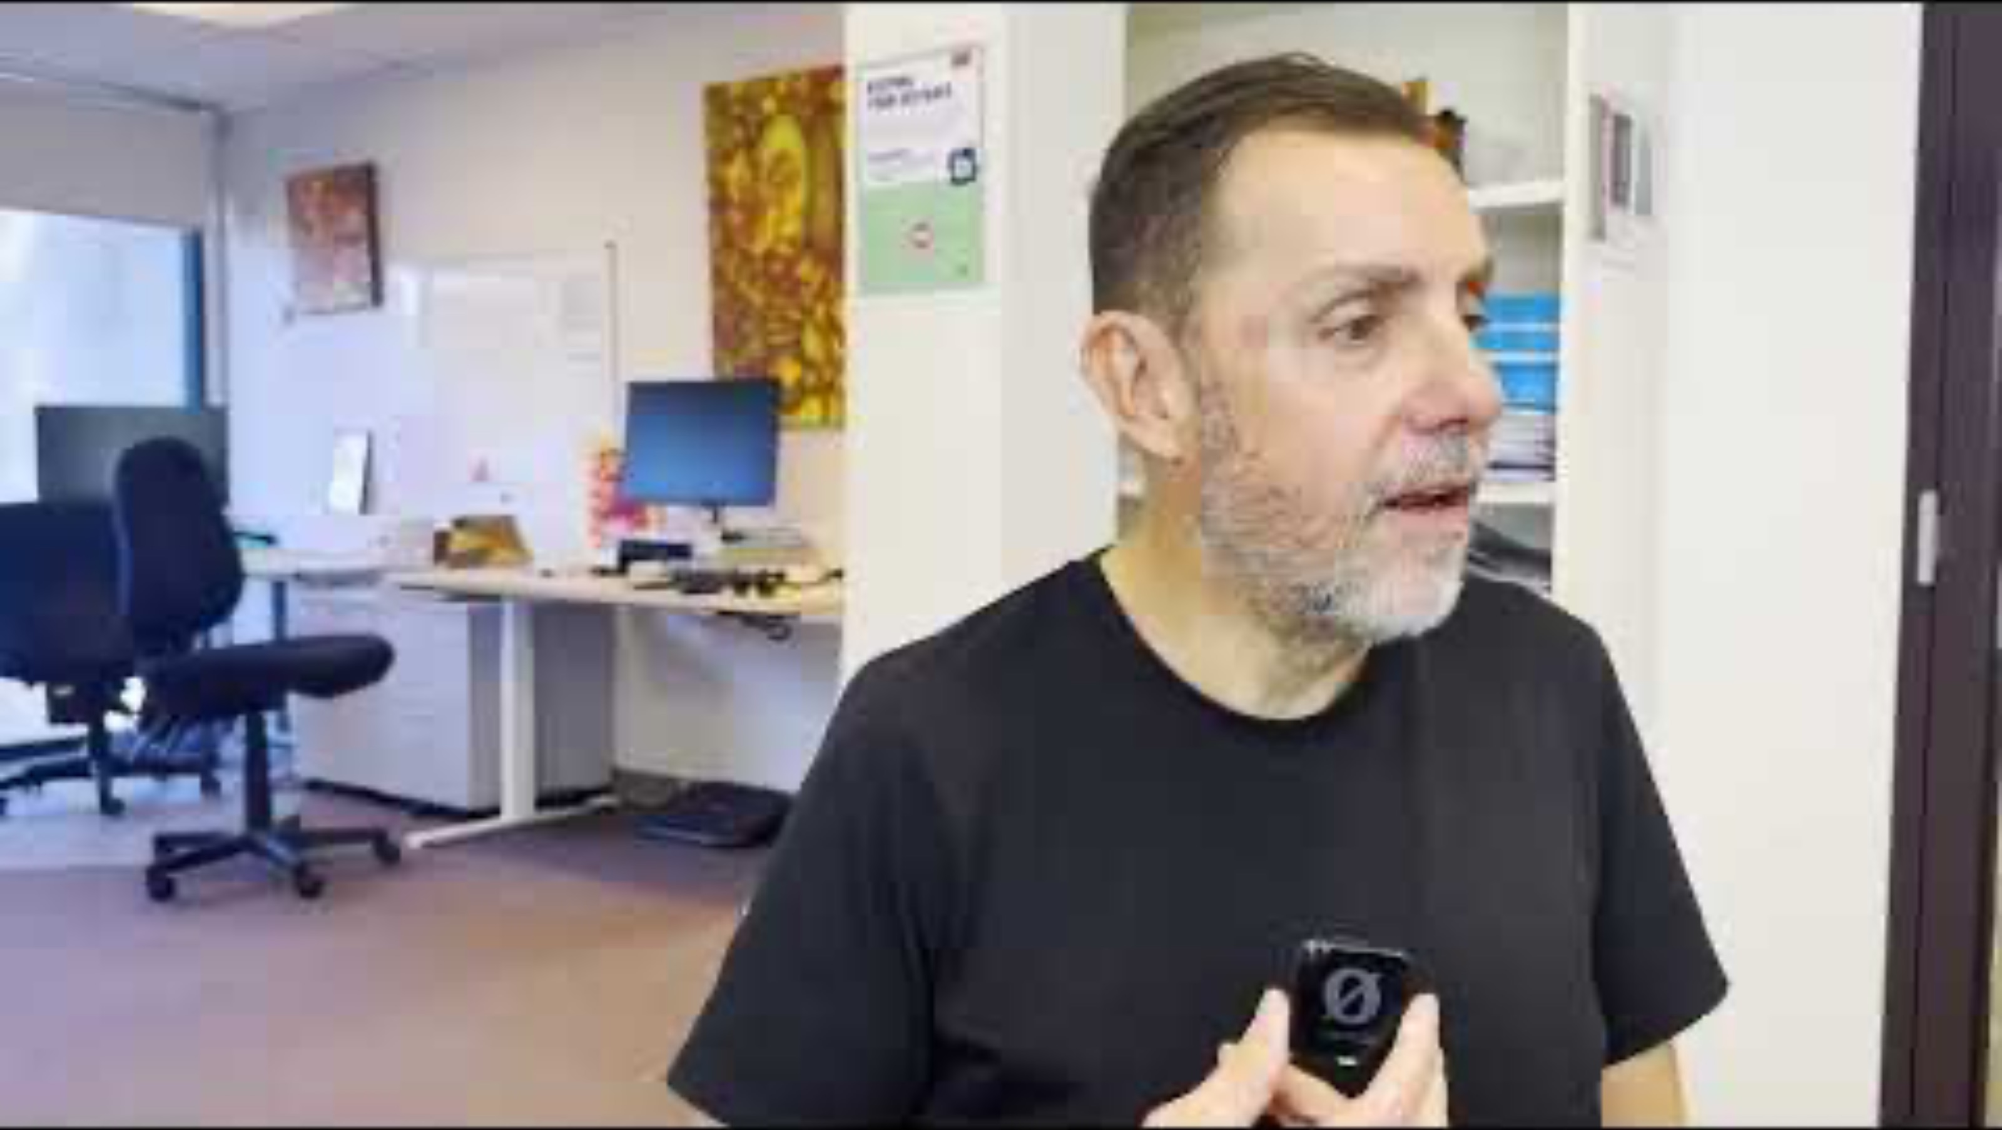
The Raw Interviews: Male # 1
Notes:
I asked the main question. I felt his answer was a little general, and I wanted more. So I asked some more personal follow ups directly related to the original question. These follow up questions evoked a stronger answer.

Slide 6
The Raw Interviews: Female # 1

Slide 7
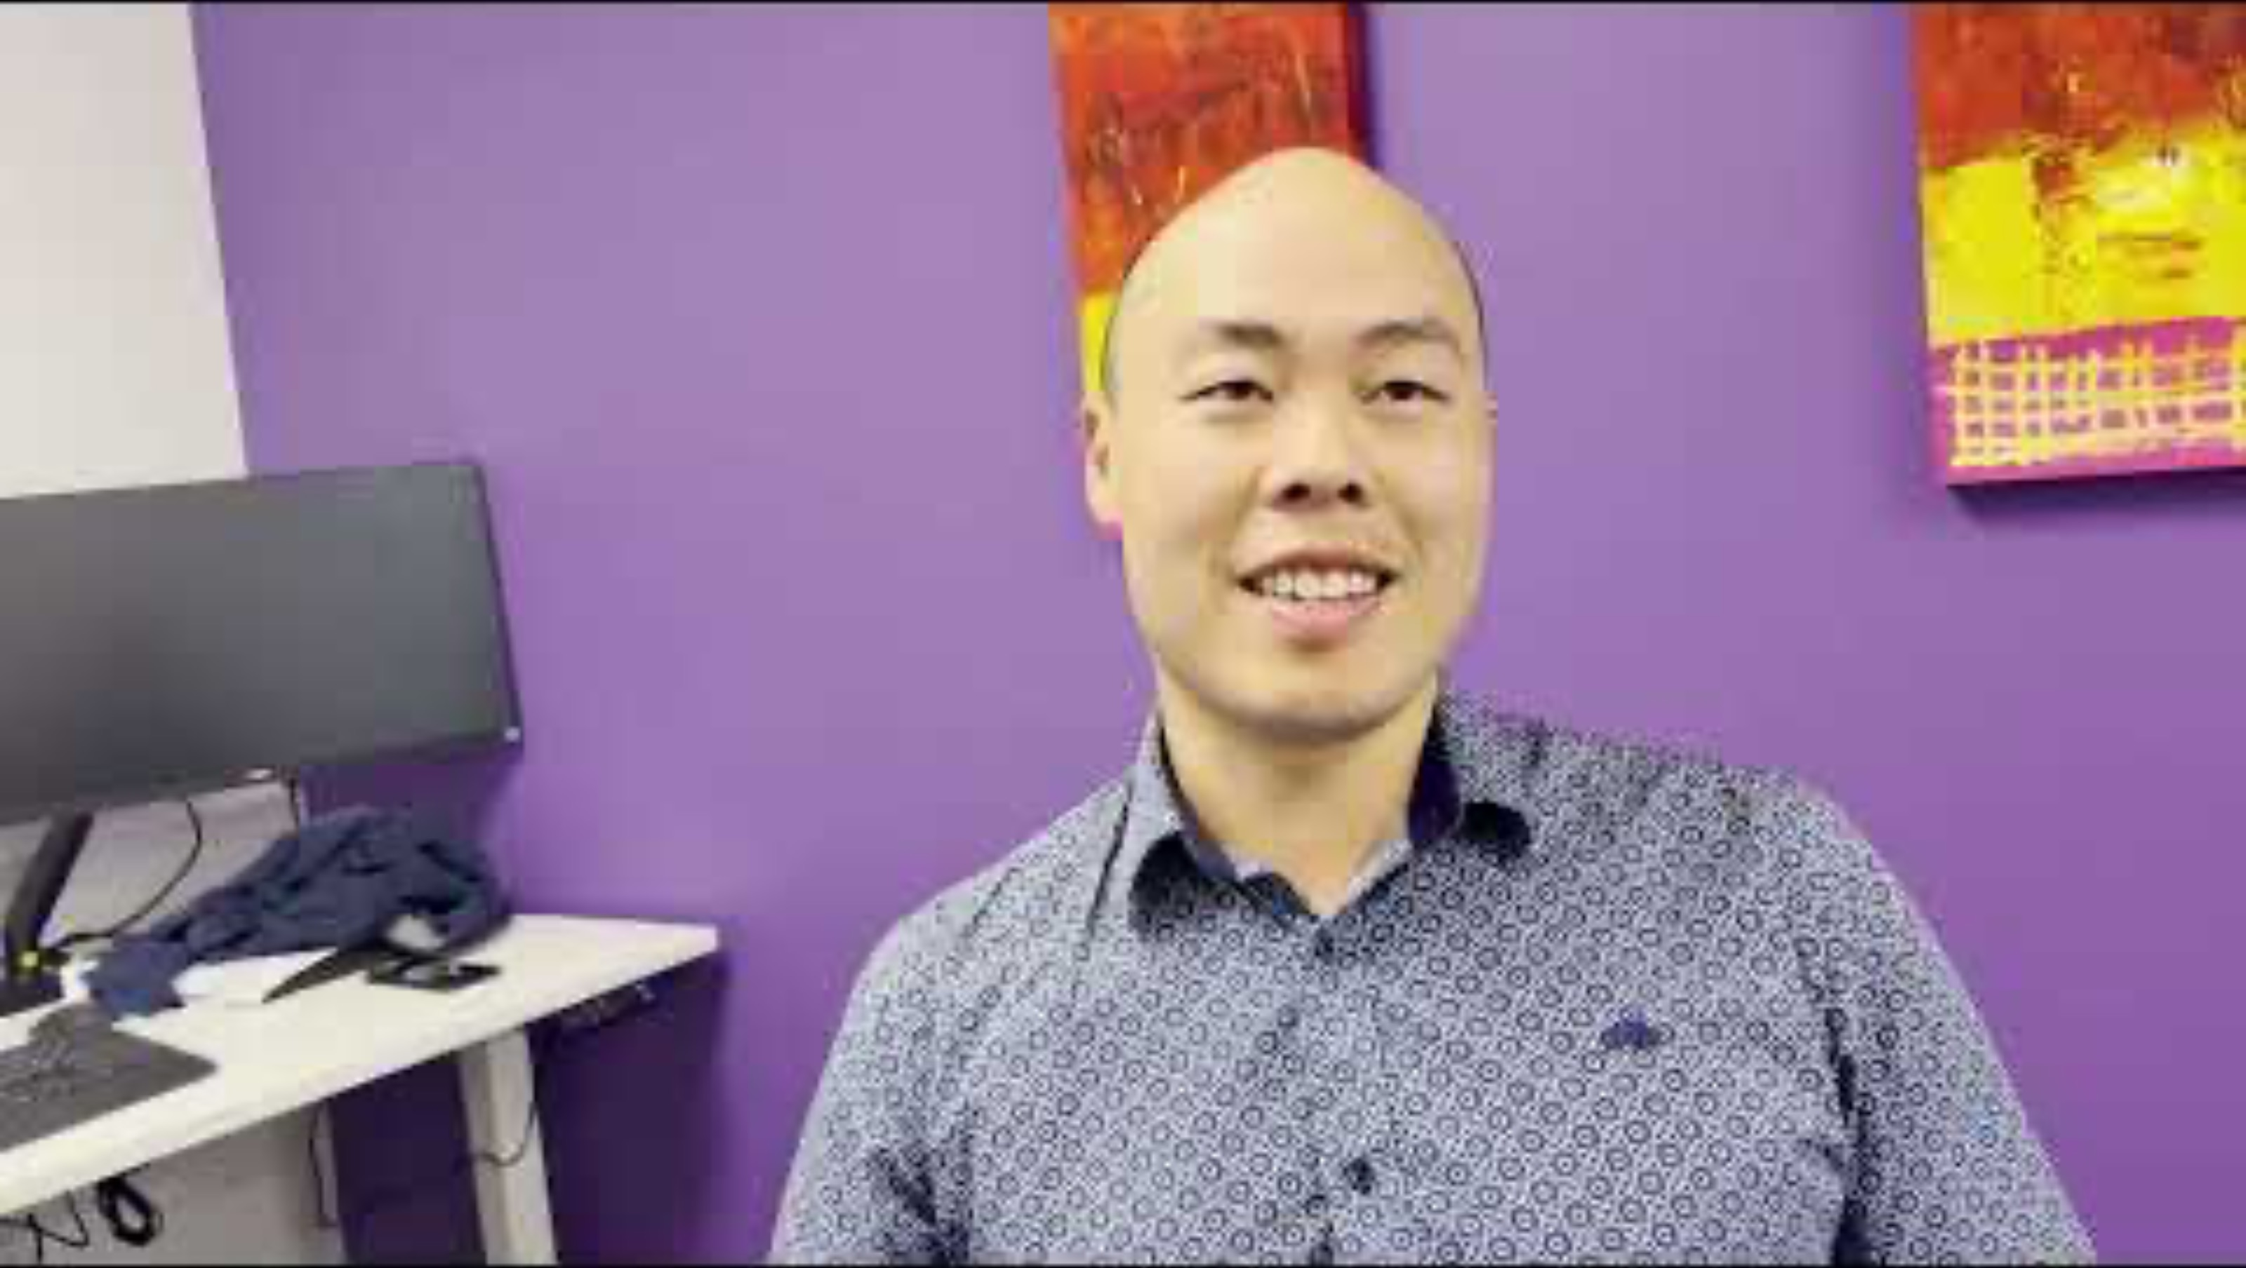
The Raw Interviews: Male # 2

Slide 8
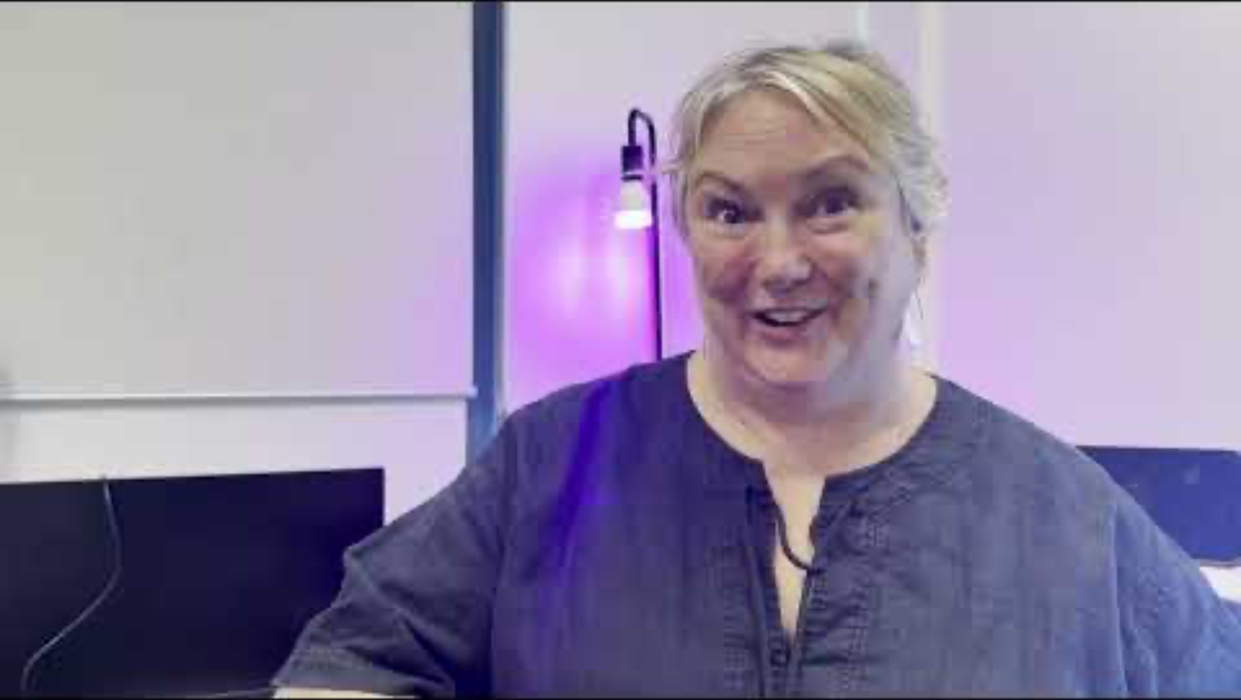
The Raw Interviews: Female # 2

Slide 9
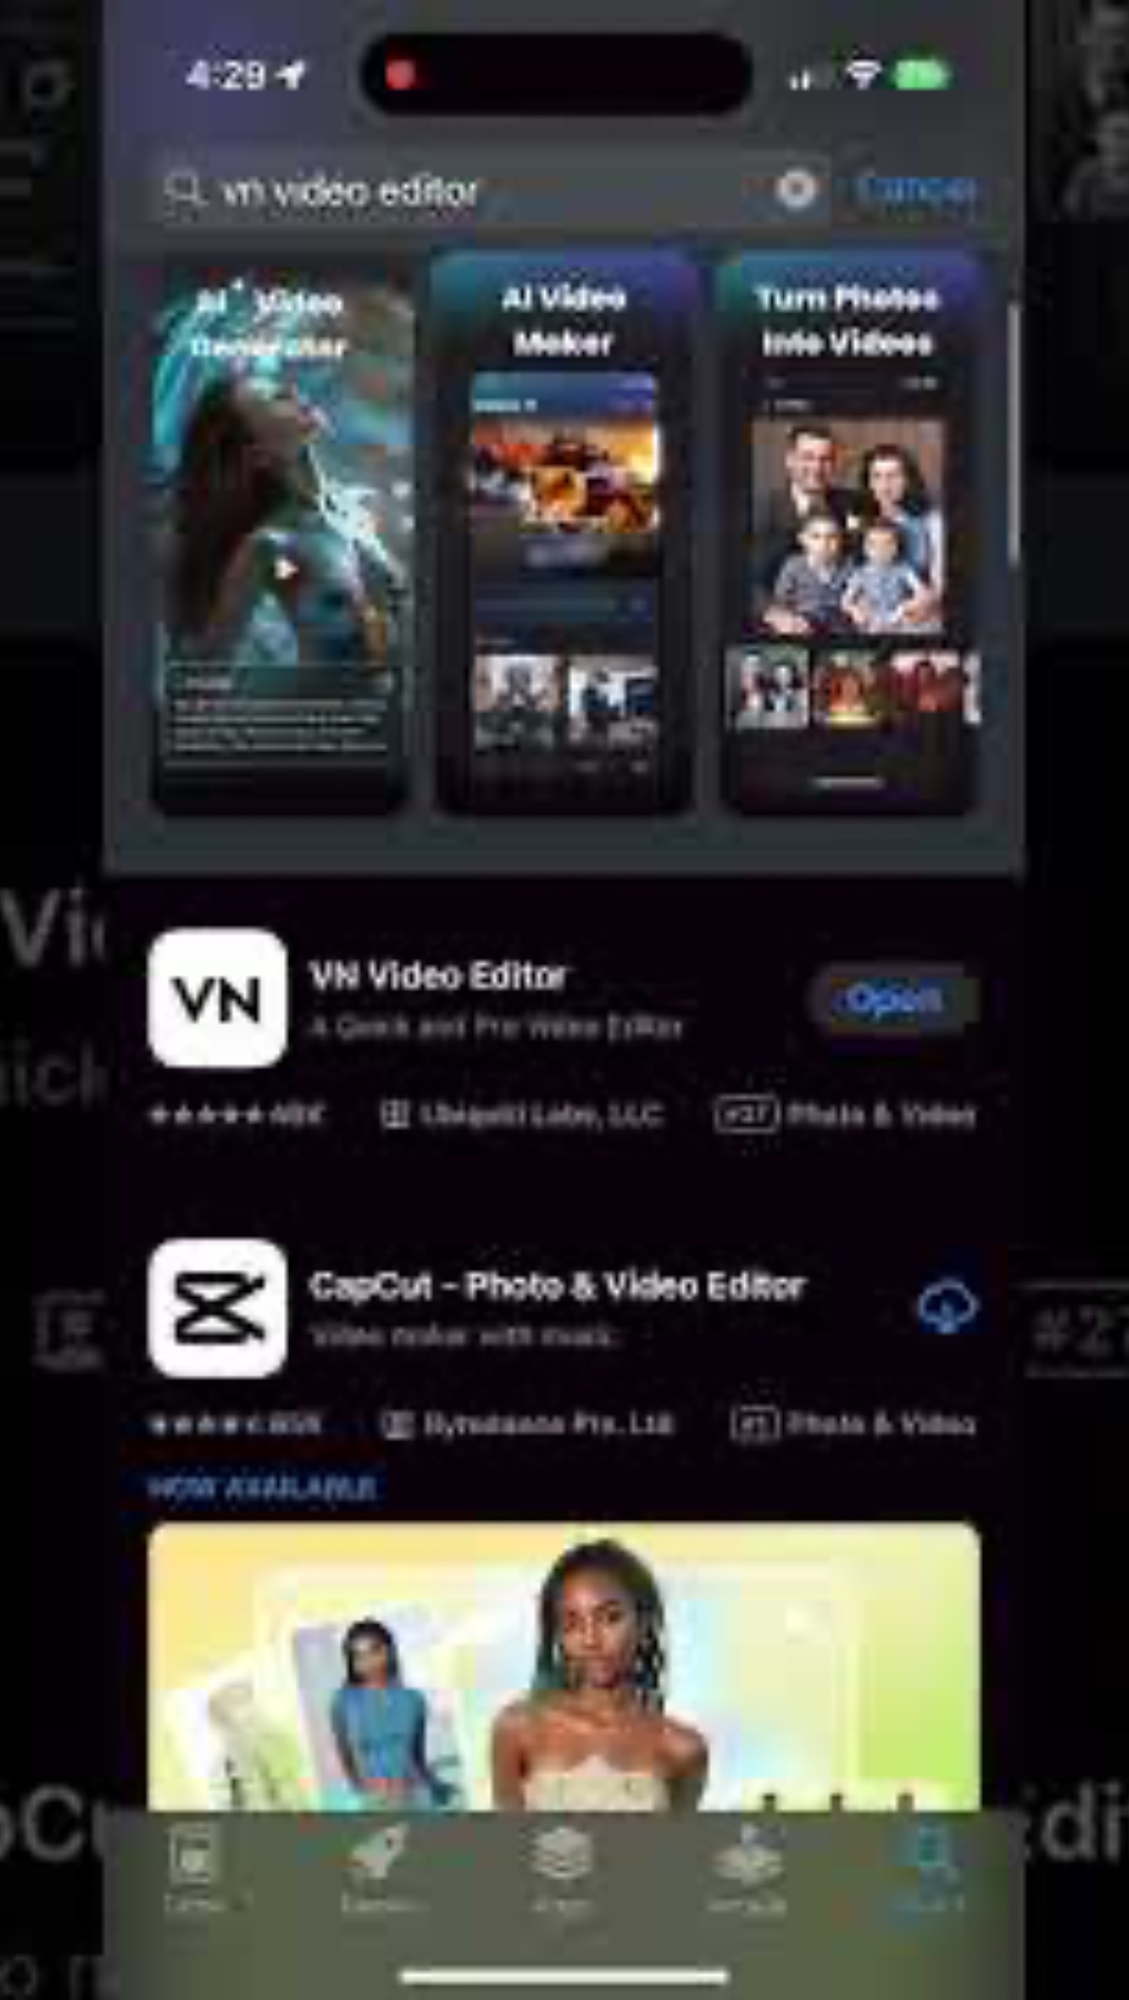
Step 1: Download VN Editor

Slide 10
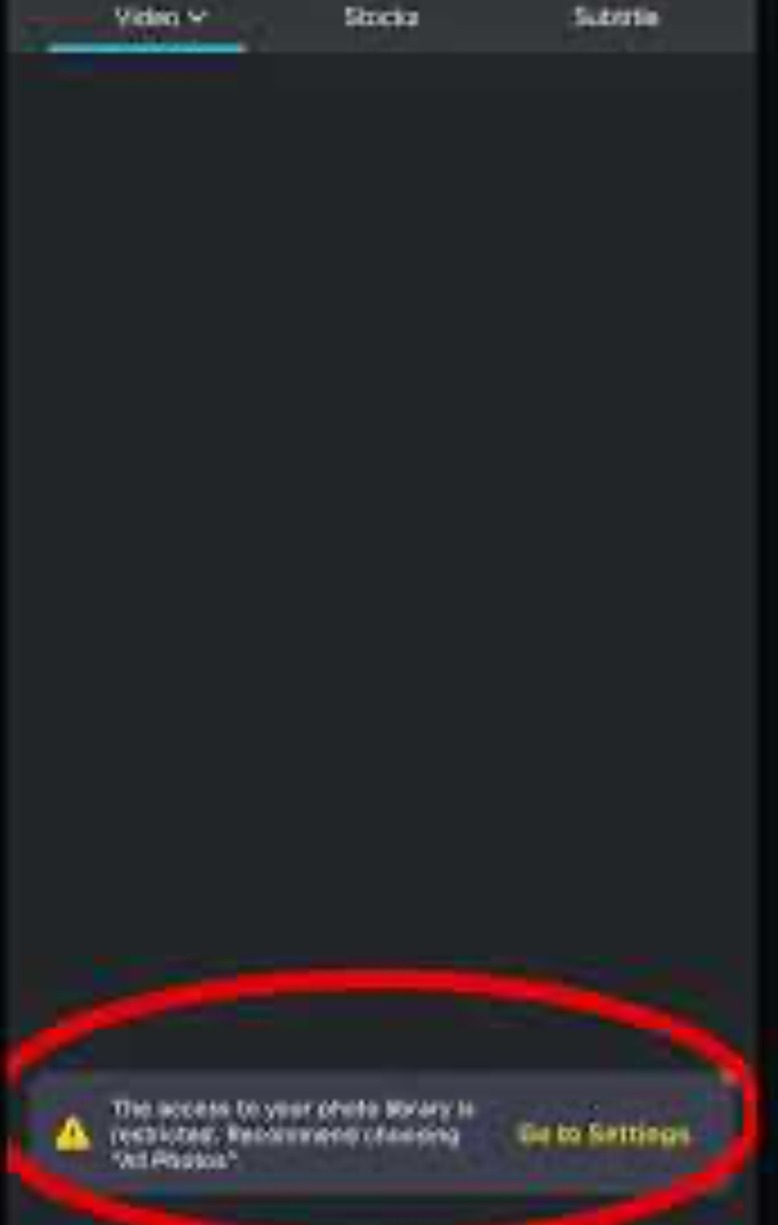
Step 2: Set up project and import videos.

Slide 11
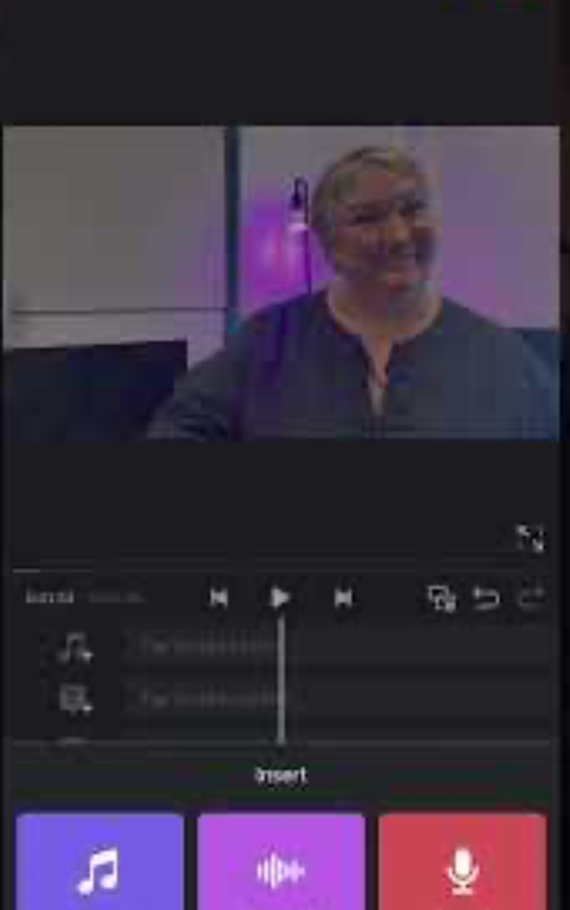
Step 3: Create cuts and select best clips

Slide 12
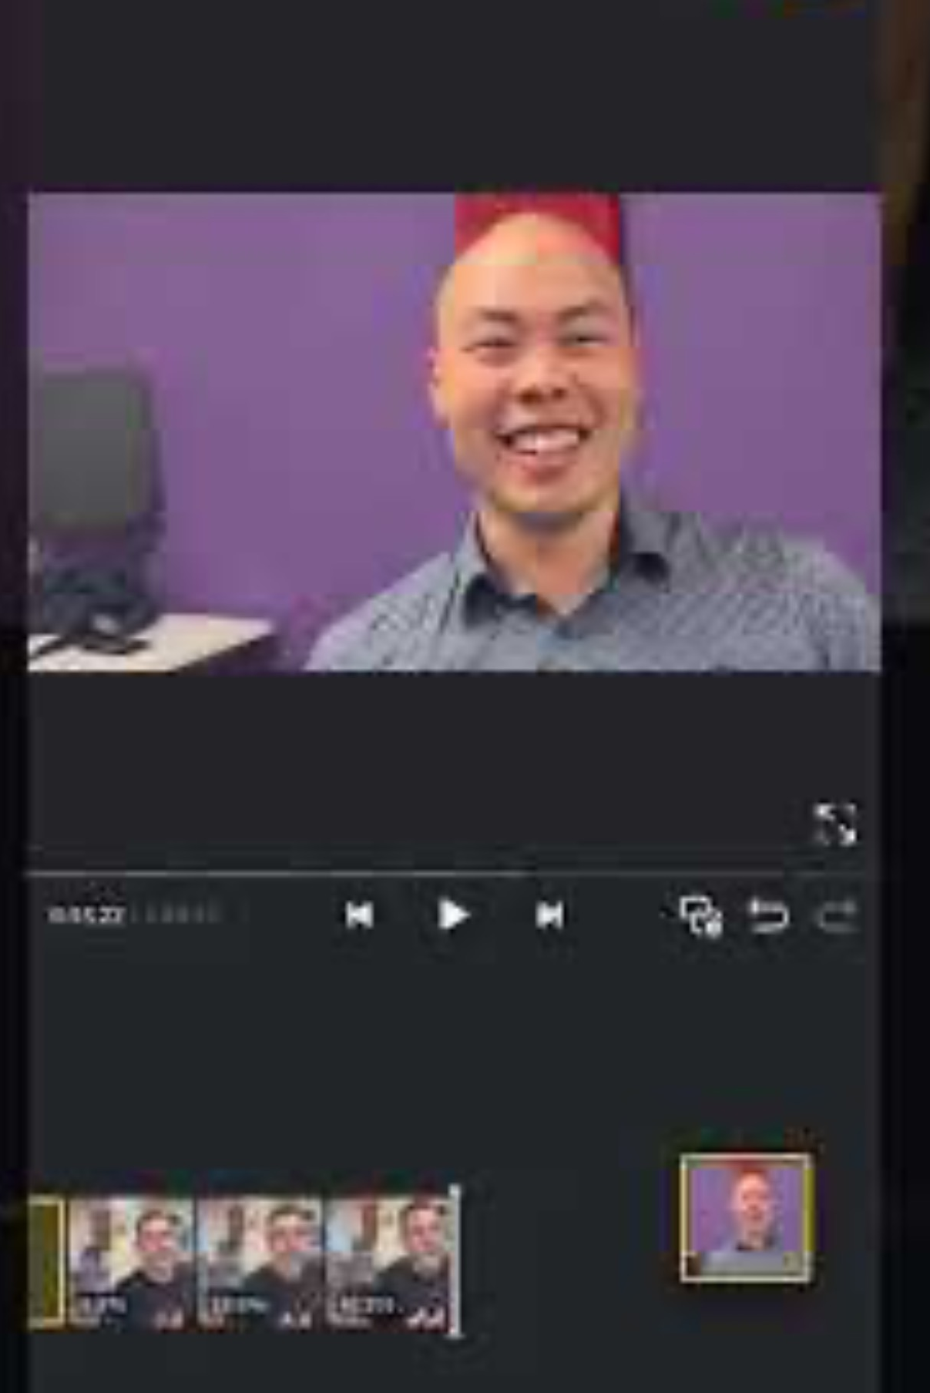
Step 4: Arranging clips

Slide 13
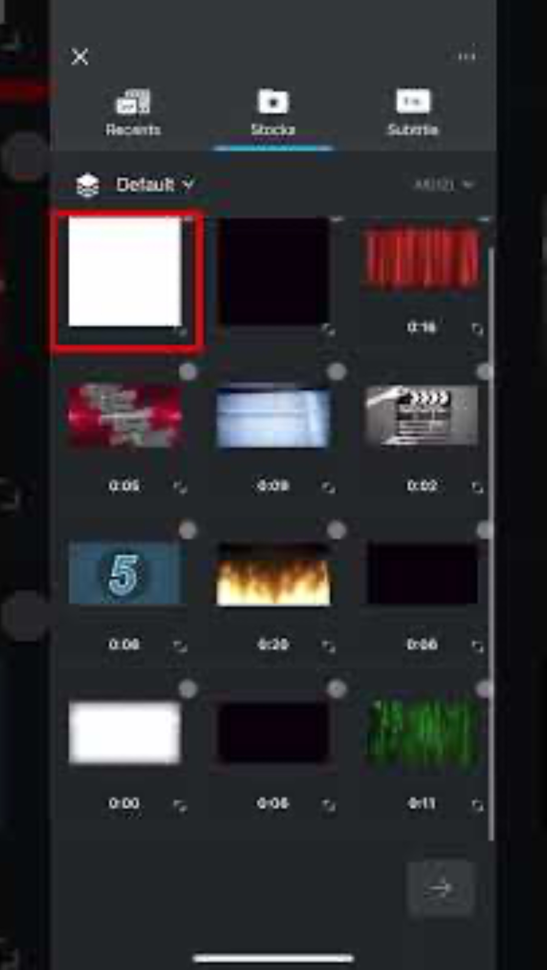
Step 5: Adding a background

Slide 14
Step 6: Adding titles

Slide 15
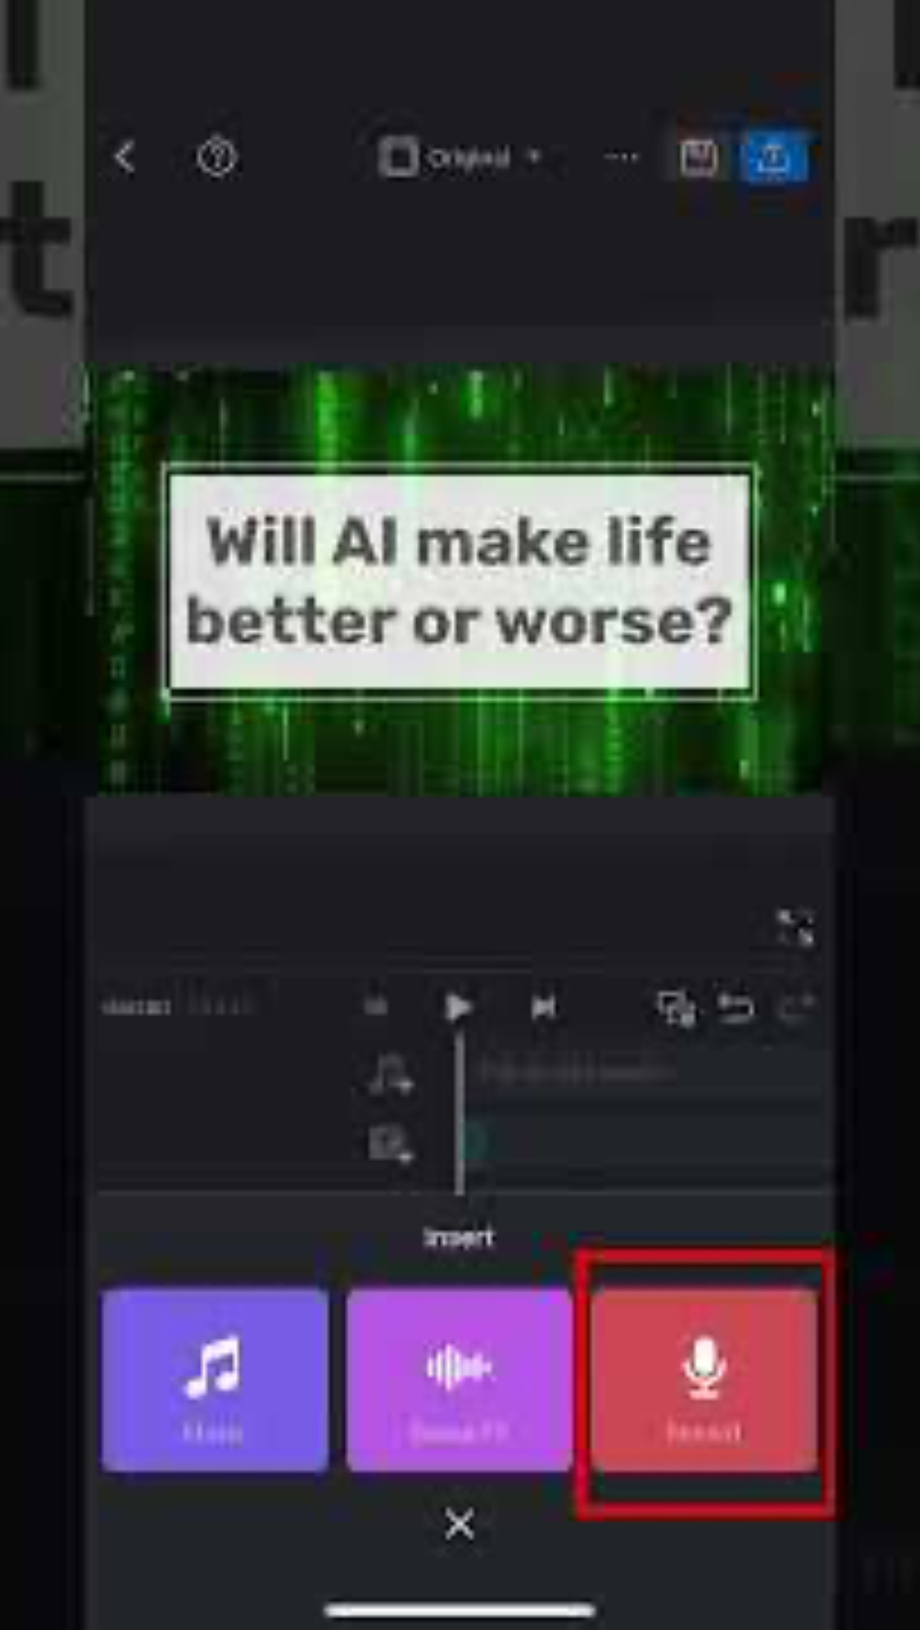
Step 7: Adding a voiceover

Slide 16
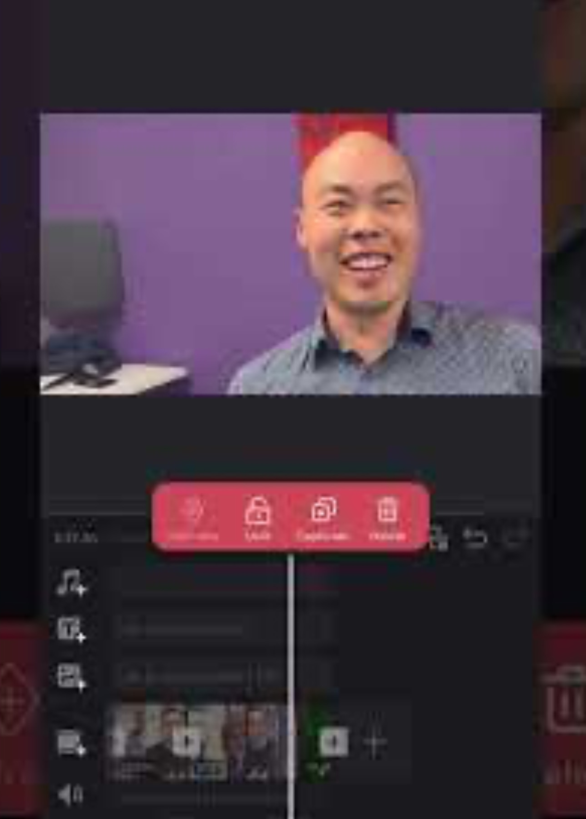
Step 8: Polishing Sound

Slide 17
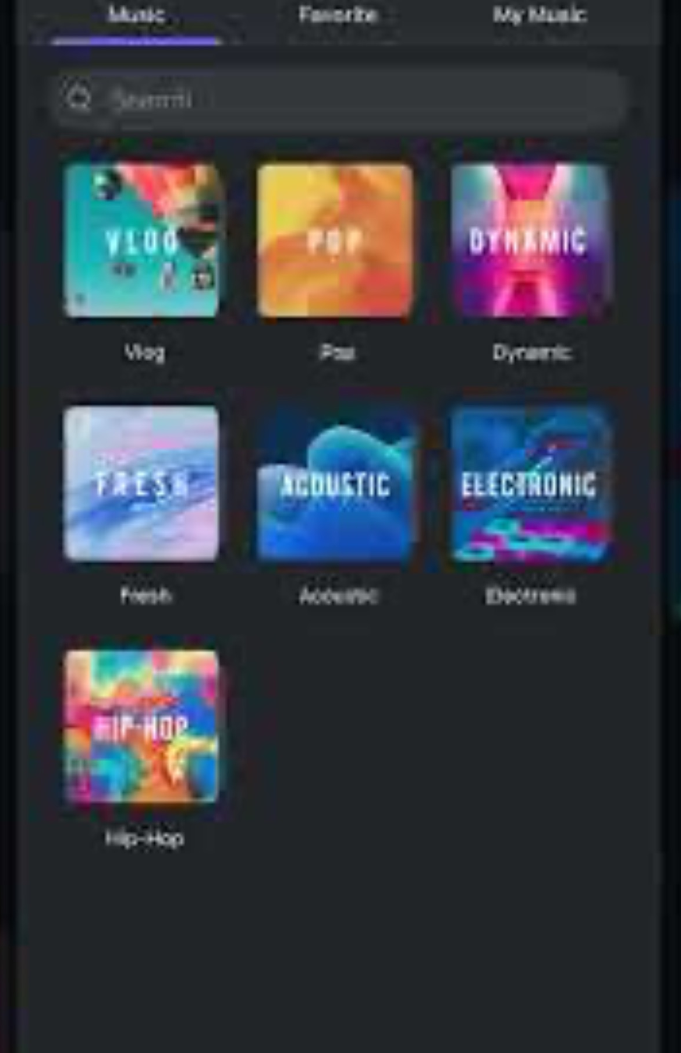
Step 9: Adding music

Slide 18
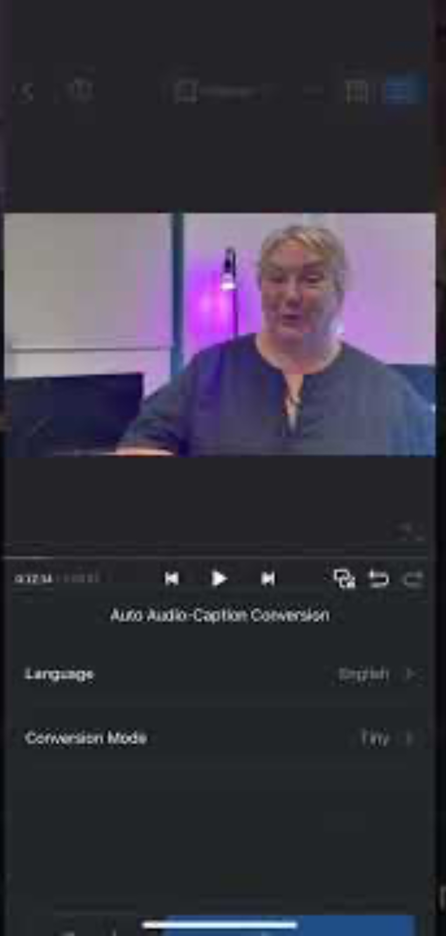
Step 10: Adding captions

Slide 19
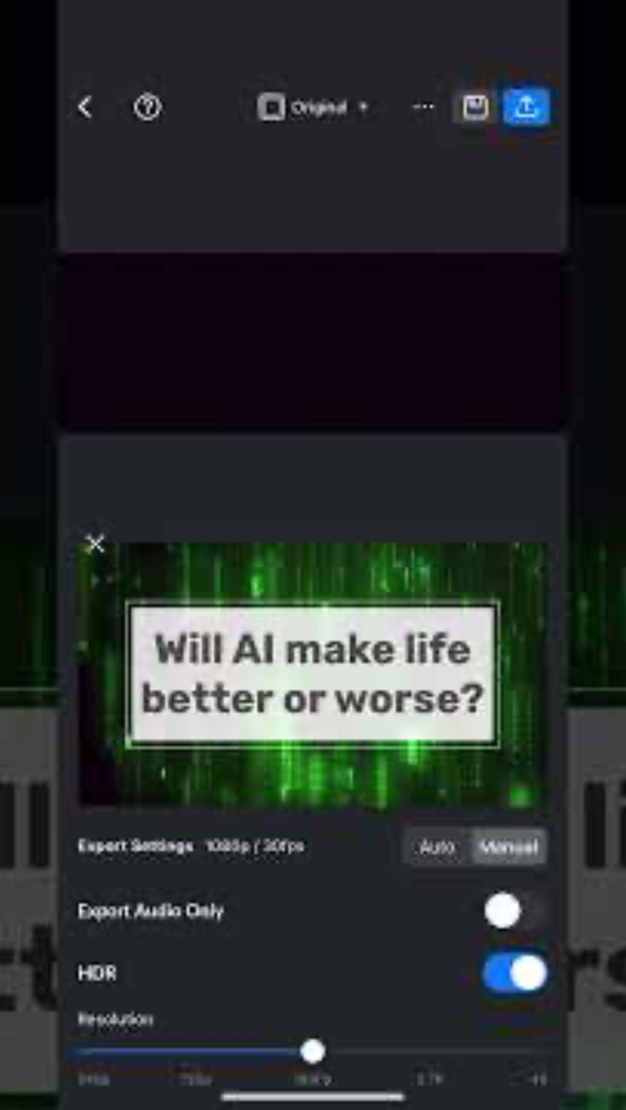
Step 11: Exporting

Slide 20
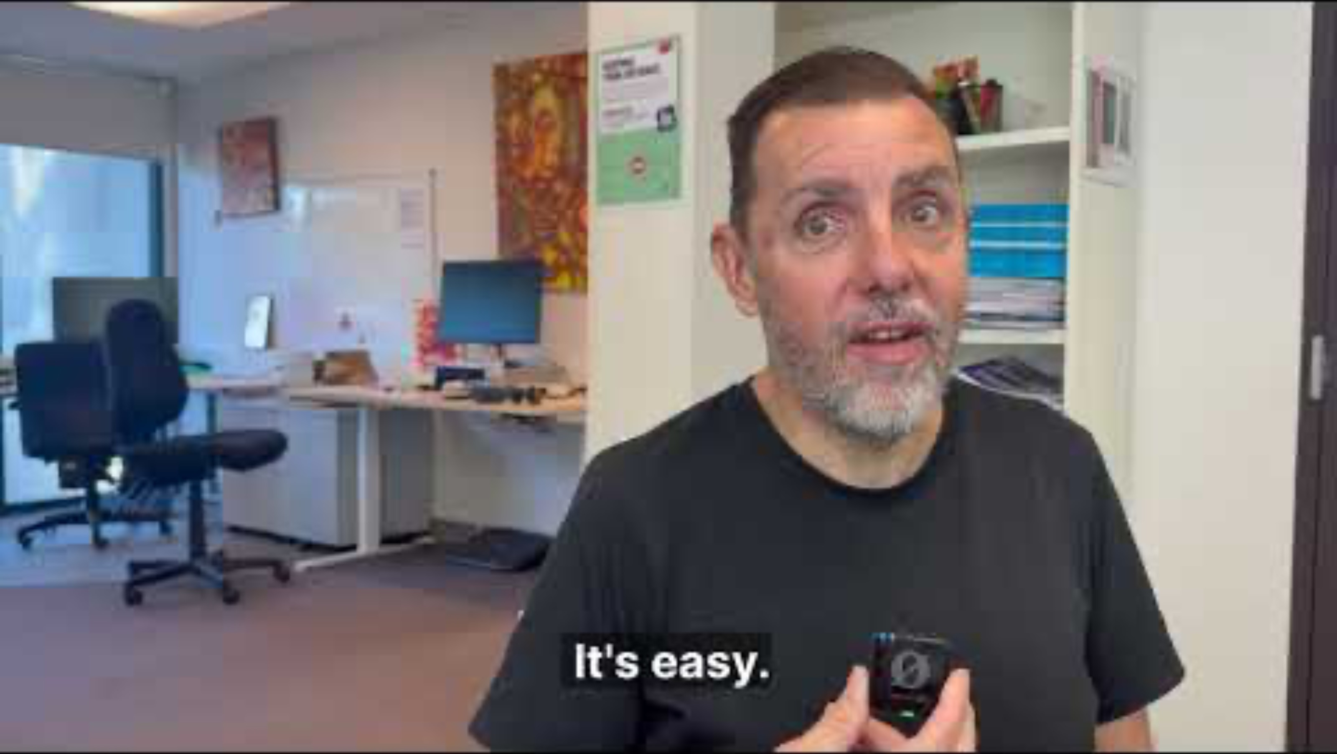
Review

Slide 21
The End:
Q & A
Fill in quick survey

