Slide 1
Learn to create your own
Vox Pop
Workshop Series 2
Part 1: Understanding vox pops and how to plan your own

Slide 2

Welcome
PRESS RECORD
Acknowledgement of Country
Recognition of disability community
Meet today’s presenter:
  Carey Scheer
Housekeeping: mute/unmute, raise your hand to speak, use the chat
Today’s session will be recorded
Notes:
Acknowledgement of Country
JFA Purple Orange acknowledges the Traditional Owners of Country throughout Australia. We work on many Aboriginal lands, including Kaurna Country, where our head office is located. We extend our respect to all Aboriginal peoples on the lands where we work, live, and learn. We are committed to walking together and building relationships grounded in the self-determination of First Nations peoples.
Recognition of the disability community
We recognise that JFA Purple Orange exists to advance the rights of people with disability.
All our work aims to create a more inclusive world where people with disability have access to the same opportunities as everyone else
An introduction to your presenter today – Carey Scheer
We have a live captioner with us today
General information – cameras, muting/unmuting, raise hand to speak, use chat to ask questions, Zoom accessibility features
This session will be recorded to share with participants afterwards
Links to resources will be shared after the session.

Slide 3
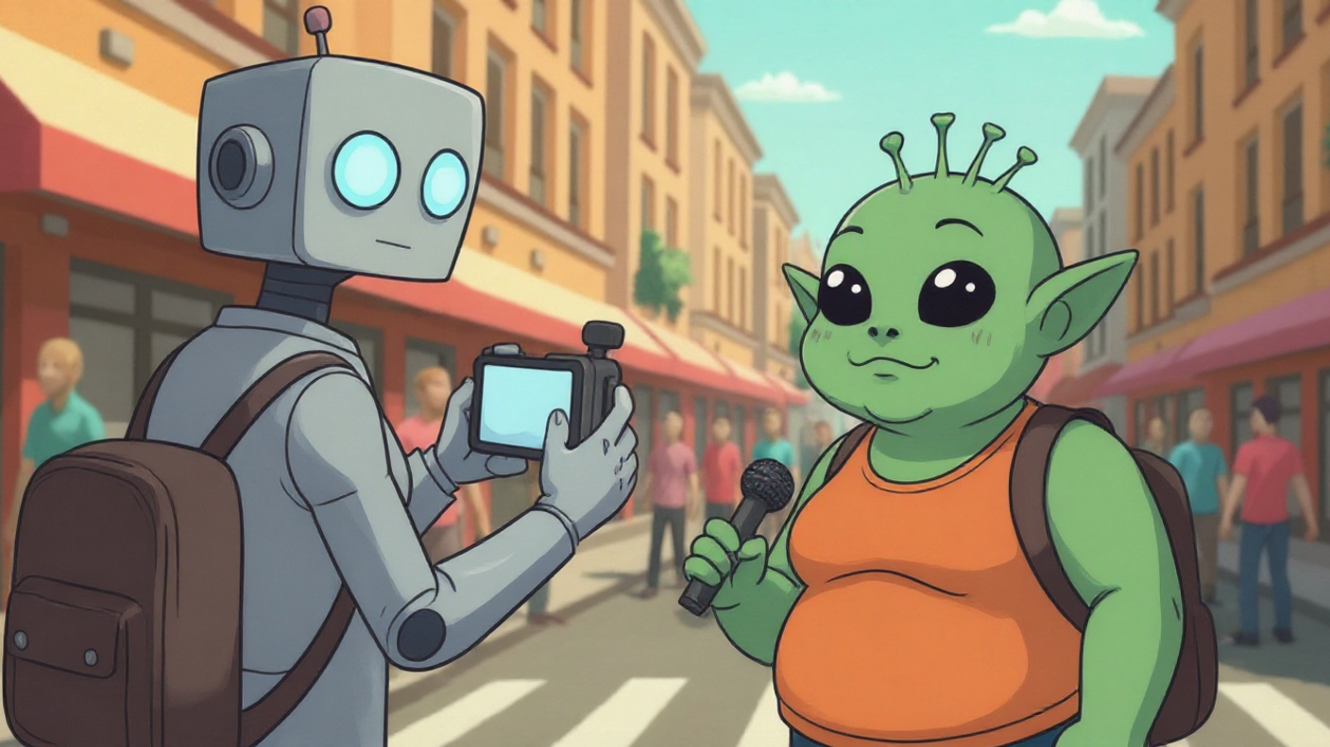

What is a vox pop?
Notes:
Vox Pop- Latin for Voice of the People
Short for Vox Populi– “Voice of the People” in Latin–a Vox Pop seeks to gauge public opinion around one central question. The question you pick could be connected to something in the news, something fun and silly or something deep and reflective. Sometimes the answers will range across these categories.

Slide 4

What is Gen Zs daily screen time?
Notes:
This vox pop is a very simple one one. One Question- One moment of truth. You don’t need something fancy to make people feel something.
Watch how much this one question reveals-
Not just in what people say, but in their tone, their faces, their hesitation
This one didn’t’ have an outro, or a reflective moment, it just let the story speak for itself.

Slide 5
Workshop goals
Part One:
Understand what a vox pop is and why people use them
Plan a clear question and ask it with confidence
Learn to film one using just your phone
Get consent the right way
Part Two:
Learn basic editing to shape a short story

Slide 6
What makes a great vox pop?
Authenticity: real people, real reactions
Energy: short, punchy answers
Meaningful: Ask something that interests you
Notes:
Keep answers short. You're looking for gold in 5 to 15 seconds, not a TEDx talk.

Slide 7
Vox Pops build real skills
Communication
Storytelling
Filming and audio
Notes:
Interviewing and questioning:
Develop the ability to think on your feet, approach strangers, and ask clear, open-ended questions that go beyond a simple "yes" or "no".
Listening and critical thinking:
Improve your ability to listen actively and identify the prevailing attitudes and opinions on a given topic by synthesizing different viewpoints.
Public speaking and confidence:
Overcome the discomfort of approaching strangers, which builds confidence and improves general public speaking skills. For interviewees, it can also teach them to buy time and answer more naturally in unexpected situations.

Slide 8
Time capsules of public feeling
A vox pop is a snapshot of what people think and feel right now.
Today’s casual opinions become a future record of how people felt in this era.

Slide 9
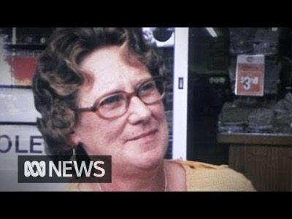
Notes:
What does International Year of the Woman mean to you? These women were sceptical of women's liberation, and the year of recognition didn't mean a thing. This report aired on ABC TV on April 14, 1975. For more from ABC News, click here: http://www.abc.net.au/news/ Subscribe to us on YouTube: http://ab.co/1svxLVE You can also like us on Facebook: / abcnews.au Or follow us on Instagram: / abcnews_au Or even on Twitter: / abcnews

Slide 10
Quick Brainstorm
What vox pop questions could capture today’s thinking about disability in a way that will feel revealing and profound tomorrow?

Slide 11
Where do we use Vox Pops?
News stories
Radio stories / Podcasts
Documentaries
YouTube
Instagram
TikTok
Other social media

Slide 12
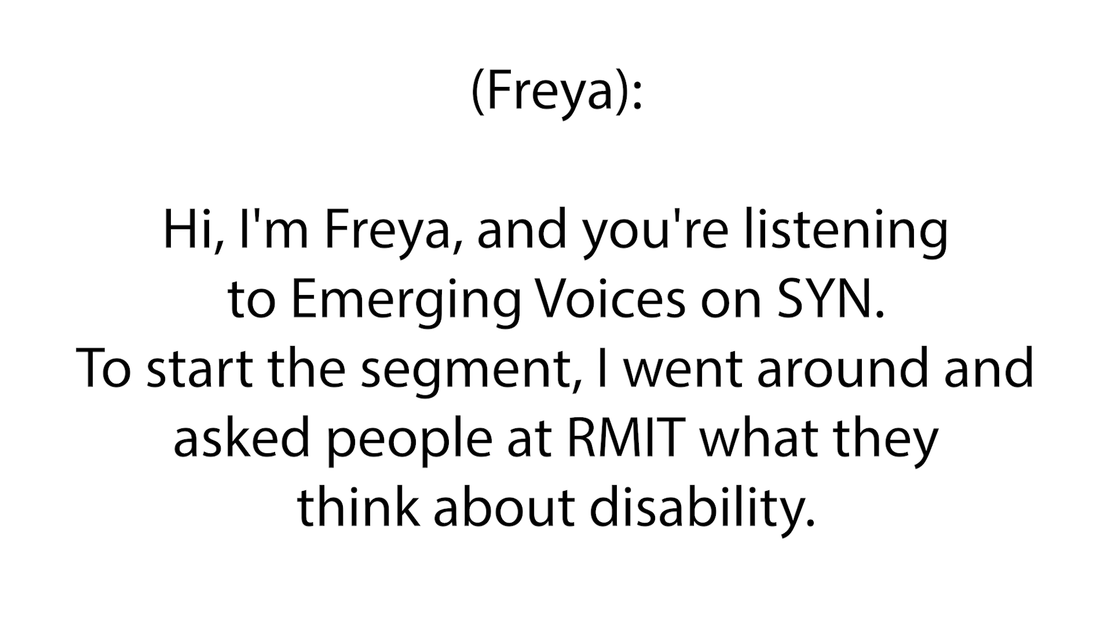
Radio Vox Pop - Emerging Voices (SYN)
Notes:
Emerging Voices, SYN Radio- based out of Melbourne. Freya shares Melbourne city vox pops about how people with disability are perceived. She uses this as a lead in to a first person radio essay.

Slide 13
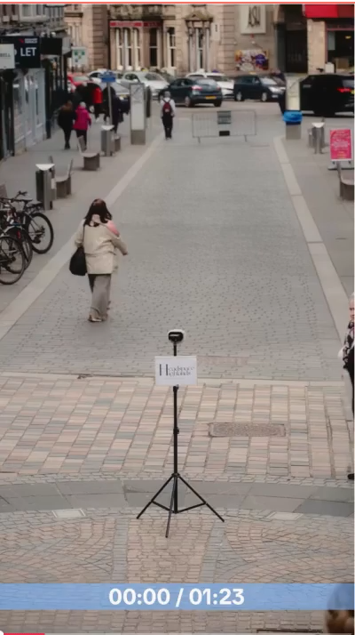

Slide 14
Planning your Vox Pop
Topics can be light, serious, surprising
Pick a question that genuinely interests you
Ask open-ended questions.
Go with a main single, simple question
Let them talk. Stay quiet while they answer. Don’t fill the pause.

Slide 15
Vox Pop Brainstorm and Practice
Notes:
Break out into small rooms
Each person take turns:
Asking a vox pop question to each other online
Regroup
How did it go? What felt easy? What was tricky?
Did you learn something about the way you ask questions?
What’s the weirdest thing you’ve seen on public transport
How has social media changed the way you see yourself?
Is AI helping or harming creativity
Should we have a 4 day work week?
How do you define success today?
Do you feel optimistic about the future?
Whats something you wish your younger self knew
When do you feel most seen or understood?
In what way are you different that you were 10 years ago?

Slide 16
Vox Pop intro and outros
Set the tone
Frame the story
Leave a lasting impression

Slide 17
Why the intro matters
Grabs attention immediately
Explains what the topic is
Sets the tone and context
Example:
“Since the pandemic, more people work from home. I wanted to know what people think about this change.”
Notes:
Without an intro the listener doesn’t know what’s happening,
Even a one-line setup adds clarity and professionalism,
**** Think of audience, what does someone need to know in 10 seconds to feel oriented.

Slide 18
The outro: Making it feel complete
Optional to a reflection or final thought
Optional sign-off
Example:
“The pandemic may have changed where we work, but for most people, it appears to be a change they don’t want to reverse.”
Notes:
The outro doesn’t need to be long – even one or two lines can turn a collection of clips into a finished piece

Slide 19
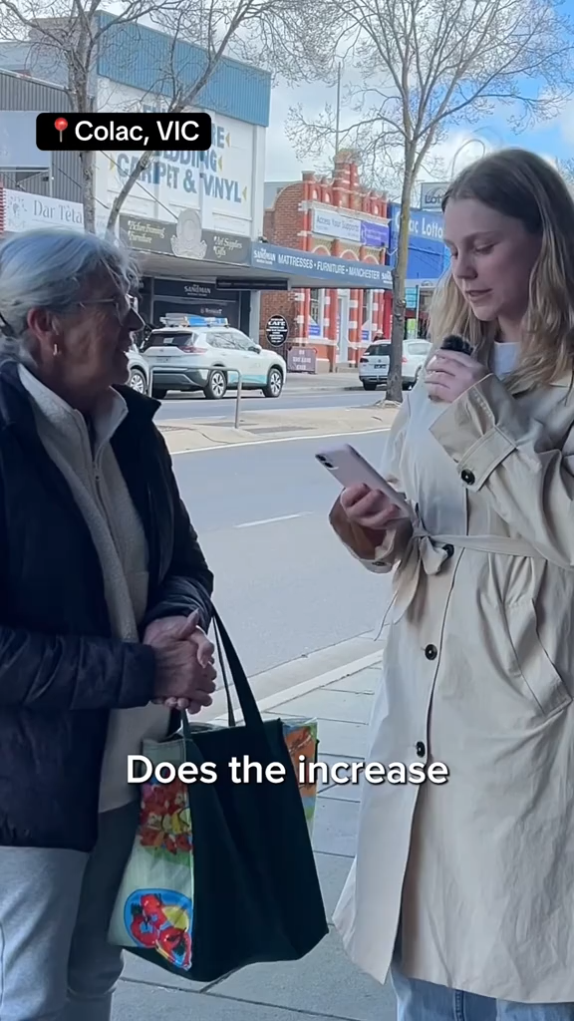
Notes:
This video has no intro or outro- it feels incomplete.

Slide 20
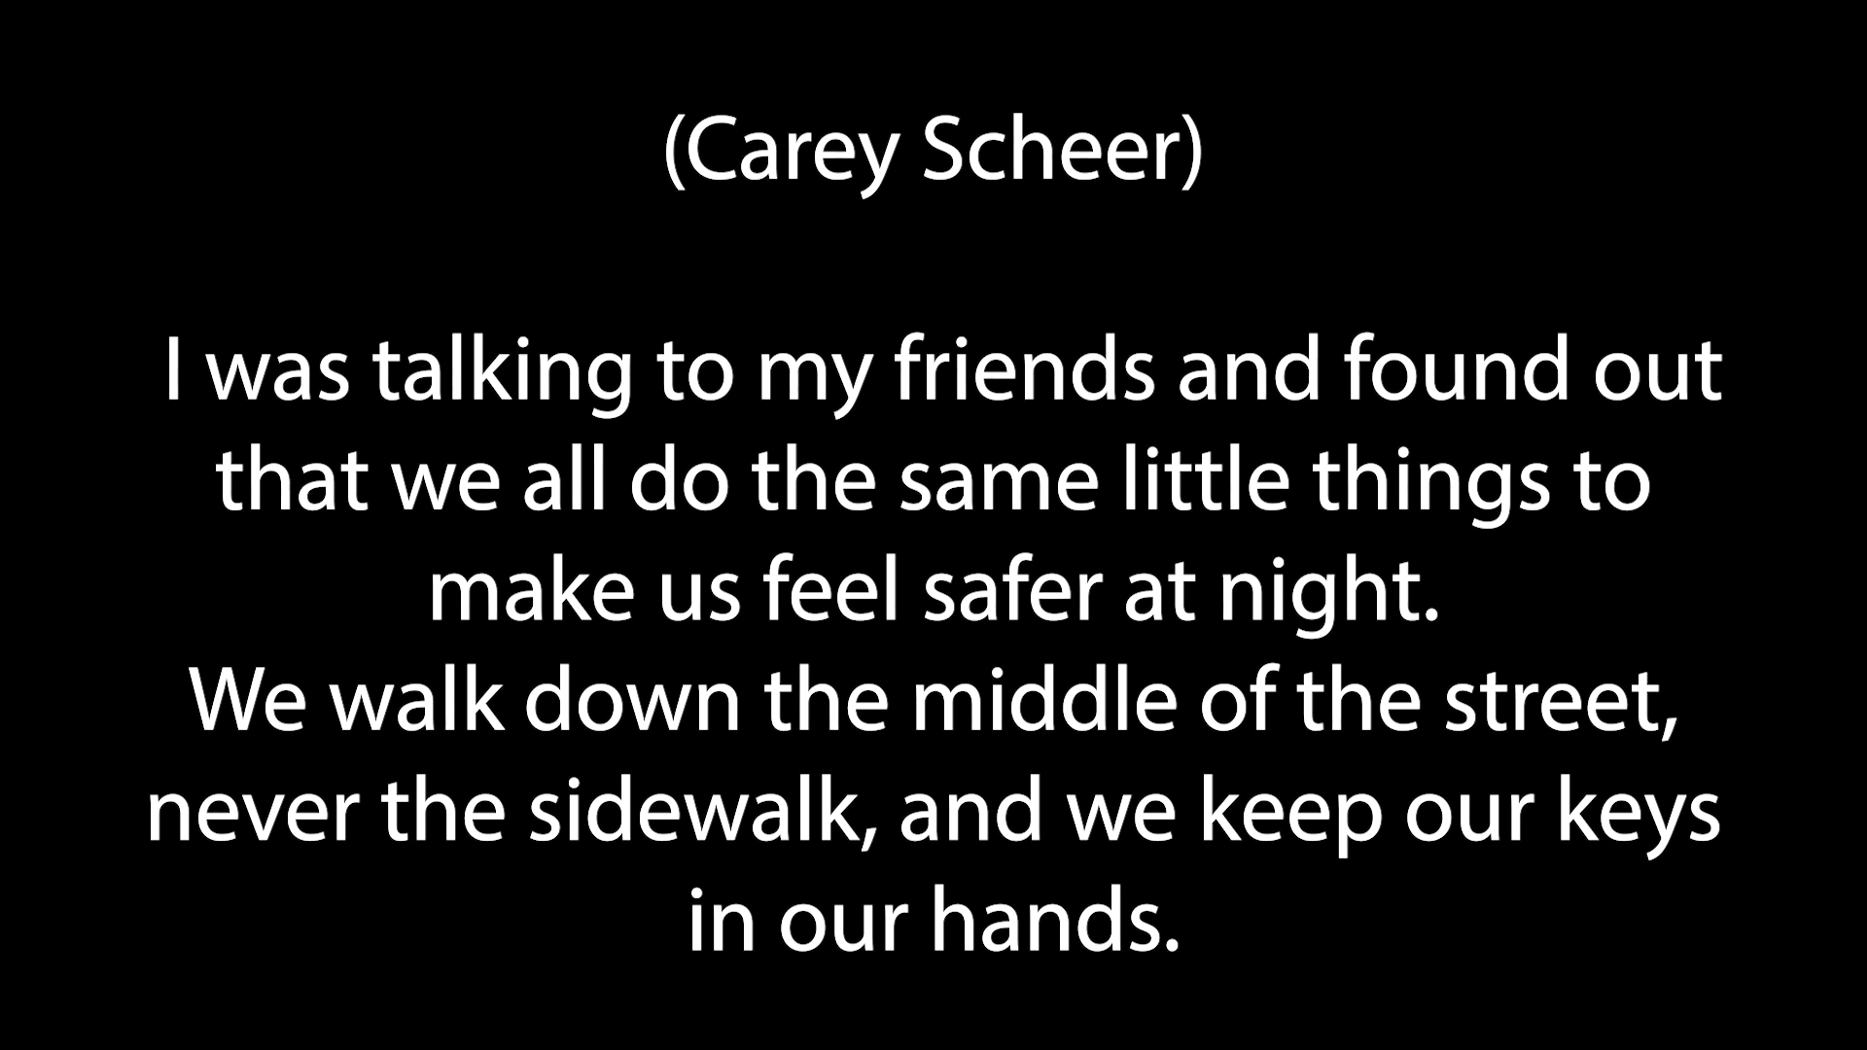
Notes:
Discuss key elements of this- The intro, The outro,
Discuss putting this together
The person says the question back – that’s great, almost always want to make use of that in the middle somewhere.

Slide 21
Mobile phone filming tips
The best equipment is what you have!
Don’t wait for the right gear. Just get started.
Doesn’t have to polished.

Slide 22
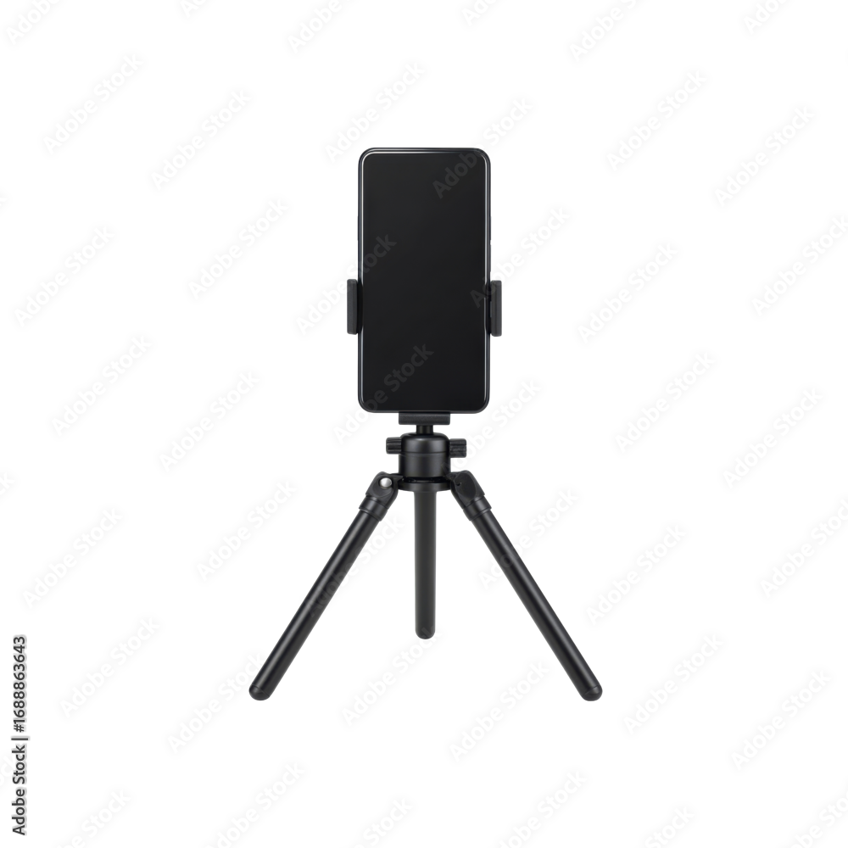
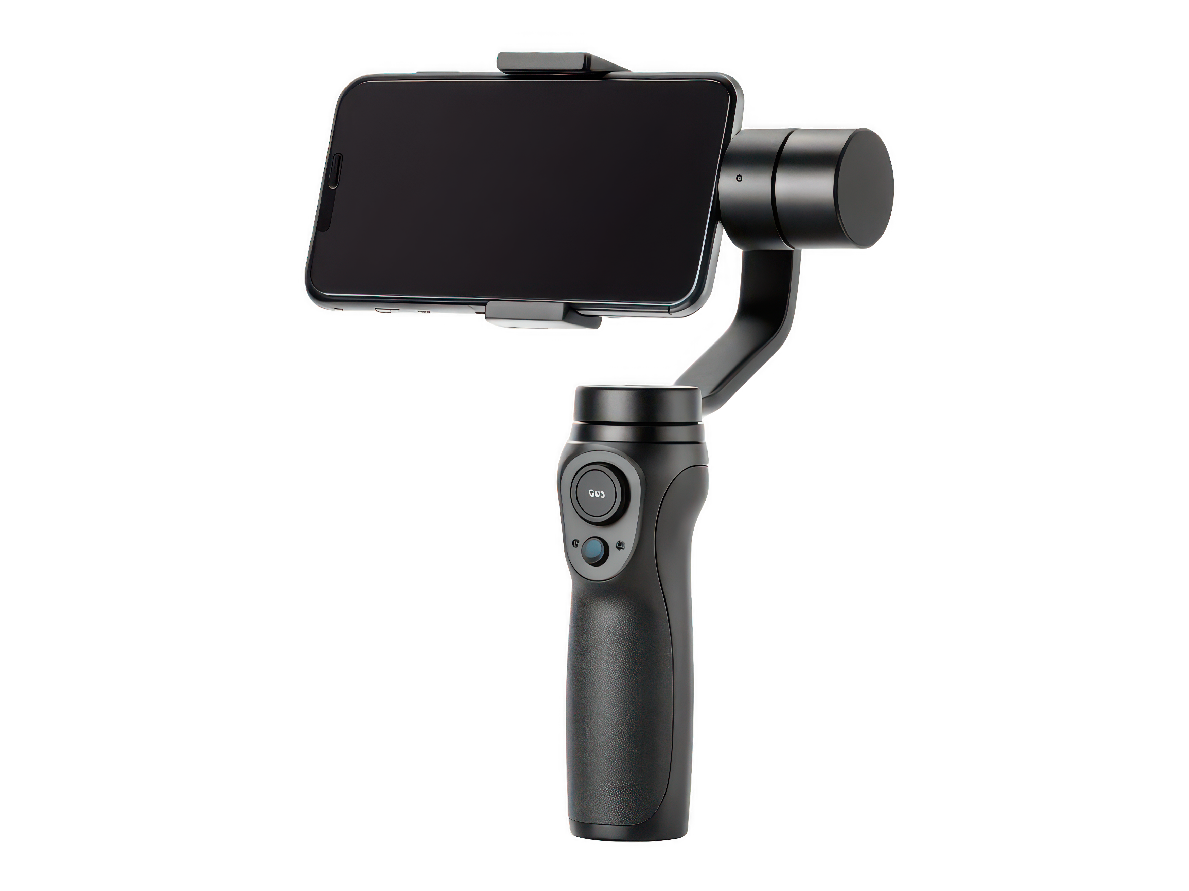
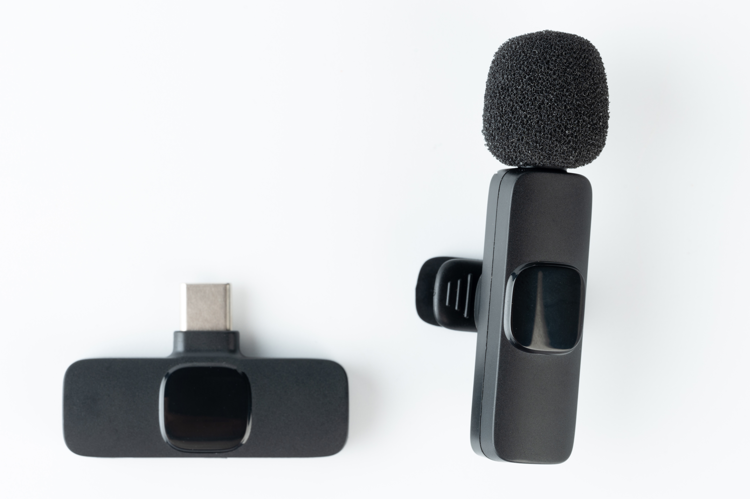
Equipment extras
Notes:
Microphones, Gimbals, Tripods

Slide 23
Prioritise sound
Use a mic if you have one.
No mic? Stand within 1 metre and block wind with your hand.
Stay away from traffic, wind, loud music.
Notes:
If the audio is trash, the video is unusable.
Ask people to project their voice.
Lapel mics: Rode SmartLav+, Boya M1, Rode Wireless Go, etc.

Slide 24
Landscape or portrait?
Portrait (9:16): Reels, TikTok, Instagram
Landscape (16:9): TV, YouTube, website
If you think you might want both, step back a little when filming in landscape. You can crop later.

Slide 25
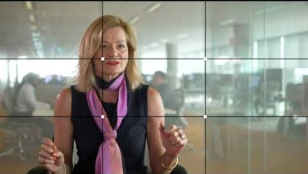
Rule of thirds

Slide 26
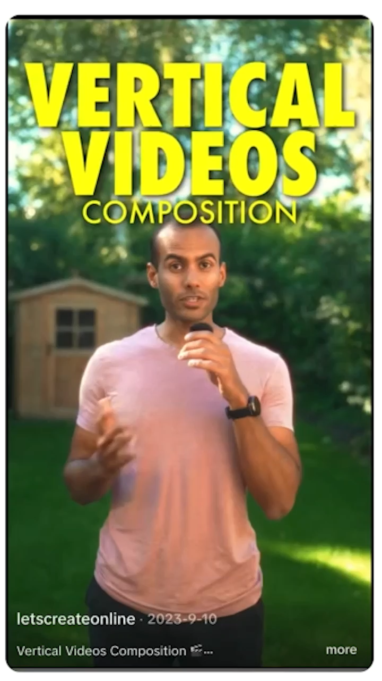
Rule of thirds - vertical

Slide 27
Light the face, not the back
Face your speaker toward the light.
Soft shade beats harsh midday sun.
Avoid strong backlight (bright sky behind them).
Indoors: stand near a window with light on their face.
If the background is brighter than their face, move.

Slide 28
Directing and people skills
Introduce yourself and ask permission
Be respectful and calm, not pushy
If they’re nervous, warm them up with an easy question
Keep them still in frame while you talk

Slide 29
Can we just film it and post it?
Is it legal?
Is it ethical?
Notes:
We do vox pops to share real voices, not actors reading scripts.
But the moment we hit record, we’re collecting someone’s face, voice, story and putting it on the internet forever.
So we have to get two things right:
Is it legal?
Is it ethical?
"Just because you can film doesn’t always mean you should."

Slide 30
What does the law say?
Filming adults in public is generally allowed.
You can usually publish that footage.
You can’t secretly record private conversations.
Some locations are off limits.
Don’t deceptively edit.
Notes:
Public place" means streets, parks, footpaths, outside events. You can film there.
If someone can see the camera and agrees to talk to you, that’s usually fine to record and post.
You cannot film and publish around certain sensitive locations (for example outside abortion/health clinics) or anything that puts someone in legal danger.
You also can’t twist their words or defame someone in the edit. If you make them look like they said something awful that they didn’t actually say, that’s on you, not them.
Important: keep this framed as "how not to get us dragged into complaints."

Slide 31
Get consent – verbal recorded
Did they understand who you are representing?
Did they agree to be filmed?
Did they agree to us posting it publicly?
Record their consent on camera
"Can you please say your first name, and confirm you’re happy for us to film you and share this video on our socials, website, and other channels?"
Notes:
They say:
"My name’s Jordan and I’m happy for you to film me and post it."
Tell participants: "You can stop at any time."
Explain to the room:
That clip is your safety net. It proves they knew what they were doing and said yes. If there’s ever a complaint later like ‘I didn’t say you could post that,’ you have proof.
If someone can see the camera and agrees to talk to you, that’s usually fine to record and post.
You cannot film and publish around certain sensitive locations (for example outside abortion/health clinics) or anything that puts someone in legal danger.
You also can’t twist their words or defame someone in the edit. If you make them look like they said something awful that they didn’t actually say, that’s on you, not them.
Important: keep this framed as "how not to get us dragged into complaints."

Slide 32
When do you need written consent?
If it’s going on your personal social media just as a story clip, verbal on-camera consent is usually enough.
If you plan to use their face to promote a program, service, funding pitch, ad, brochure, website banner, be used by an org, or business - then best practice is to get a written consent signed.

Slide 33
Wrap-up – Key points
Be friendly, don't pressure people.
Lead with one clear, open-ended question
  Can follow up with further prompting questions: E.g. Tell me more about that?
Be genuinely interested in your questions.
Prioritise good sound.
Frame simply: Rule of thirds.

Slide 34
Wrap-up – Key points continued
Pay attention to lighting.
  Face lighter than background
Don't interrupt
Short punchy answers work well
Get consent

Slide 35
Next Steps
Fill in quick survey
Next workshop: The basics of filming and editing vox pops with your phone (Wed 26 November, 12:30pm)
Download the VN AI Video Editor app from the App Store (iPhone) or Google Play (Android)

